Slide 1
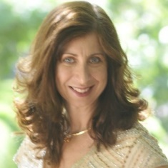
OER and ZTC: Ways to Remove a Barrier to Student Success!
Barbara Illowsky, PhD
Michelson 20MM Foundation
OER & Innovation Fellow
RETIRED, De Anza College
illowskybarbara@fhda.edu
@DrBSI
Notes:
2 polls –OER level: (1) what’s that?; (2) know about them but not using; (3) teaching out of an OER as a textbook replacement
Description:
OER, ZTC, OERCommons... You've probably heard a lot about textbook affordability. Come learn how we can and have been collaborating across the state and country in reducing textbook costs and increasing student success for our CCC students. Learn about degrees that students can earn without paying for materials, how you can create and share materials, and how students are assisting in this issue.
Bio:
Dr. Barbara Illowsky is a past president of CMC3 and recently retired from De Anza College. She co-authored “Introductory Statistics” & "Introductory Business Statistics," free and open textbooks published by OpenStax used by close to 800 colleges and universities. In her retirement, aside from playing with grandbabies, Barbara I working with the Michelson 20MM Foundation, advocating and supporting OER & ZTC in California.

Slide 2
Recent research results:
86,000 students: >100 institutions
17 %: homeless within the past year
45 %: food insecure in the past 30 days
https://www.nbcnews.com/news/us-news/hunger-campus-fight-against-student-food-insecurity-n1063291

Slide 3
Our community college students
First-generation students
Veterans
Former foster youth
ESL learners
Housing insecure
Low income
Single parents
Receiving food stamps
Disabilities

Slide 4
Hang on to your values!
Equity and Social Justice include
each student having access to required course materials on
Day 1 of the course!
Notes:
Poll: What is your experience with OER?
What’s OER?
2. Know about OER but not using an open or free textbook
3. Using an open or free textbook
4. Using OER and promoting it.

Slide 5
Get out your phones or laptops!

Slide 6
https://www.polleverywhere.com/multiple_choice_polls/7sk3dOI38ZWByWuDcadhc

Slide 7
Open Educational Resources (OER)
Open Educational Resources (OERs) are teaching, learning and research materials in any medium – digital or otherwise – that reside in the public domain or have been released under an open license…

Slide 8
Open copyright licenses
Retain
Reuse
Revise
Remix
Redistribute
Notes:
(a) Retain – the right to create, own, and control copies of the content; (b) Reuse – the right to use the content in a wide range of ways; (c) Revise – the right to adapt, adjust, modify, or alter the content itself; (d) Remix – the right to combine the original or revised content with other material to create something new; (e) Redistribute – the right to share copies of the original content, the revisions, or the remixes with others.

Slide 9
*thanks to James Glapa-Grossklag, College of the Canyons, for the ZTC slides

Slide 13
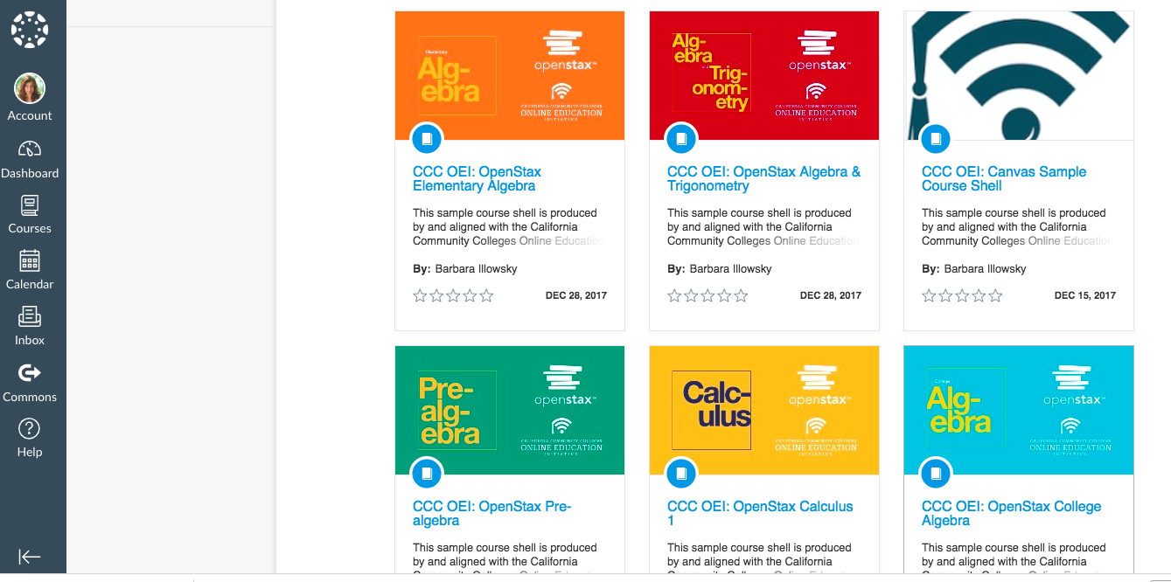
Canvas Commons
Search: CCC OEI OER Math
Notes:
Search "CCC OEI"
If add "OER" then the empty course shells shows first
To import - need to create your own empty course shell in your Canvas instance. Then, import the Canvas Commons shell into yours. Will override all info there.

Slide 14
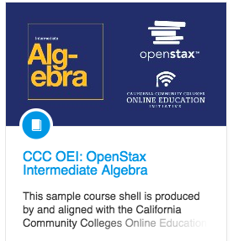
… and some more shells

Slide 15
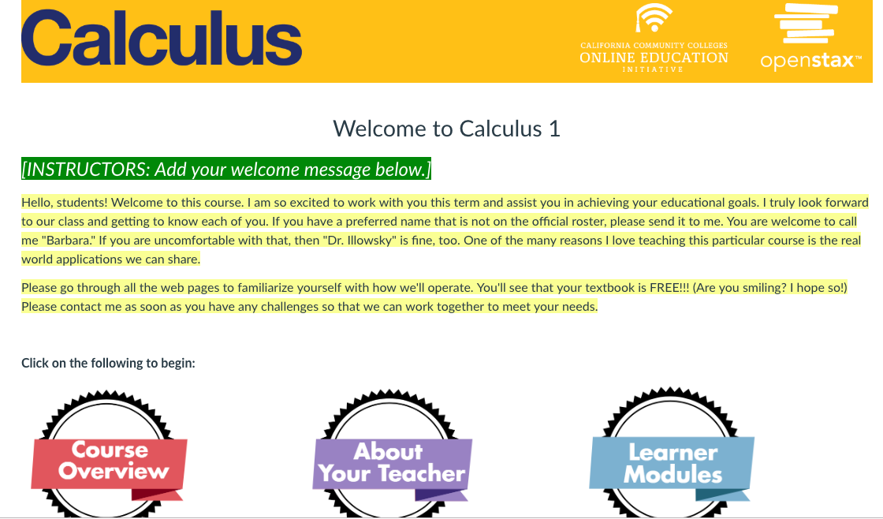
Simplified Homepage

Slide 16
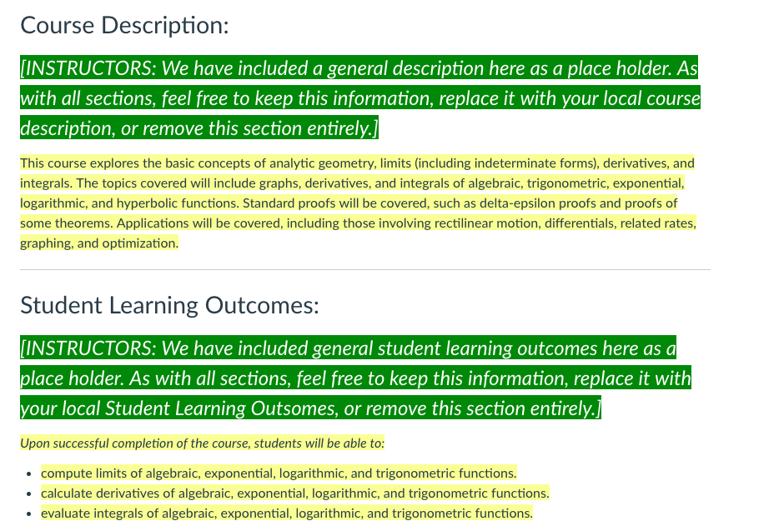
Syllabus
Notes:
C-ID descriptor where available, otherwise from a college's course catalog
Leave or change to local info

Slide 17
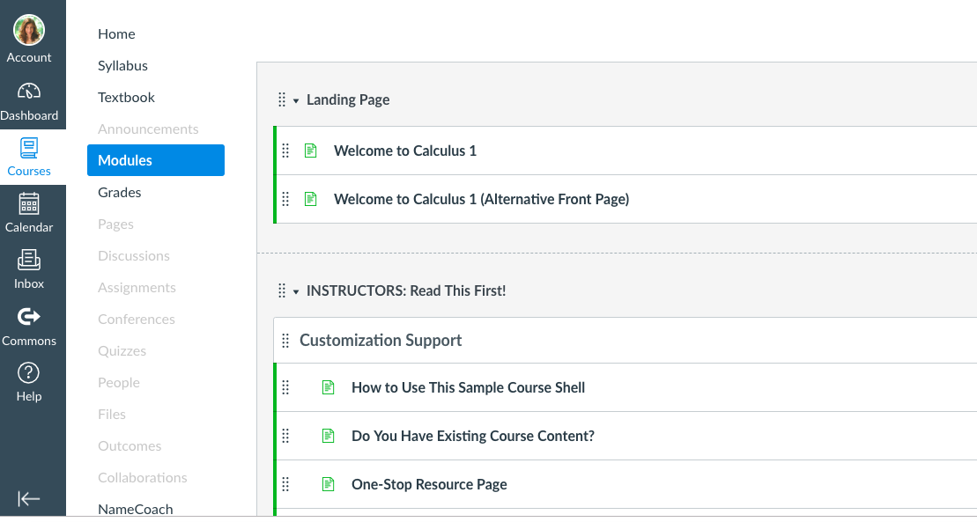
Support for Faculty

Slide 18
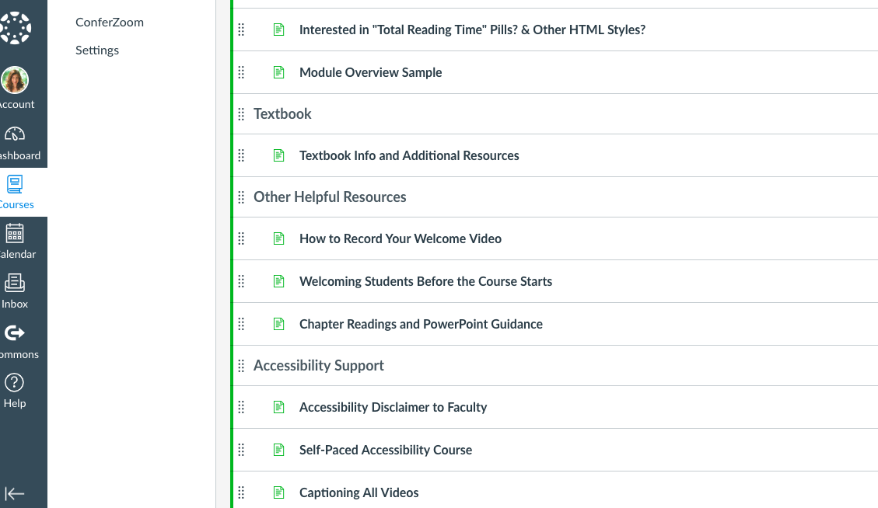
… and more support for Faculty

Slide 19
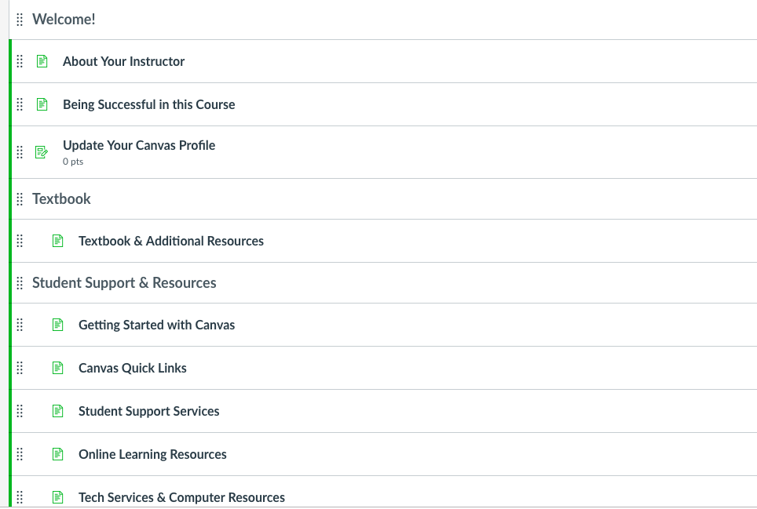
Support for Students
Notes:
Many links to Canvas supplied info

Slide 20
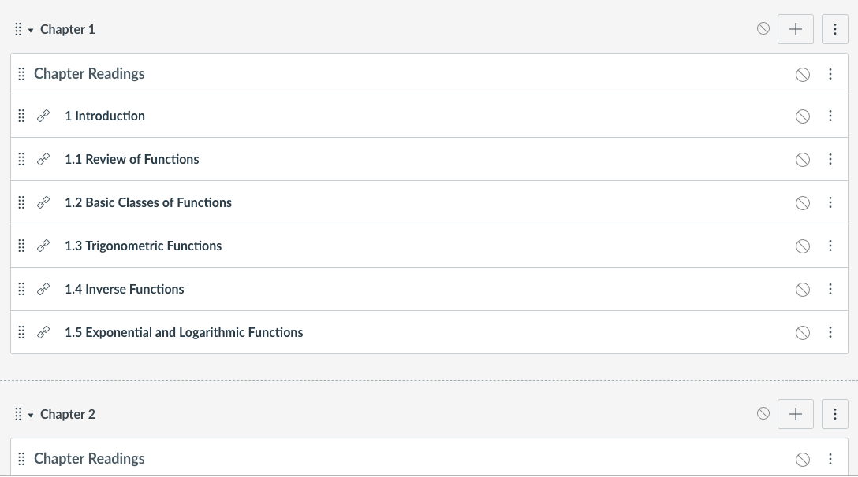
Embedded textbook
Notes:
Note text AND PPt

Slide 21
… ta da! ...
Notes:
NOTES:
Newer Addition
Get book (pdf, hard copy, oral version, iPad)

Slide 23
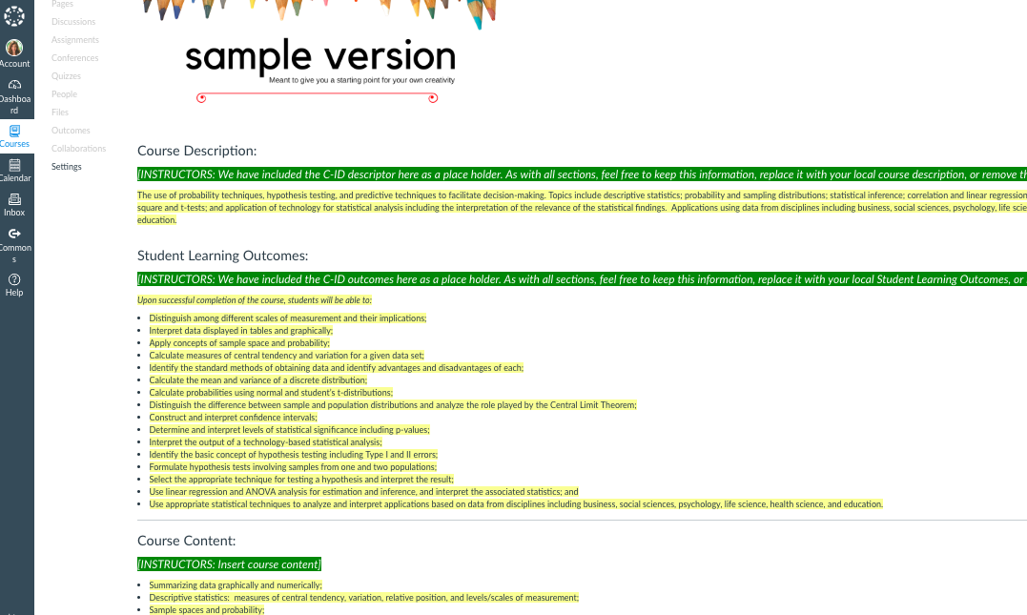
Syllabus – Elem. Stats
Notes:
C-ID descriptor where available, otherwise from a college's course catalog
Leave or change to local info

Slide 24
CC BY ➔ adaptable

Slide 25
Colleagues‘ adaptions
Replace PPts with personal ones
Embed MyOpenMath homework system
Test banks
Customizing shells
College customization

Slide 26
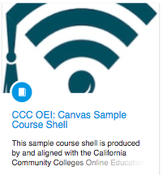
An “empty” shell
for YOU!
Use the shell with any textbook you want….
OER or not!
Notes:
"Empty shell" meaning no textbook.
Add your content.

Slide 27
OERCommons.org
Notes:
Poll: What is your experience with OER?
What’s OER?
2. Know about OER but not using an open or free textbook
3. Using an open or free textbook
4. Using OER and promoting it.

Slide 28
OERCommons.org
Notes:
Poll: What is your experience with OER?
What’s OER?
2. Know about OER but not using an open or free textbook
3. Using an open or free textbook
4. Using OER and promoting it.

Slide 29
Mathematics

Slide 30
OpenStax hub

Slide 31
What’s next?
CCC Chancellor’s Office request - $10million to expand ZTC degrees

Slide 32
To learn more...
https://www.oeconsortium.org/
https://www.cccoer.org/
http://cvc.edu/faculty-resources/open-educational-resources/

Slide 33
Questions???? Thank you!
Barbara Illowsky, PhD
illowskybarbara@fhda.edu
@DrBSI
Thanks to the Michelson 20MM Foundation for conference traveling & support.

