Slide 1
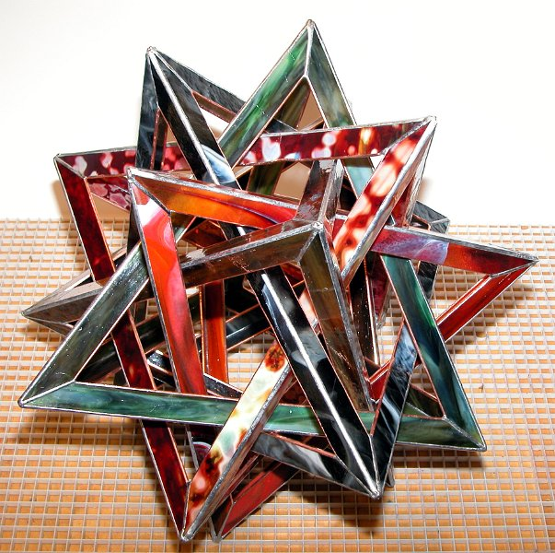
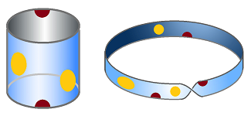
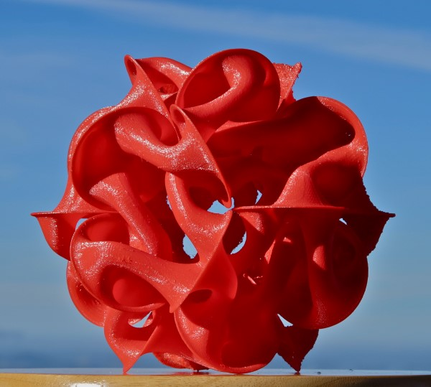
CMC3_Tahoe, April 27, 2018
The Magic Power of Geometry and Topology
Carlo H. Séquin
EECS Computer Science Division
University of California, Berkeley
Notes:
This is the title of my talk …
But first a little bit more about my background:

Slide 2
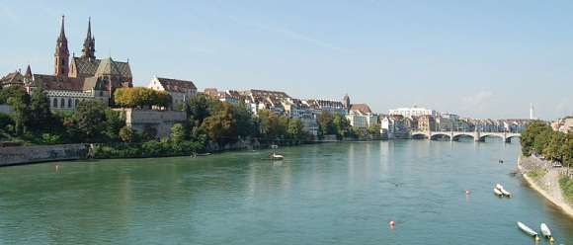
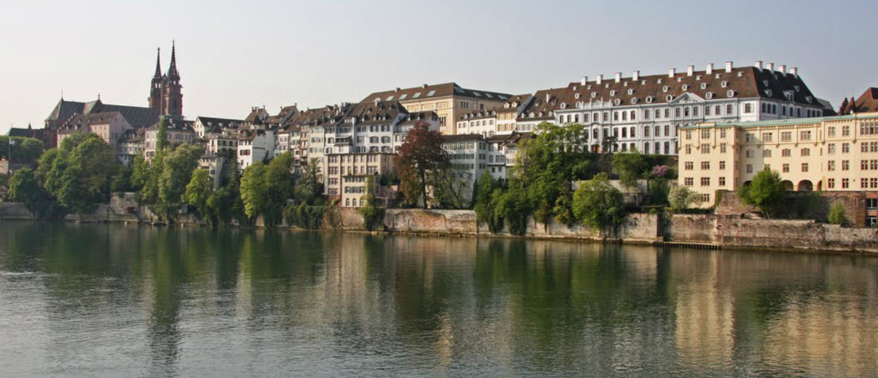
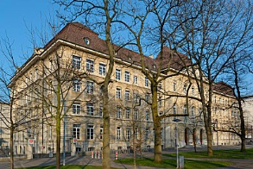
Basel, Switzerland
M N G
Notes:
I grew up in Basel, CH,
>>> where I attended the M N G (a high school with emphasis in math and science).
>>> During my university years I heard my math lectures in this 500 year old institute, where many famous mathematicians have lectured:

Slide 3
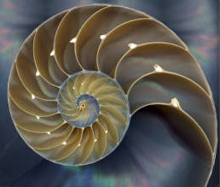
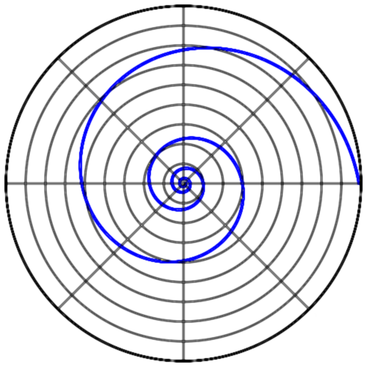
Jakob Bernoulli (1654‒1705)
Logarithmic Spiral
Notes:
such as Jakob Bernoulli, or . . .

Slide 4
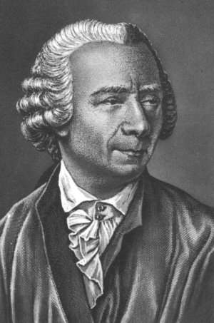
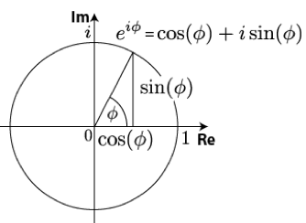
Leonhard Euler (1707‒1783)
Imaginary Numbers
Notes:
… or Leonhard Euler.
From an early age on, I was fascinated with numbers …

Slide 5
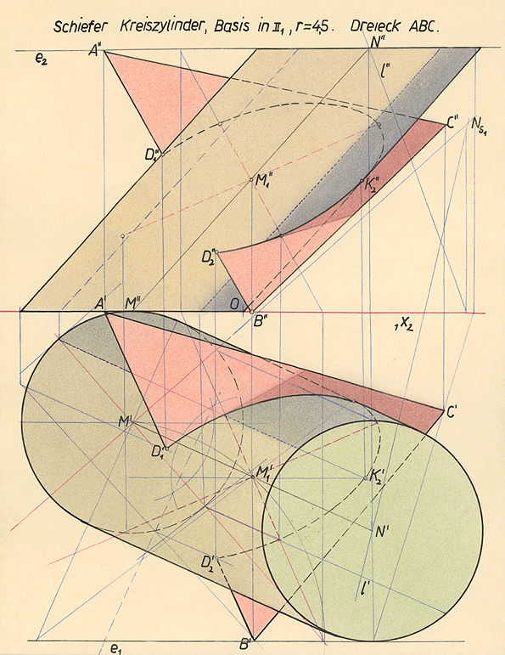
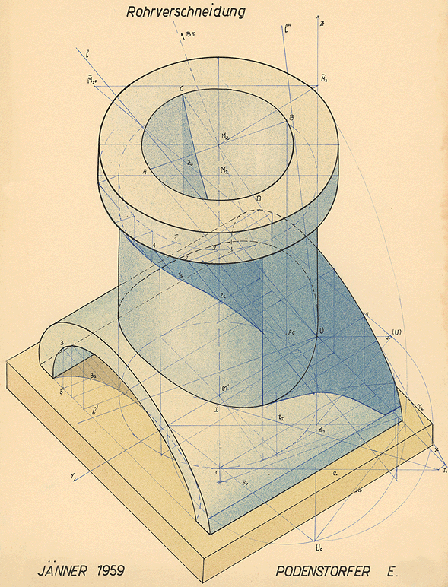
Descriptive Geometry
Notes:
and during high-school I fell in love with geometry.
In 11th grade we had a subject called Descriptive Geometry , where we constructed the intersection lines between two cylinders. -- I thought that this was very cool stuff!
– Ever since, geometry has been in my blood stream! And it has never left me.

Slide 6
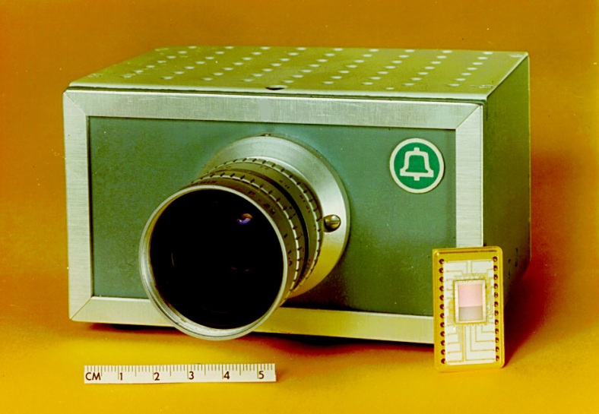
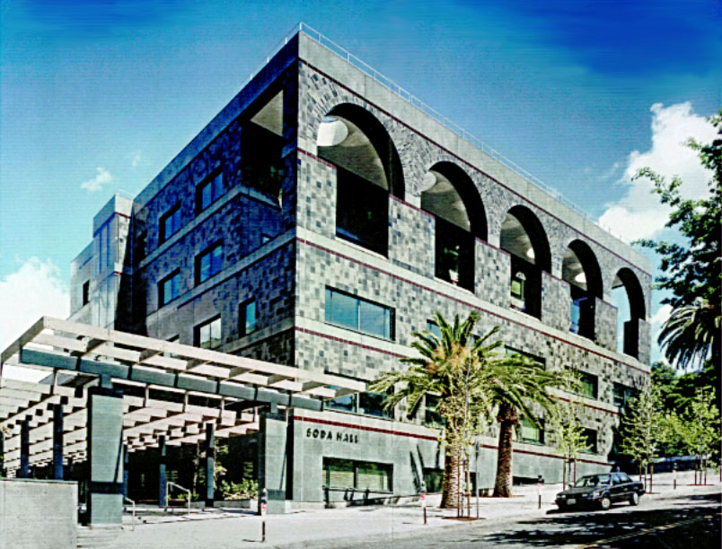
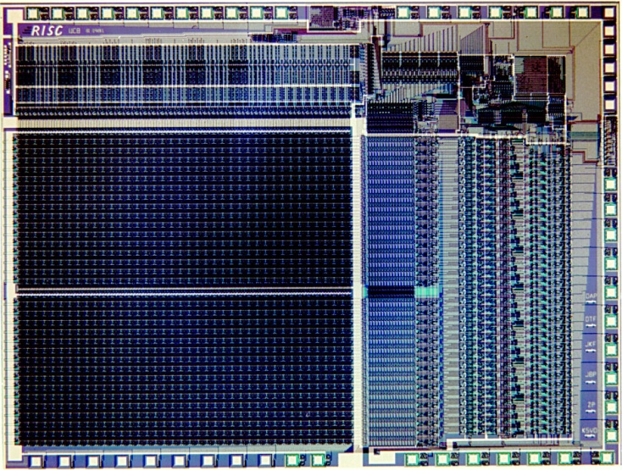
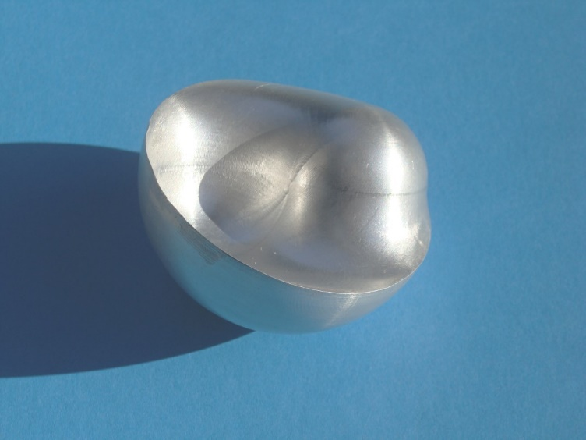
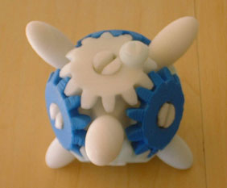
Geometry in every assignment . . .
CCD TV Camera (1973) Soda Hall (1992)
RISC 1 MicroChip (1982) 3D-Yin-Yang (2000)
Notes:
So, in many of my assignments during the last 40 years, I always look for the geometry problems.
My first job was at Bell Labs in Murray Hill. I was placed into the group that had just invented CCDs, and over 3 years we developed the first all-solid-state TV camera. (The success of this brought me to Berkeley). There I teamed up with D. A. Patterson, and we built the first Reduced Instruction Set Computer on a chip. At that time, my students and I worked mostly on IC-layout programs which offer a lot of 2D geometry problems.
Then we needed a new home for CS; and I transitioned from 2D geometry to 3D geometry. == Later I teamed up with Paul Wright in ME on a project called “CyberCut – CyberBuild”. This started with optimized tool paths for 3-axis milling machines to make free-form surfaces such as the 3D Yin-Yang. Then came along the 3D printers and additive layered manufacturing. . .

Slide 7
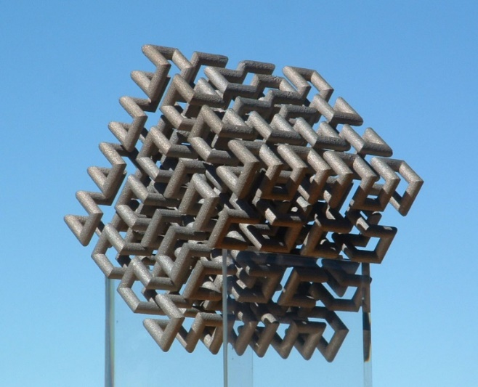
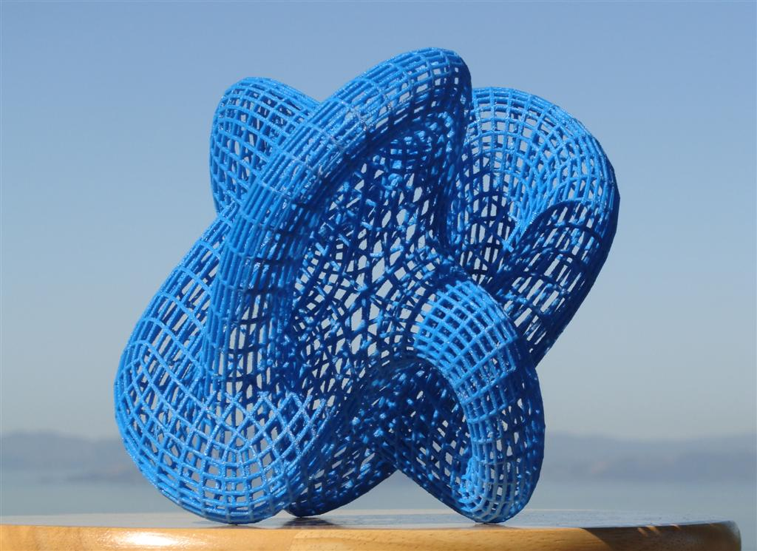
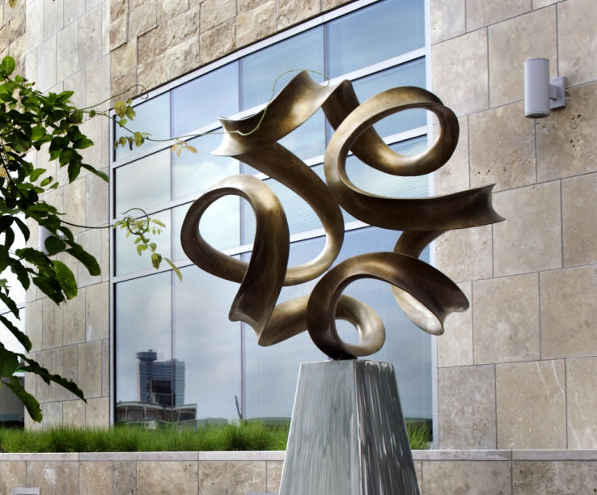
More Recent Designs and Models
“Hilbert Cube”
“Klein Bottle”
“Pax Mundi”
“Evolving Trefoil”
Notes:
During the last two decades, I have worked with artists and with mathematicians.
The top row shows some mathematical visualization models fabricated on 3D printers. Top-left is a 3D Hilbert cube with 512 “elbows”. Top right is a special, highly symmetrical Klein bottle. The bottom row shows two larger sculptures that emerged from my collaboration with Brent Collins. -- All of these involve some intricate geometry!

Slide 8
Geometry
A “power tool” for seeing patterns.
Patterns are a basis for understanding.
For my sculptures, I find patterns in inspirational art work and capture them in the form of a computer program.
Notes:
Why is geometry so useful in so many fields? -- It is a power tool for seeing patterns!
And discovering patterns is a basis for true understanding.
For my sculptures, I find such patterns in inspirational artwork by more intuitive artists, and I then capture them in the form of a computer program.
=== But “seeing patterns” really happens in your mind …

Slide 9
Mathematical “Seeing”
See things with your mind that cannot be seen with your eyes alone.
A hexagon plus some lines ? or a 3D cube ?
Notes:
In this talk I will introduce you to a way of seeing things in your mind that cannot be seen in an ordinary way.
The left figure looks like 6 triangles, or like a hexagon with some internal lines. -- But if we rotate this figure a little, it suddenly starts to look like a 3D cube.
This is a simple example of an image that is composed by your mind.

Slide 10
Seeing a Mathematical Object
Very big point
Large point
Small point
Tiny point
Mathematical point
Notes:
Here is how our high school teacher introduced us to seeing a mathematical object: At the top is a very big point, and I am sure that everyone can see it.
>>> Next is a point that is still fairly large – Can you still see it ?
>>> Now we have a much smaller point: WHO can still see this ?
>>> Tiny point: …
>>> At the bottom: an even smaller “Mathematical point” – Who can see that one? =>> You are true mathematicians!
You used your mind to infer that there is a point at the location to which the yellow arrows are pointing.
This is mathematical seeing! -- I will use a similar approach when we later look at 4D objects.

Slide 11
Regular Polygons (in 2D)
“Regular” means: All the vertices and edges making up each of the polygons are indistinguishable from each another.
There are infinitely many of them!
. . .
Notes:
But let’s start with some simple geometry in TWO dimensions:
These are some regular polygons. Regular means that …
So we can have equilateral triangles, squares, and regular n-gons for all higher numbers.
There are infinitely many of these regular polygons.

Slide 12
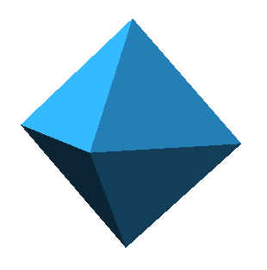
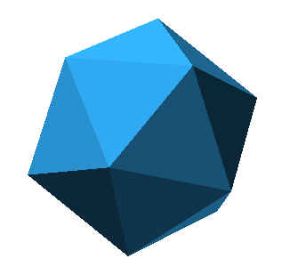
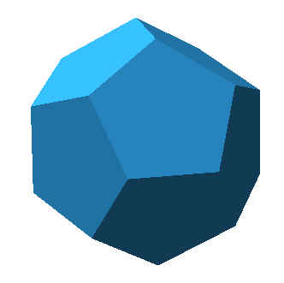
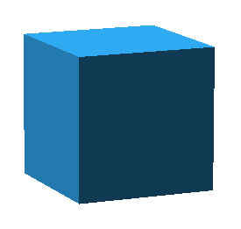
Regular Polyhedra (in 3D)
All faces, all edges, all corners, are the same.
They are composed of regular 2D polygons:
Tetrahedron Octahedron Cube Icosahedron Dodecahedron
The Platonic Solids
There were infinitely many 2D n-gons!
How many of these regular 3D solids are there?
Notes:
Now we go to 3 Dimensions. To make a polyhedron regular: all vertices, edges, faces must be the same. This means that the surfaces of these polyhedra are made of the 2D regular polygon tiles seen in the last slide.
Here are 5 regular polyhedra, known as the Platonic solids. They have been known to mankind for 2 millennia. Are there any other regular polyhedra ?
How would you prove to someone, that there are only these 5 ??

Slide 13
Making a Corner for a Platonic Solid
Put at least 3 polygons around a shared vertex to form a real physical 3D corner!
Putting 3 squares around a vertex leaves a large (90º) gap;
Forcefully closing this gap makes the structure pop out into 3D space, forming the corner of a cube.
We can also do this with 3 pentagons: → dodecahedron.
Notes:
In order to construct the surface of some Platonic solid, we have to assemble some 2D polygons, so that they form real physical 3D corners; (use CARDBOARD MODEL).
Thus we need at least 3 faces coming together at each corner. When we put 3 squares around a shared vertex, then there is still a large gap left. Now we forcefully close this gap, and the structure pops out into the 3rd dimension, and a real cube corner is formed. 8 of these corners make a complete cube.
We can also use 3 pentagons, and the result will be the dodecahedron.

Slide 14
Why Only 5 Platonic Solids?
Lets try to build all possible ones:
from triangles: 3, 4, or 5 around a corner:
from squares: only 3 around a corner:
from pentagons: only 3 around a corner:
from hexagons: → “floor tiling”, does not bend!
higher n-gons: → do not fit around a vertex without undulations (forming saddles)! → then the edges would no longer be all alike!
4T
8T
20T
Notes:
Now we can see why there are only 5 Platonic solids: When we use triangles for the surface facets, we have a choice, we can use 3 or 4 or 5 around a point (use fingers) to form a regular pyramid-like corner. This leads to the Tetrahedron, the Octahedron, and the Icosahedron which uses 20 triangles. If we try to form a corner with 6 triangles, we just get a flat, infinitely large tiling.
Next, if we use squares, there is only one option: 3 squares around a corner – forming a cube. Four squares around a point would just produce a kitchen floor!
And we have already seen that with 3 pentagons we can make a dodecahedron.
All larger n-gons are too “round” and are not able to make true 3D corners. They can possibly form saddles with some convex and some concave edges. No longer all alike – No longer “regular.” – So this is your proof!

Slide 15
4D “Platonic Solids” ??
Now we apply the same reasoning to find all regular objects in FOUR dimensions!
Notes:
Now we are going to step into the 4th dimension …
We will apply the same reasoning to find all regular objects in FOUR dimnsions.

Slide 16
What is the 4th Dimension ?
Some people think: “it does not really exist,” “it’s just a philosophical notion,” “it is ‘TIME’ ,” . . .
But, it is useful and quite real!
Notes:
What is this “4th dimension” ??
Some people think: …
But higher geometrical dimensions _do_ exist -- and they are quite useful.

Slide 17
Geometrical View of Dimensions
Read my hands … (inspired by Scott Kim, ca 1977).
Let me put on my magical extrusion gloves . . .
Notes:
To introduce you to the higher geometrical dimension, I use an approach that I learned from Scott Kim about 40 years ago.
Let me put on my “magical extrusion gloves.”

Slide 18
Notes:
Let’s start with that “mathematical point” that I have introduced earlier: -- Here it is at my finger tips. This point has zero dimensions.
Now I duplicate that point and move one sibling through space. This produces a 1-dimensional line segment.
Next I grab that whole line and sweep it at right angle to itself. This process is called extrusion; and in this step it produces a square.
Now I repeat that process again with the whole square and extrude it perpendicular to itself so that if forms a cube. – I hope you get the hang of this process!
So now I just take the whole cube and move it perpendicular to itself into the 4th dimension. This generates a hypercube …
Ahhh – but wait – in which direction should we move the cube? It has to be perpendicular to all the 3 directions that the cube already uses; -- IS THERE SUCH A DIRECTION? >>> --- The last step is difficult for us to comprehend.

Slide 19
Flat-Land Analogy
Assume there is a plane with 2D “Flat-worms” bound to live in this plane.
They can move around, but not cross other things.
They know about regular polygons:
3-gon 4-gon 5-gon 6-gon 7-gon . . .
Notes:
Perhaps we can understand why this is -- with an analogy to FLATLAND…
Assume there is a plane with 2D Flat-worms, bound to live in this plane. They can move around, but NOT cross other things.
They know about Regular Polygons – even thought they cannot see them the way you can; they can only walk around them and measure the lengths of sides and the angles between them, and make sure that they are all the same. -- Then they can “see” them in their minds.

Slide 20
Explain a Cube to a Flat-lander!
Just take a square and extrude it “upwards” . . . (i.e., perpendicular to both edge-directions ) . . .
Flat-landers cannot really “see” this!
Notes:
One day, a visitor comes from our 3D world and tries to explain to them what a CUBE is: She says: Just take a square and extrude it upwards,
-- NO, not in a diagonal direction, but truly “UPWARDS”, in a direction that is perpendicular to both edge directions of the square. This is difficult to do for the flat worms!!
Same as for us, when we try find a direction for extrusion to make a HYPER-CUBE. Perhaps, some 4D aliens, looking down on us, also smile at our efforts trying to point into the 4th dimension!
But it is out there !!

Slide 21
Geometrical Dimensions ( not TIME ! )
Point - Line - Square - Cube - Hypercube - ... 0D 1D 2D 3D 4D 5D
EXTRUSION
Notes:
So let’s review again what I have just done: We started with a point. A first extrusion produced a line; the next one made a square; and the 3rd one gave us the cube. In each step the number of vertices doubled.
No comes the step that is more difficult to see directly, which produces the hypercube.
The basic process can continue into arbitrary many dimensions!

Slide 22
4D Polytopes
“Polytope” is the generalization of ‘Polyhedron’ in higher dimensions.
The “shell” or “crust” of a regular 4D polytope is composed of regular 3D polygons, i.e., the Platonic solids.
All corners and edges between these “cells” must be the same!
How can we “see” these polytopes ? ? ?
Notes:
But let’s stick to 4 dimensions and ask: Are there any completely regular polytopes like the Platonic solids in 3 dimensions?
“Polytope” is the generalization of …

Slide 23
“Seeing Higher-Dimensional Polytopes”
I showed you the 3D Platonic Solids … But I did not show you any 3D models!
For some of them you have only seen projections. Did that bother you ??
Good projections are almost as good as the real thing. Our visual input, after all, is only 2D. -- 3D viewing is a mental reconstruction in your brain, -- that is where the real "seeing" is going on !
We will use this to “see” the 4D polytopes.
Notes:
… but I only showed you 2D projections …

Slide 24
Wire Frame Projections
The shadow of a solid object is mostly a blob.
Better to use wire frames, so we can also see what is going on on the back side.
Notes:
Here is an oblique projection of a cube.
On the left I show this projection as just a shadow. Clearly, this is not very informative; it is just a feature-less blob!
It is much better to project wireframes of these objects; -- then we can see through them, and also see their backsides.
The figure on the right is also just a 2D image, but your brain allows you to see it as a cube – a 3D object.
With a little practice you can also look at 3D projections and gain an understanding of the 4D object from which they were derived.

Slide 25
Oblique or Perspective Projections
3D Cube → 2D 4D Cube → 3D (→ 2D )
We may use color to give “depth” information.
Notes:
These are the main projections that I will use: On the left are oblique projections (front and back features of the object are drawn at the same scale);
and on the right are perspective projections; here the back features appear smaller.
== In addition, we can also use color to give depth information: Here, red is the front object, cyan is the extruded back object, and yellow-green are the transition edges going from front to back.
For the 4D objects, I first projected them to 3D space as wire-frame objects; then I projected those onto the screen here as 2D line drawings.

Slide 26
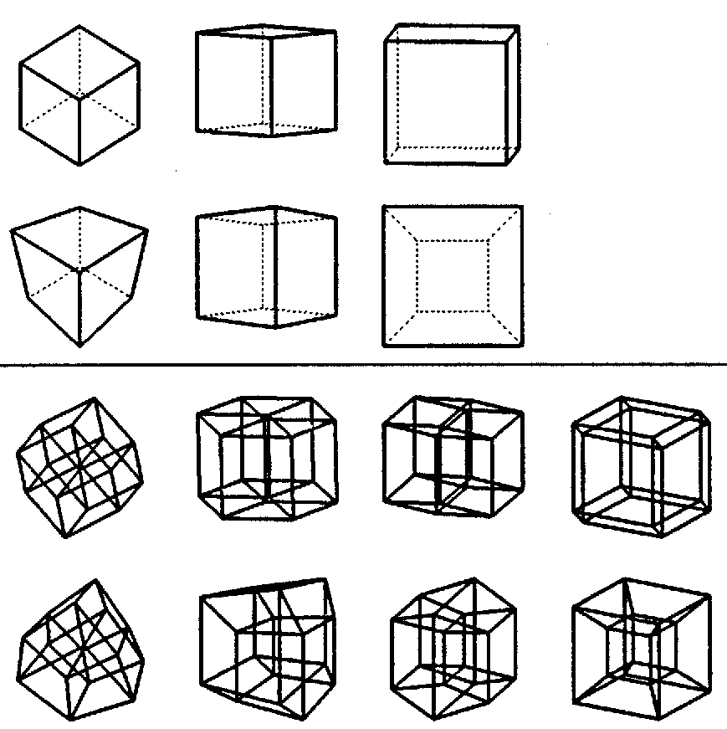
Projections: VERTEX / EDGE / FACE / CELL - first.
3D Cube:
Parallel projection
Perspective proj.
4D Cube:
Parallel projection
Perspective proj.
Notes:
An other crucial decision is the direction from which we look at one of those objects. The top half shows different views of a wire-frame cube.
We can orient our line of sight so that it passes through opposite vertices; this would be called a vertex-first projection. Or we can line up the mid-points of opposite edges or faces, and get different images, called “edge-first” or “face-first” projections
For 4D objects we have one more special direction, called cell-first; -- depicted at the extreme right; -- this is when we are looking squarely at one of the 3D cells that form the “crust” of a regular 4D polytope.

Slide 27
Finding All Regular 4D Polytopes
Constructing a 4D Corner:
2D
3D
Forcing closure:
?
3D
4D
creates a 3D corner creates a 4D corner
Notes:
Now we would like to find all possible regular 4D polytopes. Let’s do again what we did for the construction of Platonic solids: We took a few regular n-gons that did not fill the space around a vertex, and forced the gap to close.
Now we do this again, one dimension higher! We will take a few Platonic solids, say cubes, and fit them around a common edge (shown in red). I use the same 2D model again, but now assume that a 3D cube is behind each of the 3 squares!
Once again, we force the left-over wedge of empty space to close, -- and POP, we get a 4D corner!

Slide 28
Finding All Regular 4D Polytopes: (2)
Reasoning by analogy helps a lot: -- Remember how we found all the Platonic solids . . .
Now: Use the Platonic solids as “tiles” and ask:
What can we build from tetrahedra?
or from cubes?
or from the other 3 Platonic solids?
Need to look at dihedral angles: Tetrahedron: 70.5° Cube: 90° Octahedron: 109.5° Dodecahedron: 116.5° Icosahedron: 138.2°
Notes:
Now we have to count in how many different ways we can do this. The crucial value now is the dihedral angle, i.e., the angle between two adjacent faces of a Platonic cell; it tells us how many of a particular solid can be fit around a shared edge, -- and how much space is left over! For the tetrahedron this critical angle is 70.5 degrees,
>>> so we can fit 3, 4, or 5 tetrahedra around a common edge without exceeding 360 degrees, and still have a little room to do some bending through 4D space.

Slide 29
All Regular Polytopes in 4D
Using Tetrahedra (70.5°):
3 around an edge (211.5°) → (5 cells) Simplex
4 around an edge (282.0°) → (16 cells) Cross-Polytope
5 around an edge (352.5°) → (600 cells) 600-Cell
Using Cubes (90°):
3 around an edge (270.0°) → (8 cells) Hypercube (Tesseract)
Using Octahedra (109.5°):
3 around an edge (328.5°) → (24 cells) 24-Cell
Using Dodecahedra (116.5°):
3 around an edge (349.5°) → (120 cells) 120-Cell
Using Icosahedra (138.2°):
→ None! : dihedral angle is too large (→ 414.6°).
Notes:
… and all three options yield valid regular 4D polytopes: specifically: the simplex, the cross polytope, and the 600 cell.
With cubes there is only one valid option: 3 cubes around an edge form a hypercube corner.
We can also use 3 octahedra to make a valid corner; this leads to the 24-cell. Or we can use 3 dodecahedra and then obtain the 120-cell.
But the icosahedron is useless: its interior angle at each edge is more then 120 degrees, 3 of them don't fit around a common edge. -- So now we have seen all the possibilities!

Slide 30
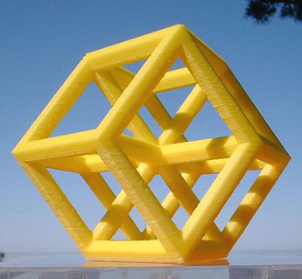
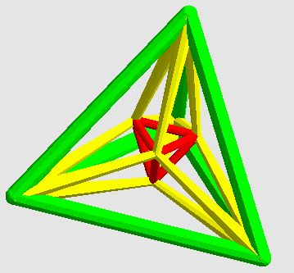
The 6 Regular Polytopes in 4-D . . .
Notes:
Here are the first 4 of the six regular polytopes in 4D space. The first is the simplex or 5-cell shown in a cell-first perspective projection. It is composed of 5 tetrahera. Four of them are distorted because of the projection into 3D space.
The second is a vertex-first projection of a hypercube, consisting of 8 cubes. The third is its dual, the 16-cell or cross-polytope, made of 16 tetrahedra. And finally there is the 24-cell composed o 24 octahedra. I think this is the most beautiful one.

Slide 31
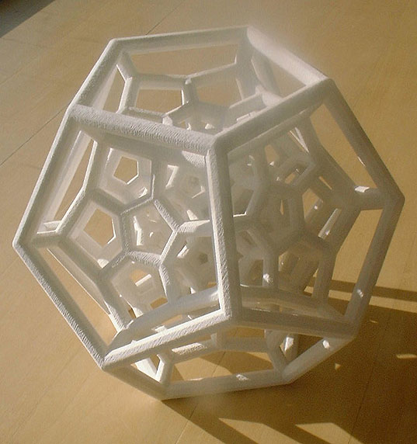
120-Cell ( 600V, 1200E, 720F )
Cell-first, extreme perspective projection
Z-Corp. model
Notes:
And here is number 5; the 120 Cell. It has 600 vertices and 1200 edges. Here it is shown in an extreme perspective projection, where the camera was very close to one of the dodecahedral cells; this is the big one on the outside of this wire frame.

Slide 32
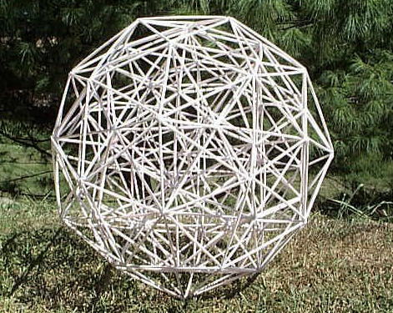
600-Cell ( 120V, 720E, 1200F ) (parallel proj.)
David Richter
Notes:
And this is number 6! – a model built by David Richter from drinking straws. This is a parallel projection in which more than half of all the edges are hidden by superposition.
This like when you do a parallel projection of a cube, looking perpendicularly onto one face; -- all you see is a square!

Slide 33
More Models of 4D Polytopes . . .
Notes:
I am going to show you quickly a few more models of the regular 4D polytopes, to show you the variety by which these objects can be depicted.

Slide 34
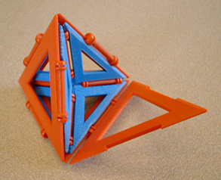
4D Simplex
Additional tiles
made on our
FDM machine.
Using Polymorf TM Tiles
Notes:
First, again, is the 5-cell, showing some of the internal structure. I started with commercially available Polymorf Tiles, and then made the special tiles used inside on a Fused-Deposition-Modeling machine.

Slide 35
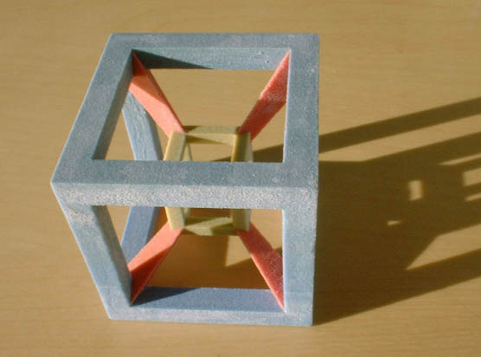
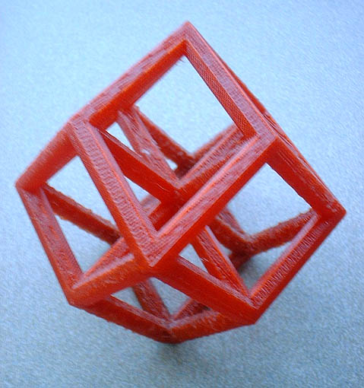
Hypercube or Tesseract in 4D
8 cells, 24 faces, 32 edges, 16 vertices.
(Its dual is the 16-Cell).
Notes:
Here are two different projections of the Hypercube or Tesseract, which has 8 cubic cells and 16 vertices.
On the left I used a perspective projection with depth-color information; this was made on a Z-corp machine.
On the right is a vertex-first parallel projection.

Slide 36
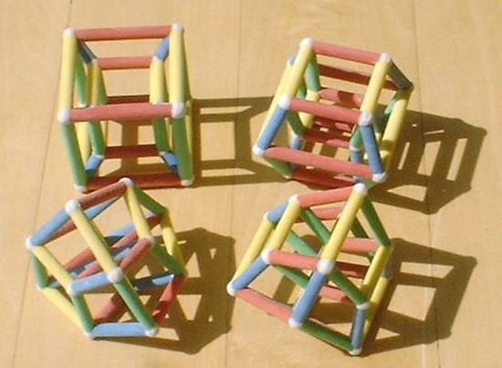
Hypercube, Perspective Projections
Notes:
Changing the position of the camera in 4 dimensional space results in different wire-frame models. Cell-first, face-first, edge-first, vertex-first.

Slide 37
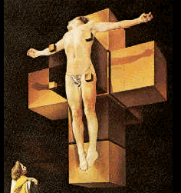
Corpus Hypercubus
“Unfolded” Hypercube
Salvador Dali
Notes:
Dali’s view of an unfolded hypercube, where you can see all 8 cells quite clearly.

Slide 38
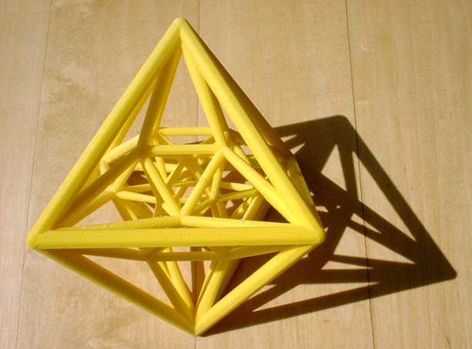
24-Cell in 4D
24 cells, 96 faces, 96 edges, 24 vertices.
self-dual; 1152 symmetries (in 4D).
Notes:
This is my favorite: 24 octahedra make the beautiful 24-Cell. It is self-dual -- This means, it has the same number of cells and vertices.
It has 1152 symmetries! – but unfortunately, you can only see them in 4D space!

Slide 39
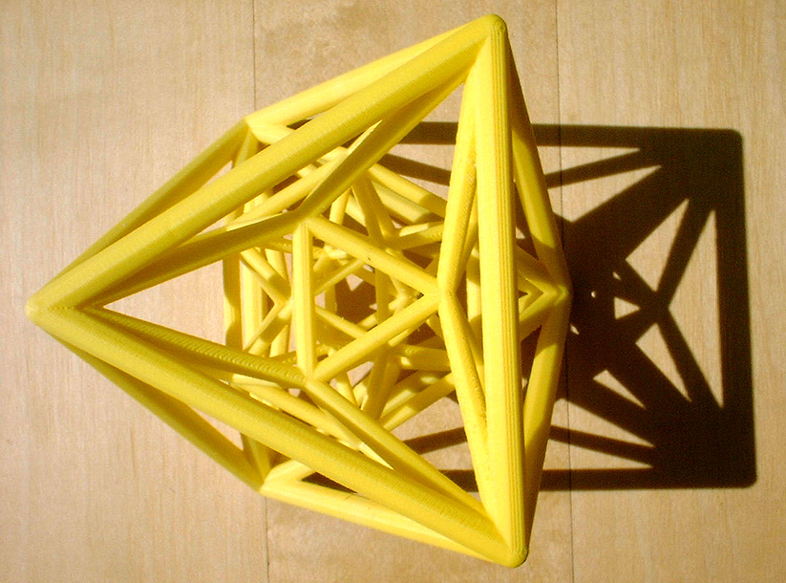
24-Cell, showing 3-fold symmetry
Notes:
An alternate view that demonstrates one of its 3-fold rotational symmetries.

Slide 40
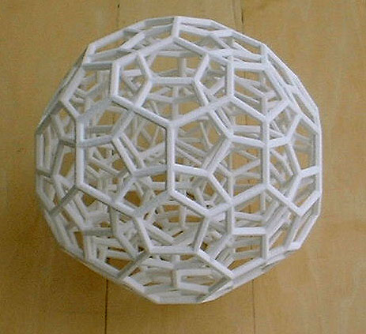
120-Cell in 4D
120 cells, 720 faces, 1200 edges, 600 vertices. Cell-first parallel projection, (shows less than half of the edges.)
Notes:
Here is the 120 cell -- made of 120 dodecahedra. It has 1200 edges.
But in this parallel projection you can only see about half of them, because some edges “obscure” some other ones.

Slide 41
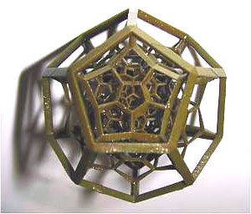
(smallest ?) 120-Cell
∼5cm
Wax model, made on a Sanders machine
Notes:
Here is a perspective projection of the same thing. In principle it shows all 1200 edges, but some of them lie close to the center of this model and are very small!
The diameter is just a couple of inches It was made by Bathsheba Grossman.

Slide 42
Going Beyond 4D
What Happens in Higher Dimensions ?
Notes:
Now you are probably burning with the question: What happens if we go to even higher Dimensions … and try to find all regular polytopes.

Slide 43
Polytopes in 5 Dimensions
Use 4D tiles; look at “dihedral” angles between cells:
5-Cell: 75.5°, Tesseract: 90°, 16-Cell: 120°, 24-Cell: 120°, 120-Cell: 144°, 600-Cell: 164.5°.
Most 4D polytopes are too round …
But we can use 3 or 4 5-Cells, and 3 Tesseracts.
There are three methods by which we can generate regular polytopes for 5D and for all higher dimensions.
Notes:
Now we need to use our 4D polytopes as tiles to construct the surfaces of the regular 5D polytopes.
But when we look at the dihedral angles, we find that all but two – the simplex and the hypercube – are too round to be of use.

Slide 44
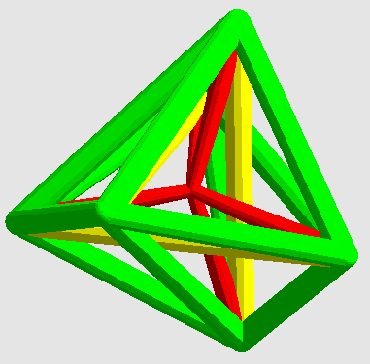
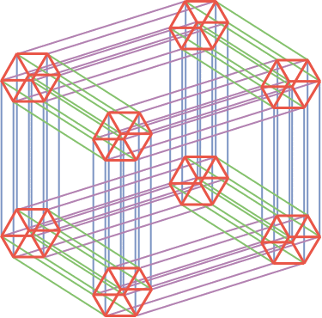
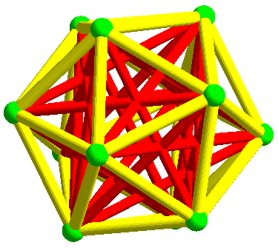
Beyond 4 Dimensions …
What happens in higher dimensions ?
How many regular polytopes are there in 5, 6, 7, … dimensions ?
Only THREE for each dimension!
Pictures for 6D space:
Simplex with 6+1 vertices,
Hypercube with 2⁶ vertices,
Cross-Polytope with 2*6 vertices.
Notes:
So, the answer to this question is …
>>>
There are just 3 tracks by which we can continue to construct higher-dimensional regular polytopes.
We can build simplexes, hyper-cubes, and cross-polytopes in all dimensions.
Let’s look at these 3 series separately.

Slide 45
Simplex Series
Connect all the dots among n+1 equally spaced vertices: Add new vertex above centroid. 1D 2D 3D
This series goes on indefinitely!
Notes:
First the simplex series: To make a n-D simplex, take n+1 vertices and arrange them at equal distances from one another.
This can easily be done recursively, by starting with the simplex one dimension lower, and adding one more point “above” it in the new dimension at just the right distance, so that all the edges are the same length.

Slide 46
Hypercube Series
“Measure Polytope” series:
Repeated extrusion process; consecutive perpendicular sweeps:
1D 2D 3D 4D
This series extents to arbitrary dimensions!
Notes:
The second series is based on hyper-cubes. It uses the repeated extrusion process that I have described to you before.

Slide 47
Cross Polytope Series
Place vertices on all coordinate half-axes a unit-distance away from origin.
Connect all vertex pairs that lie on different axes. 1D 2D 3D 4D
A square frame for every pair of axes
6 square frames = 24 edges
Notes:
And this series delivers all the corresponding duals to the hypercubes. Here is a possible construction process: Place . . .

Slide 48
5D and Beyond
The three polytopes that result from the
Simplex series,
Cross polytope series,
Measure polytope series,
. . . is all there is in 5D and beyond!
2D 3D 4D 5D 6D 7D 8D 9D … ∞ 5 6 3 3 3 3 3 3
Luckily, we live in one of the interesting dimensions!
Duals !
Dim. #
Notes:
In summary: Beyond the 4th dimension there are just 3 regular polytopes in each dimension.
Dimensions 3 and 4 seem to be most exciting! … Luckily . . .

Slide 49
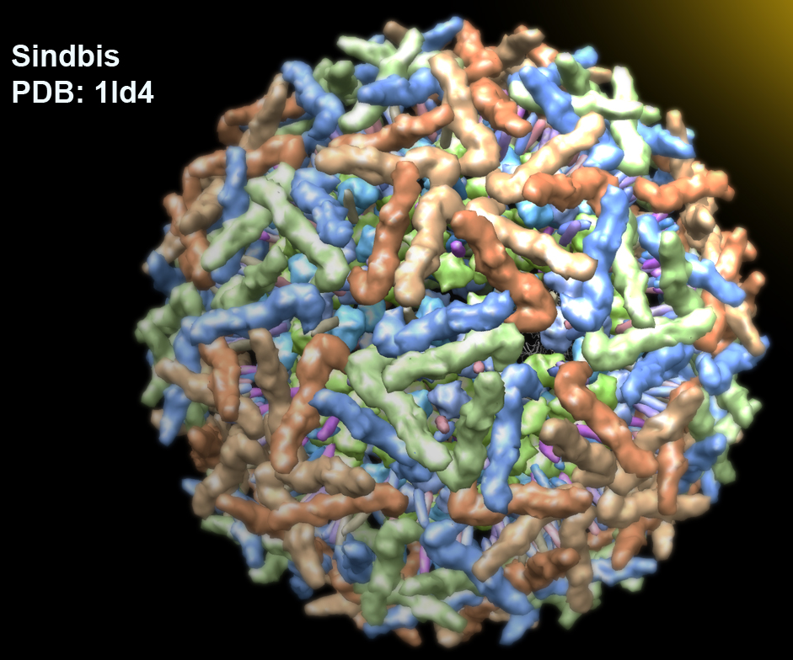
“Platonic Symmetries”
Patterns based on the symmetry of the Platonic solids.
Notes:
The Platonic solids serve a much bigger role than just existing as regular polyhedra. The symmetries represented by these objects show up in many much more complex objects, e.g. viruses.

Slide 50
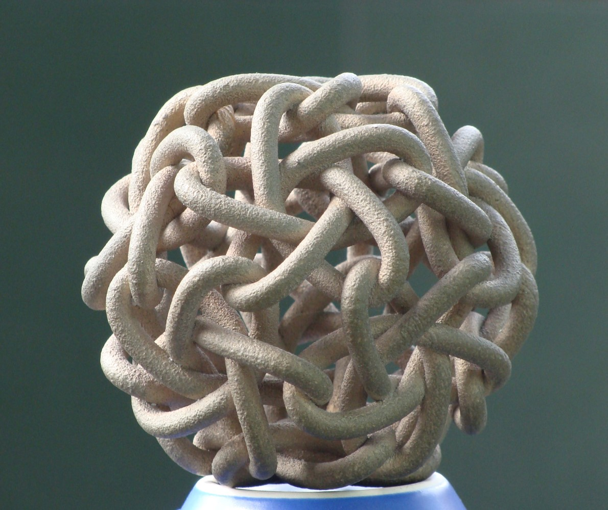
Using Platonic Symmetry
Pentafoil Tangle
Notes:
We can use the symmetry of the Platonic solids to place other objects than just n-gonal faces in a symmetrical manner.
Here I have replaced the faces of a dodecahedron with a dozen mutually interlocking pentafoil knots.

Slide 51
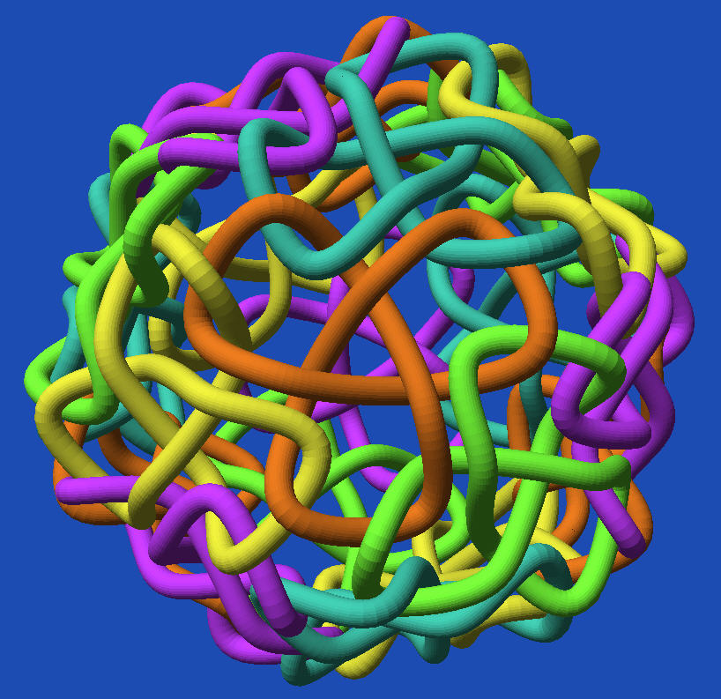
Icosahedral Trefoil Tangle (type 3)
Doubly linked with each neighbor
Notes:
And here is an even more complex linking scheme:
Every trefoil links twice with each one of its 3 neighbors.

Slide 52
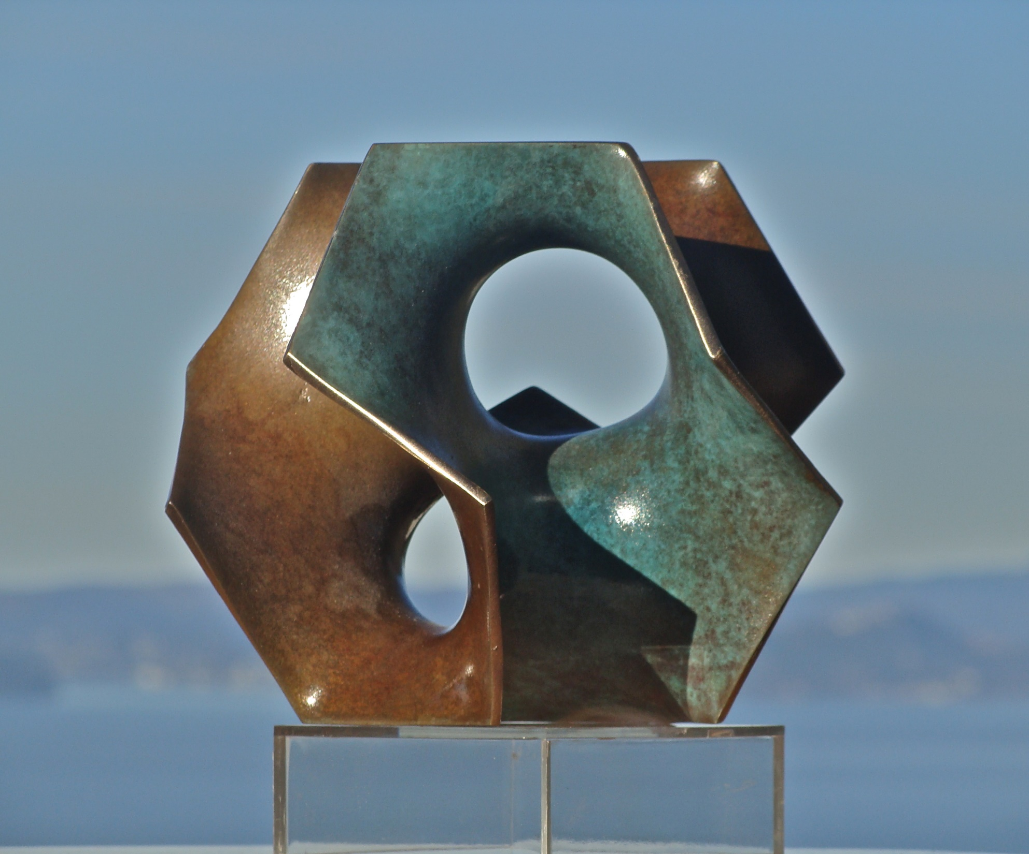
Hamiltonian Cycle on Dodecahedron
Minimal surface of genus 1 suspended in that cycle
Notes:
Here is a sculpture that started out as a dodecahedron. I broke the full symmetry and removed some edges so that there remained a Hamiltonian cycle using 20 selected edges from its total of 30 edges forming a single loop. In this loop, we can then suspend a soap-film or other minimal surfaces. Here is a minimal surface with two tunnels.
The casting and patina was done by Steve Reinmuth in Eugene, OR.

Slide 53
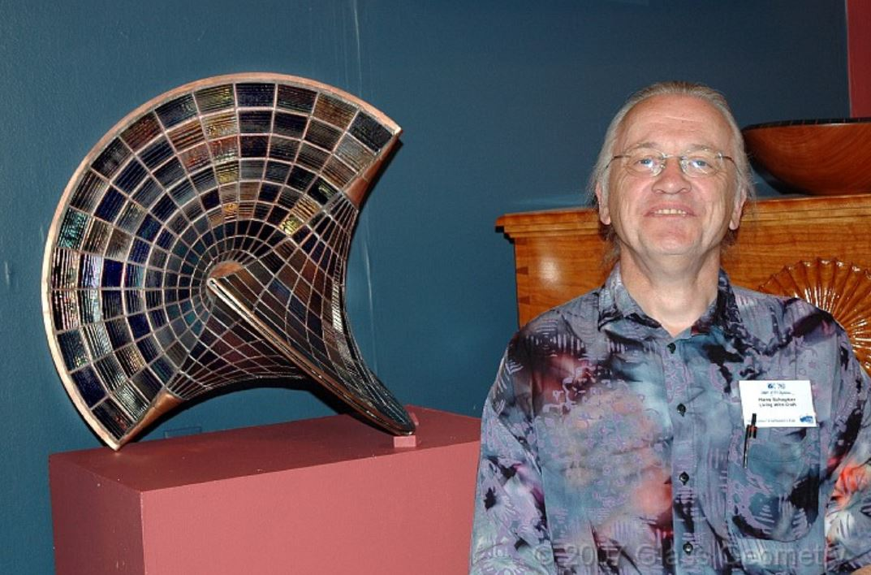
Hans Schepker, Harrisville, NH
Notes:
To a mathematician, the Platonic solids are beautiful in their own way.
But they can also inspire artists to create artifacts that look beautiful also to non-mathematicians. One such artist is Hans Schepker; he is about my age and lives in Harrisville, NH.

Slide 54
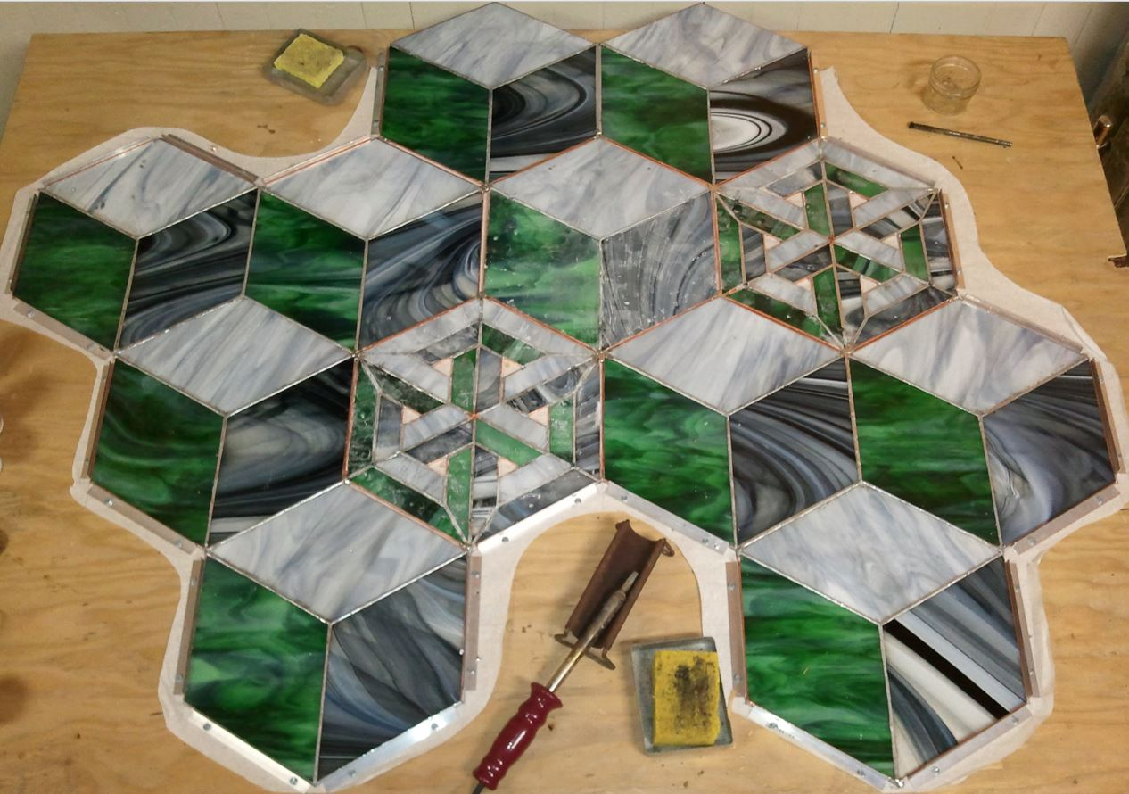
Hans Schepker: Stained-glass Art
technique
Notes:
He does beautiful lead-framed stained-glass art. Check his web page called “Glass Geometry”.

Slide 55
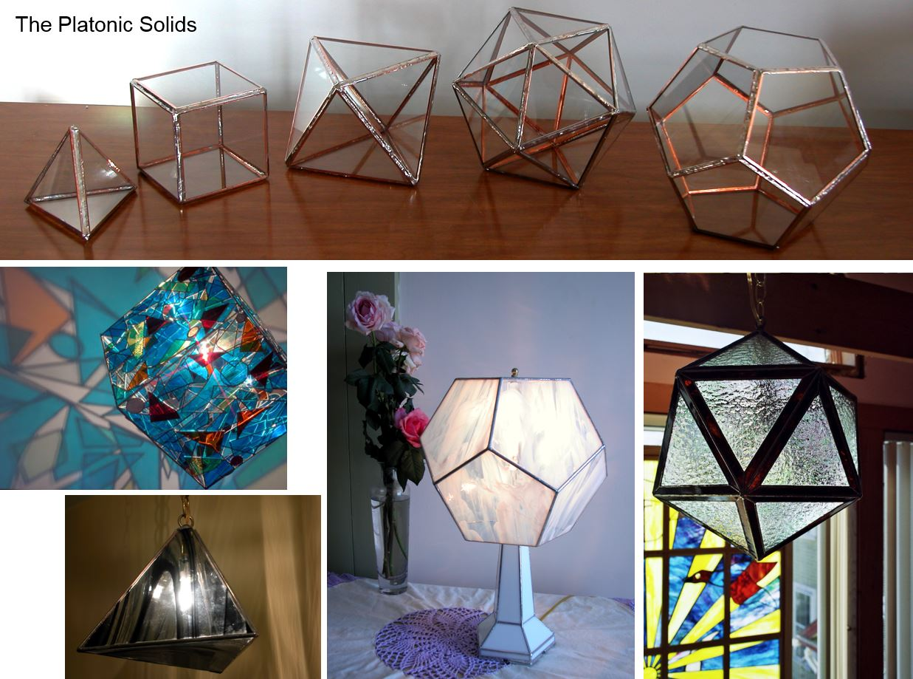
x
Notes:
This is what he makes of the Platonic solids. The top row should look rather familiar to you.
Bottom half: on the left: cube and tetrahedron, followed by Dodecahedron and Icosahedron.

Slide 56
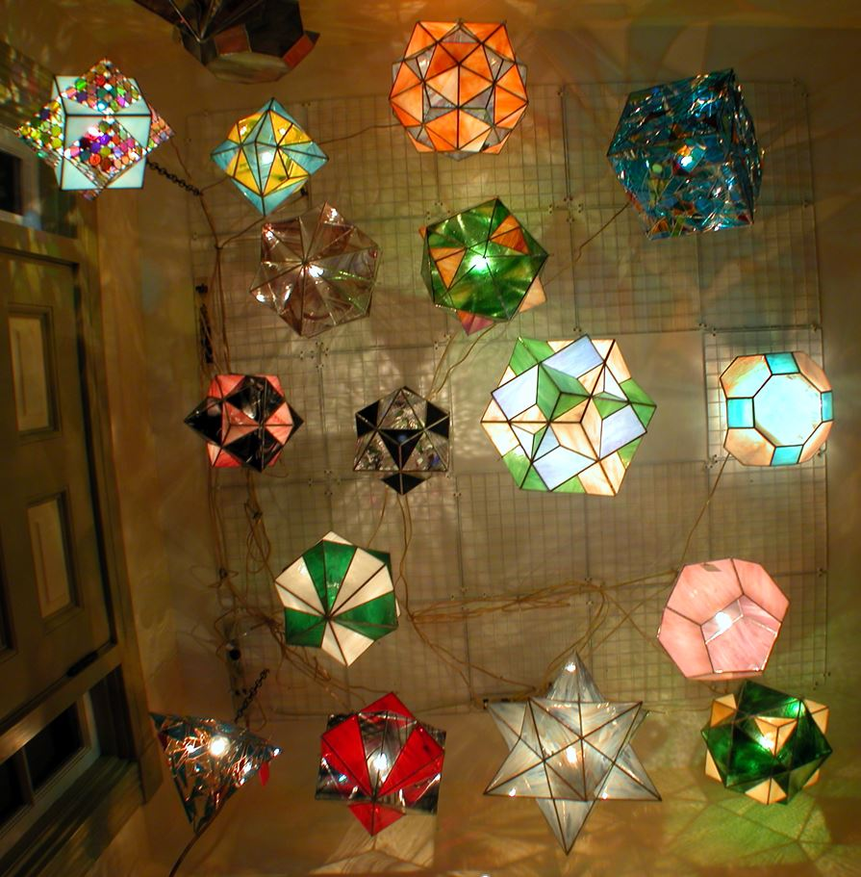
Lamps by Hans Schepker
Notes:
Hans often turns these things into lamps. Obviously he does much more than just replicate the Platonic solids.

Slide 57
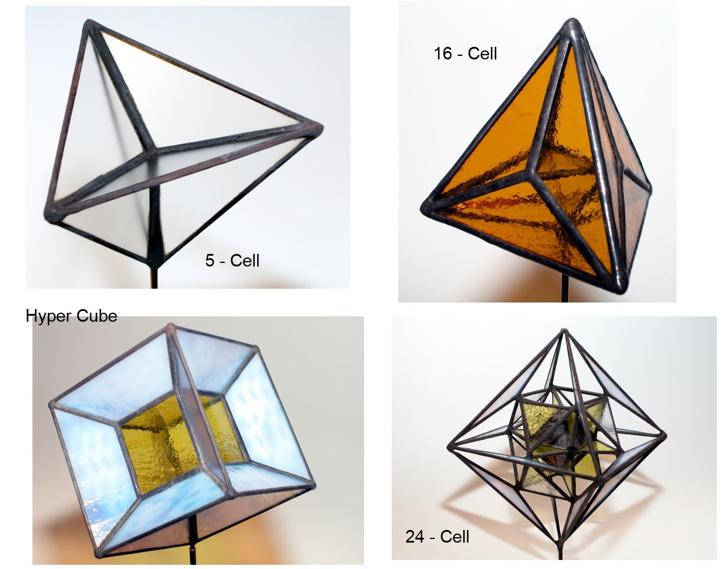
x
Notes:
This is what he did with the four simpler 4D regular polytopes.

Slide 58
Hans Schepker
600-Cell
Notes:
Sometimes, for the more complicated polytopes, he realizes only a subset of all faces and edges to avoid the dense clutter near the center.

Slide 59
Semi-Regular Polyhedra (in 3D)
Archimedean Solids (13)
Different regular polygons; all vertices are the same.
Notes:
Even in 3D, there are many beautiful polyhedra in addition to the five Platonic solids. There is a whole zoo of semi-regular polyhedra. They are composed of more than one type of regular n-gonal tile. But all the vertices must still be the same.

Slide 60
Hans Schepker
Stellated dodeca
Notes:
And then there are the stellated objects. For instance: Start with a dodecahedron and add 5-sided pyramids on all its faces. This results in the “small stellated dodecahedron.”
Hans then cut off the points of the pyramids and turned them inwards; -- and that is how he obtained the “Dis-a-Pointed Small Stellated Dodecahedron”.

Slide 61
Hans Schepker
“Trefoil Knot”
Notes:
But Hans does not just do semi-regular polygons. He also creates objects like this trefoil knot….

Slide 62
Hans Schepker
“Ohloid Surface”
➔ Smooth free-form surfaces
Notes:
… or this minimal surface derived from the “Ohloid” configuration of two half-circles.
>>> So, this is a good segway to leave the world of polyhedra and talk about smooth, free-form surfaces.

Slide 63
Charles O. Perry
“Femisphere”
“Open Mace”
Notes:
This surface has also fascinated another East-coast artist: Charlie Perry, and he has done many variations thereof.

Slide 64
2-Manifold (Surface) Sculptures
Endless Ribbon Dual Universe Loop_785 Heptoroid
Max Bill Charles Perry Eva Hild Brent Collins
stone metal ceramic wood
Notes:
So, let’s talk about surfaces more formally. Intuitively, these are thin, 2-dimanional sheets that are bent into the third dimension. They may have many holes and open border lines. Here are several different sculptures that fall into this category. Here are some more examples of 2-manifold sculptures. They come in quite different shapes and different materials.
Max Bill’s Moebius band has been carved from stone; Perry’s “Dual Universe” was cast in bronze; Eva Hild forms many of her sculptures from clay; and Brent Collins’ “Heptoroid” is made from wood.

Slide 65
2-Manifolds
Structures made out of thin sheets of material, e.g., paper, sheet metal, plastic …
Mathematicians abstract this to where we have an infinitely thin sheet of math substance.
Every interior point has a disk-like neighborhood.
Every rim-point has a half-disk neighborhood.
Notes:
The mathematical idealization of such surfaces are called “2-manifolds”. To qualify, every small neighborhood of a point must be equivalent to a disk (shown in yellow), or equivalent to a half-disk (shown in red) if the point lies at a border rim.
Examples: << Show a piece of cardboard; some sculpture model {Volution} … >>
Structures like a book, where multiple pages hang from a joint spine are NOT 2-manifolds.
->> Now we want to do a topological analysis of such surfaces.

Slide 66
Topological Analysis
What is Topology?
A coffee mug and a donut are both
“handle-bodies of genus 1”
Geometry is NOT important – only connectivity!
Notes:
For that, we need to understand: What is topology ? -- As the joke goes:
For a topologist there is no difference between a coffee mug and a donut: they are both “handle-bodies of genus 1”
Topologists do not look at geometry; they only are concerned with connectivity.
For topologists shapes are infinitely stretchable and pliable; you are just not allowed to make any cuts or tears.

Slide 67
Topological Analysis of 2-Manifolds
Surface Classification Theorem:
All 2-manifolds immersed in 3D Euclidean space can be characterized by 3 parameters:
Number of borders, b: # of 1D rim-lines;
Orientability, σ: single- / double- sided;
Genus, g, or: Euler Characteristic, χ, specifying “connectivity” . . .
Notes:
But now I want to focus on the topological analysis of surfaces. The key theorem says: All 2-manifolds embedded in 3D Euclidean space can be characterized topologically by just 3 parameters: The number of its borders, b: i.e., # of 1D rim-lines; its orientability, σ: whether the surface is single- or double-sided; and its connectivity, specified either by the Genus, g, or by the Euler Characteristic, χ,
== Let’s look at these three characteristics more closely: . . .

Slide 68
Determining the Number of Borders
Run along a rim-line until you come back to the starting point;
count the number of separate loops.
Here, there are 4 borders:
Perry: “Tetra” (1999)
Notes:
Determining the number of borders is the easiest of the 3 tasks:
Run along a rim-line until you come back to the starting point and count this as ONE border; then count the number of separate loops.
In Perry’s “Tetra” sculpture, there are 4 borders, all circular rings.

Slide 69
Determining the Surface Orientability
Flood-fill paint the surface without stepping across rim.
If whole surface is painted, it is a single-sided surface (“non-orientable”).
If only half is painted, it is a two-sided surface (“orientable”). The other side can then be painted a different color.
A double-sided surface
Notes:
Next, the orientability of a surface can be determined by starting to flood-fill-paint the surface without ever stepping across the rim.
If, in the end, all surface areas have been painted, then the surface is single-sided.
If only half of it got painted, and the rest of the surface can be painted with a different color, then the surface is double sided.
If something else happens, then the surface was not a proper 2-manifold in the first place.

Slide 70
Determining Surface Orientability (2)
A shortcut: If you can find a path to get from “one side” to “the other” without stepping across a rim, the surface is single-sided.
Notes:
Sometimes there is a quicker way to determine surface orientability: If you can find a path to get from a point on “one side” of the surface to “the same point on other side” without stepping across a rim, the surface is single-sided.

Slide 71
Determining the Genus of a 2-Manifold
The number of independent closed-loop cuts that can be made on a surface, while leaving all its pieces connected to one another.
Closed surfaces
(handle-bodies)
Surfaces with borders
(disks with punctures)
genus 0
genus 2
All: genus 0
genus 4
Notes:
The genus of a surface specifies its connectivity. It is defined as the number of independent closed-loop cuts that can be made on the surface, while still leaving all its pieces connected to one another.
On the left, I show 3 examples of handle-bodies: A sphere has genus 0: any closed loop will cut out a disconnected region. On the two-hole torus, we can make two cuts shown by the red lines, and the surface will still be connected into a single piece. On the genus-4 handle-body, we can make the 4 red loop-cuts, and still move from anywhere to anywhere on this surface. --- On the right, I show a few disks with a varying number of punctures or holes. All of them have genus 0: Any closed loop will cut out a disconnected region. The number of punctures does not change anything!

Slide 72
Determining the Euler Characteristic
Sometimes a simpler approach:
χ = V – E + F = Euler Characteristic
How many cuts to obtain a single connected disk?
Disk: χ = 1; every ribbon-join lowers χ by 1; → thus “Tetra” ribbon frame: χ = –2
From this:
Genus = 2 – χ – b for non-orientable surfaces;
Genus = (2 – χ – b)/2 for double-sided surfaces.
Notes:
Sometimes it is simpler to determine first the Euler Characteristic, and then calculate the genus from that.
One way to find the E.C. is to draw a mesh onto the surface and then apply the formula that E.C. is equal to # of V-E+F.
But often there is a short-cut; particularly for sculptures that are composed from many interconnected ribbon elements: We simply count the number of ribbons that we have to cut, until we are left with a jagged piece of surface with a single rim, that is topologically equivalent to a disk. The Euler characteristic of our original surface is then 1 minus the # of cuts made. When we do this to the “Tetra” frame we have to make 3 cuts, so its E.C is -2.
From the E.C. we can then calculate the genus of the surface according to these two formulas.

Slide 73
“Endless Ribbon” Max Bill, 1953, stone
Single-sided (non-orientable)
Number of borders b = 1
E.C. χ = 2 – 3 + 1 = 0
Genus g = 2 – χ – b = 1
Independent cutting lines: 1
Notes:
Let’s apply this to: “Endless Ribbon” by Max Bill. This is a non-orientable Moebius-band; it has a single border. Its E.C. can be found most easily by laying a simple mesh on this surface, consisting of 2 vertices, 3 edges and a single rectangular, twisted face. It’s E.C. thus is 0, and from this we calculate a genus of 1.
And indeed there is one cut we can make on a Moebius band that keeps the surface still connected. You probably have seen this trick how a Moebius band can be cut down the middle, resulting in a double-sized, 2-sided loop with a full twist in it.

Slide 74
Volution_1 Carlo Séquin, 2003, Bronze
Double-sided (orientable)
Number of borders b = 1
Euler characteristic χ = –1 (2 cuts to produce a disk)
Genus g = (2 – χ – b)/2 = 1
Independent cutting lines: 1
Notes:
Now I want to apply this surface classification to a wide variety of sculptures:
As a warm-up – I start with some of my own small sculpture. (Here I know exactly what the shape looks like…).
This surface is 2-sided and has a single border, consisting of 12 quarter-circle segments. It takes two cuts, shown in green to break the two tunnels and open this surface into a disk; so it’s E.C. is -1. From this we calculate its genus to be 1, and indeed we can find a closed cutting loop that still leaves the surface completely connected.

Slide 75
Costa_in_Cube Carlo Séquin, 2004, bronze
Double-sided (orientable)
Number of borders b = 3
Euler characteristic χ = –5
Genus g = (2 – χ – b)/2 = 2
Independent cutting lines: 2
Notes:
Playing this same game on this more complicated surface, we find 3 borders: a 3-segment curve on the upper left, and equal one on the lower right; and a 6-segment border around the equator. We have to make six cuts to open up all the tunnels, and from this we calculate a genus of 2, which means we can make two loop cuts that leave the surface connected.

Slide 76
“Duality”, Pugh Residence, Greenwich, CT Charles Perry, 1986, bronze
Double-sided (orientable)
Number of borders b = 2
Euler characteristic χ = –2
Genus g = (2 – χ – b)/2 = 1
It is a torus with 2 punctures.
There is one closed-loop cut that leaves this sculpture connected !
Notes:
Now let’s look at one of Perry’s sculptures: “Duality” is double-sided and has 2 borders. Its genus turns out to be 1. So, for a mathematician, this is equivalent to a torus with two punctures!
A genus of 1 also means, that there must be one closed-loop cut that leaves this sculpture connected.
>>> It is indicated by the magenta line.

Slide 77
D2d, Dartmouth College, Hanover, NH Charles Perry, 1975, bronze
Double-sided (orientable)
Number of borders b = 4
Euler characteristic χ = –2
Genus g = (2 – χ – b)/2 = 0
It is a sphere with 4 punctures.
Notes:
“D2d” referring to the overall symmetry of the this shape. Topologically, it is the same as the “Tetra” sculpture that we have seen earlier.
Here it might be easier to see that this is just a sphere with 4 large holes. To visualize this, push the front branch with the positive diagonal slope to the back, and pull the other diagonal branch to the front; and now you can see the 4 large holes, 2 in front and 2 in the back.

Slide 78
Skeletal Graph of a Ribbon Sculpture
Reduce ribbon segments to 1D line elements.
This results in a graph, where the line segments form the edges and the junctions between them are the nodes.
“D₂d” skeletal graph “Tetra” twisted variation
Notes:
Now I want to introduce one more mathematical parameter: The skeletal graph of a ribbon sculpture. We obtain this by reducing all ribbon segments into simple 1D line segments. These line segments form the eges of a graph, and the junctions between them are the nodes in the graph.
The 3 sculptures shown here have all the same skeletal graph: that of a tetrahedral wire frame.
On the right is my variation of Perry’s Tetra, where I let all 6 ribbons twist through 180 degrees. While this leads to quite a different topological surface (it is now single-sided, and there are only three border curves), it still has the same tetrahedral skeletal graph.

Slide 79
Sculptures with Simple Skeleton Graphs
“Duality” (1986) “Duality_2” (1990) “Dual Universe” (1994)
All have the same skeleton graph:
Notes:
Here are three different Perry sculptures all with the same skeleton graph. This graph is different from the tetrahedral graph, because there are two edges between the same pair of nodes.
This one as well as the tetrahedral graph all called “planar”, because they can be drawn in a plane without any edge crossings.

Slide 80
“Continuum”, Space Museum, Washington D.C. Charles Perry, 1976, bronze
Single-sided (non-orientable)
Number of borders b = 1
Euler characteristic χ = –5
Genus g = 2 – χ – b = 6
Independent cutting lines: 6
Notes:
Now let’s look at one of the more complex ribbon sculptures by Perry. This is Continuum…
And this one actually is a single-sided surface! It also has only a single border. It can be seen as a highly warped wagon wheel with 6 spokes and a twisted rim (as indicated in the orange diagram). Here we need six cuts to reduce it to a jagged patch with the topology of a disk; this gives it an E.C. of -5, and from this we calculate a genus of 6, since it is single sided. This means we should be able to accommodate 6 separate closed-loop cutting lines! We can indeed do this around each of the 6 openings in this wagon wheel. When we do this, we are essentially cutting 6 Moebius bands along their center lines into knotted branches with a 360* twist.
== However, its skeletal graph is still very simple: A wheel with six spokes. This is also a planar graph. >>> So, what does a non-planar graph look like ??

Slide 81
Graph-Embedding Problems
Pat
Bob
Alice
Notes:
Here is an example:
Pat Bob and Alice live in three adjacent locations as indicated at the bottom of this slide.
They all have spiffy cars and use them to go to Safeway, or Blockbuster, of the local gas station.
They don’t like each other and therefore want their individual private roads to the three shopping places.
And the road must not cross each other! --- Unfortunately this is not possible on a spherical world.
To make this possible you would need at least a torus world.
This graph is also known as the “utility graph.”

Slide 82
Non-Planar “Utility Graph”
3 residences (red) need to be connected with 3 utilities (power, water, gas).
The 9 trenches should not cross!
Artistic, 3-fold symmetric renditions of the utility graph
starting from a trefoil knot (green).
Notes:
3 residences, marked by red dots, need to be connected to three blue utilities, without the 9 trenches crossing. This is not possible; this is a non-planar graph!
Below are artistic, 3-fold symmetric renditions of the utility graph in 3D space. They all start from a trefoil knot (green) with 3 additional cross-connectors (shown in red).
I thought I would start from this graph and try to make a sculpture in the style of Charlie Perry…

Slide 83
“Utility Trefoil” Ribbon Sculptures
s =1 b =1
s =2 b =3
s =2 b =3
s =1 b =4
Different amounts of twists in each ribbon segment
Notes:
There are many topologically different ways by which a this graph can be realized as a simple ribbon sculpture. The trefoil ribbon, as well as the connector pieces can be given different amounts of twist.
The resulting 2-manifold surface may then be single-sided or double-sided, and it may have anywhere from a single border curve to 4 borders.

Slide 84
Artistic “Utility Trefoils”
Different geometrical realizations
Notes:
In addition, once a topology has been chosen, there is still a lot of freedom of choosing the exact geometry of the realization.
The connectors can be applied in different locations of the trefoil, and they may be connecting the inside edges of the trefoil ribbon, or the outer borders. They can also be curled in different ways.
Here are a few variations that a I tried. And at right is the sculpture that I like the best – so far. This one is going to be in the Bridges conference art-show this summer.

Slide 85
“Utility Trefoil” Perry-Style
Non-planar skeleton graph
6 val-3 vertices, 9 edges
2-sided surface
3 borders
E.C. = –3
Genus = 1
= Torus with 3 punctures
Notes:
And here is the topological analysis: It is a two-sided surface with 3 borders, and its genus is 1. So this is basically a torus with 3 punctures.
If you look carefully at the border curve in the upper right, it shows some unnecessary wiggle or undulation. Perry would never allow this!
He has a trick to make sculptures with really elegant smooth borders …

Slide 86
Edge-Defined 2-Manifolds
Perry starts by defining the edges of his ribbon sculptures with thick steel cables that guarantee smooth boundary curves.
In “Tetra” they are circles.
Notes:
{Perry’s sculptures have nice smooth border curves.}
He achieves this by starting out with thick steel cables that guarantee smooth boundary curves.
He suspends these cables in an external framework with several strings. When he likes the shape that they assume, he solidifies these cables into stiff geometry by infiltrating them with hot solder.
In “Tetra”, the border curves are just four perfect circles.

Slide 87
Starting with 4 Trefoil Knots
Place 4 trefoil knots onto the faces of a tetrahedron.
Let pairs of trefoils interlink across the tetrahedral edges.
Form a “soap-film” between those border curves.
Notes:
So ,recently I have started to try a wild experiment in this spirit of sculpture design. == Let’s start out with four Trefoil knots as border curves.
I place them onto the faces of a Tetrahedron and let them hang over the tetrahedral edges, so that their lobes can interlink with their neighbors.
Then, I form something like a soap-film between those border curves, trying to approximate a minimal surface.

Slide 88
Tetrahedral Trefoil Tangles
Start with 4 trefoil-shaped border curves.
Place them on the faces of a tetrahedron.
Let their lobes interlink across the edges.
We can start by filling-in the three lobes of the individual trefoils.
Their centers stay open.
We can start by filling-in the twisted ribbons formed between two interlinked lobes.
Notes:
There are actually two options how we can generate such a soap film: . . . We can start by filling in …
… This keeps the trefoil lobes mostly open but fills in the triangular region in the center.

Slide 89
Tetrahedral Trefoil Tangles
→ Two possible spanning soap films:
TTT-1 TTT-2
Notes:
And these are the results:
The left one is kind of difficult to figure out from just a 2D image.
But in the right image you can clearly see the filled-in triangular area of one of the trefoil centers.

Slide 90
Topological Analysis
TTT-1
Single-sided surface
“Sphere” with 14 holes = cuboctahedral frame
12 val-4 vertices, 24 edges
Cut 13 edges → E.C. = –12
Genus = 2 + 12 – 4 = 10
TTT-2
Double-sided surface
“Cube-frame” + 6 face bisectors
(8 + 12) val-3 vertices, 30 edges
Cut 11 edges → E.C. = –10
Genus = (2 +10 – 4) / 2 = 4
Notes:
And again – ( if you must know :-) – here is the topological analysis…
One of them is single sided, and the other one turns out double-sided.
It also turns out that both skeletal graphs are planar, since these are mostly “spherical cages.”
I also would like to point out, that these sculptures adhere to the symmetry of the oriented tetrahedron. So we are closing the conceptual loop to the Platonic solids with which we started out!

Slide 91
Eva Hild
Ceramic surfaces
Notes:
But now I want to give you a glimpse of yet another artist, and show the mathematical thoughts that it inspired.
Eva Hild lives in Sweden and creates such beautiful, flowing ceramic surfaces with intricate connectivity.
I never met her personally; but became aware of her work on the Internet.

Slide 92
More Ceramic Hild Surfaces
Notes:
Here are some more example of the type of surfaces that interest and intrigue me the most:
They all have some partial “funnel” shapes and many “internal tunnels”, but they also have these long, beautiful, undulating border curves.
== Now my challenge is, how can I characterize and capture such shapes in a CAD program??

Slide 93
Key Features
Rims Funnels Tunnels
Surface, connecting: Rims & Funnels & Tunnels
Notes:
These are some of the clearly identifiable key features:
The undulating border curves, which I call “rims”, are marked in red,
If these curves are roughly circular or elliptical, I call them “funnels” and mark them in blue;
And then there are internal toroidal tunnels, as can be found in a donut; here are 3 of them, marked in green.

Slide 94
Sculptures Defined by Key Features
Rims Funnels Tunnels
Marked features:
Notes:
Here are two more-complex sculptures, on which I have marked many of these 3 types of key features.
The green “tunnel” construct can be used to define narrow constrictions, as well as the maximal cross-section of a bloated bulb.

Slide 95
“NOME” Non-Orientable Manifold Editor
Place key features: Rims, Funnels, Tunnels;
Connect their borders with surface patches;
Smooth the assembly with CC-subdivision;
Use offset-surfaces to thicken the 2-manifold;
Create finely tessellated B-rep (STL-file);
Send to 3D-Printer.
Notes:
With the help of a couple of students, we are building a home-brewed CAD tool to make the design of such surfaces easier.
We call it NOME – standing for “Non-Orientable Manifold Editor” -- because single-sided surfaces like Moebius bands and Klein bottles are a particular interest of mine.
This tool allows us to place the key features into desired configurations and then connect the borders of the funnels and tunnels and rims with small surface patches.
In the end, the whole polyhedral assembly is smoothed with the Catmull-Clark subdivision process. It is then given some thickness, and a boundary representation of that object can be exported as an STL file, which can be sent to any 3D printer.

Slide 96
Computer-Aided Design Process
Modeling “Interruption” → 3D-print
Notes:
Here is how this works for one of the simplest Eva Hild sculptures, called “Interruption.”
On the left, I start with a picture of the Hild sculpture, marking the 3 types of key features; then I use NOME to place simple ribbon elements that represent those features in 3D space.
In the middle column, you see the simple triangular and quadrilateral facets that connect the control polylines of the various features with one another to yield a polyhedral surface with the proper topology. After subdivision, the blue&red surface smoothly connects the various key features.
Now all we have to do is to form offset surfaces to obtain the desired material thickness and write out an STL file that we can send to a 3D-printer.

Slide 97
Understanding “Hollow”
Front and back views & clay model
Notes:
With the emerging NOME tool in my hand, I was ready to tackle a more complex Hild surface.
But I had some difficulties to fully understand this sculpture, called “Hollow.”.
The problem was, that I could only find images from the front side as shown in the top row.
Eventually I got an image of the backside by using Google Street-view and maneuvering into a position, where I could see the greenish reflection in a large window behind the sculpture.
Only more recently, could I find a picture of a ceramic model of this sculpture (bottom center) that gave me a clear view of the backside of this sculpture. A crude clay model helped me to fully understand the connectivity of this surface.

Slide 98
Modeling “Hollow” with NOME
Features – surface – 3D-print
Notes:
Top left, you see the key features that I placed to define this sculpture, and below, the surface patches that I stitched between them.
In the middle column is the merged surface, which was subdivided 3 times, and then thickened.
On the right are photos of the resulting 3D print.

Slide 99
“Hollow” by Eva Hild, Varberg, (2006)
Double-sided (orientable)
Number of borders b = 1
Genus g = 2 (after closure)
= 2-hole torus with 1 puncture
Notes:
For the mathematically inclined, here is the topological analysis of this sculpture: It is a double-sided surface with a single border. When you glue a suitably warped disk to this border, you obtain a simple two-hole torus. So this sculpture is a 2-hole torus with a single puncture.

Slide 100
Modeling Hild’s “Whole”
Original – clay model – key features – 3D-print
Notes:
Here is the same design process applied to another Hild sculpture of moderate complexity.
Again I made a clay model to gain a clear understanding of the connectivity of this surface.
With this, I was then able to identify the key features defining this sculpture: They are the 2 yellow “cross tunnels” and a 3-period “Gabo curve“ forming the undulating ribbon surrounding the core.

Slide 101
Two Different Approaches
Eva Hild:
-- incremental (organic) growth
-- avoid strict symmetry
-- no clear plan → surprising results
My CAD approach:
-- clear plan of overall final structure
-- find maximal symmetry to reduce design work:
-- green: D3-symm; overall: D1d=C2h
Notes:
With this sculpture, I would like to point out an important difference between Hild’s way of creating a sculpture and my own, computer-assisted approach: Hild grows her ceramic surfaces incrementally, a few inches at a time. in a process that may take weeks or months. She does not aim for symmetry; she prefers more organic, less rigid shapes. She does not start out with a clear overall plan, but develops each sculpture as she gradually builds them.
In contrast I look first for overall symmetry; it reduces the overall amount of definition work that I have to do. I only need to design part of a sculpture and the rest then follows by repeating or mirroring the initial geometry. The green 3D-print model has 3-fold symmetry in its outer rim, and overall bilateral mirror-symmetry. (D1d)

Slide 102
Extending the Paradigm
1, 2, 3 cross-tunnels
2, 3, 4 Gabo undulations
Notes:
Now, with the general features defined for this sculpture, I can try to make new sculptures by placing a different number of key features and choosing different symmetries. Here I show 3 models; they started out, respectively, with 1, 2, and 3 central cross tunnels, and are surrounded by Gabo curves that have 2, 3, and 4 up-down periods, respectively. The bottom row shows the results.
In the model on the right, the 3 cross-tunnels are standing in a straight row.

Slide 103
3 Cross-Tunnels
In a 3-fold symmetrical configuration
Notes:
But these cross tunnels can also be placed in a circular, 3-fold symmetrical configuration, and then be surrounded with a 3-period Gabo curve.
To turn this into an attractive, and more dramatic, stand-alone sculpture, I added a conical stem at the bottom.

Slide 104
4 Cross-Tunnels
Surrounded by 6-period Gabo curve
8-fold D_{2d} symmetry
Notes:
Here I start with an arrangement of four cross-tunnels; but now all upper tunnels point in the same direction -- towards the viewer. A 6-period Gabo curve has been wrapped around this core. It naturally connects to half of all the tunnel openings, but it also makes an extra up/down transition in between. This leads to a somewhat convoluted inner border curve, for which I have not found a good way to let it terminate in one or more additional funnels. Fortunately, this odd border is not readily visible from the outside. (This model has overall 8-fold D2d symmetry).

Slide 105
“Wolly” by Eva Hild
Free-form surfaces offer a bigger modeling challenge!
Notes:
Let’s look at one of Hild’s more complex and more convoluted, free-form sculptures.
==
How can I possibly capture a thing like this ?? These free-form surfaces offer a much bigger modeling challenge.

Slide 106
Topology of “Wholly”
2-sided, single border, genus 4
Notes:
The first step is always to figure out the topology and connectivity of the given surface.
Here it is captured in the relatively simple model at the bottom. This is an orientable surface of genus 4 with a single border.
Geometrically, it can be seen as a chain of 8 side-by-side criss-crossing tunnels.

Slide 107
A Flexible, Parameterized Model
Polyhedral model, with high-level edit-controls
Notes:
The top row shows a basic polyhedral model that yields the proper topology for “Wholly.”
But it would be overwhelming to ask the user to move all individual vertices of this model into “appropriate” locations to recreate “Wholly.” -- We need a higher level of control. Here I defined the 9 cross sectional planes, 7 of which go through the walls between pairs of adjacent tunnels, and 2 more cover at the ends.
Each of these sections can now be non-uniformly stretched, rotated, and shifted. A result of such coordinated edits is shown in the bottom row. Each of the 9 cross sections remains planar and symmetrical, but their sizes and positions define the shapes and orientations of the tunnels between them. The shape in the lower right starts to show the flavor of Hild’s “Wholly” sculpture.

Slide 108
First Result from the New Approach
Wholly_B1 coming off the 3D printer
Notes:
After some not so successful trials, this is what came off an inexpensive 3D printer. Here the supporting scaffolding is made of the same material as the sculpture; and it has to be removed by manually.

Slide 109
Model after Clean-up
Wholly_B1
Notes:
This shows the same model cleaned up and propped-up in the proper position. I think this demonstrates some modest success.
== But, I must admit, for such truly free-form surfaces, I have no great results yet. So, Eva does not have to fear competition form me anytime soon!
== On the other hand, her sculptures also have inspired a different kind of quest: -- This sculpture is a 2-sided, orientable surface; and so are all the ones that I have analyzed. I find it intriguing that Hild’s incremental creation process never seems to have resulted in a single-sided, non-orientable surface!

Slide 110
Orientability
Cooling tower
Moebius band
Hild: “Interruption”
Dyck loop
2-sided, 1-sided, orientable non-orientable
Notes:
So, I wanted to see how the typical elements in Hild’s sculptures can be combined into non-orientable surfaces. Here are some basic geometrical shapes and their topological orientabilities.
Cylinders and “cooling towers” are orientable and have distinct insides and outsides; and so is Hild’s “Interruption” -- as shown by the red and blue paint.
== But the Moebius band on the right is single-sided. It is also called non-orientable: If you move a right-hand shape once around the loop, it then is seen as its mirror image.
We can make a single-sided surface by starting with a Dyck disk, this is a double funnel with two stubs going off in opposite directions, and then connect these stubs into a closed loop. -- But such toroidal structures are not part of the repertoire in Hild’s collection.

Slide 111
Tunnels and Tongues
A
B
C
D
“Tongues” form paths from inside to outside of a “cooling tower”
Notes:
One way of creating a single-sided surface from elements found in Hild’s portfolio, is to take 3 tunnels or cooling towers, and use a tongue to connect the top of one to the bottom of the next one in a cyclical fashion.
The minimal version of this approach is a single tower with a helical tongue connecting the top to the bottom rim. I tried a few different geometries, changing the length, width, and steepness of that ribbon as shown in B, C, and D. The last on is my favorite; I think this one would feel at home in Hild’s collection.

Slide 112
Dyck Loops
3, 5, 7 Dyck disks in a cycle
Notes:
But we can also start with the Dyck loop (shown at top left) and make it look more like an Eva Hild creation: We can replace the toroidal ring with two more Dyck disks to obtain the desired cyclical loop closure. Any such loop formed by an odd number of disks will result in a single-sided 2-manifold; the bottom row shows loops with 3, 5, and 7 such disks.
== However, these surfaces are too regular to be taken for a true Hild surface.

Slide 113
Less Regular Dyck Ring
5 Dyck surfaces + a “bulb”
CAD model 3D-print
Notes:
Eva Hild typically avoids rigid symmetry and makes the tunnels and lobes in a sculpture of somewhat different sizes.
So, here, I scaled subsequent instances of Dyck disks by 10% and let this logarithmic spiral sweep through only 300 degrees. The remaining 60 degrees are then filled in with a bulbous element, as found in Hild’s sculpture “Hollow” which you have seen earlier. This provides a convenient way to connect two Dyck disks with rather different diameters.

Slide 114
Final Take: “Pentagonal Dyck Cycle”
Made it into the Nominees’ Gallery of the 2017 Bridges Art Exhibition.
Notes:
After a little bit of fine-tuning in our NOME editor, this lead to the “Final Take” of this “Pentagonal Dyck Cycle”.
This sculpture made it … -- and I think it would fit right in with Hild’s portfolio.

Slide 115
Not a “Hild Sculpture”
Tetrahedral configuration of 6 “Super Dyck disks” with 4 stubs
Notes:
But I am not trying to neat Eva at her own game. I know that my computer-assisted process most directly leads to surfaces that are not easily confused with Hild’s creations.
So, contrarily, I decided to push symmetry and topology to new extremes: Here I start with 6 “Super Dyck disks,” –these have two stubs going off on either side, and place them across the edges of a tetrahedron. I connect all 24 stubs with 12 curved tunnels. The result is is a single-sided surface of genus 14. It is equivalent to the connected sum of 7 Klein bottles with 6 punctures.
It may not be beautiful in the traditional sense, but it is definitely intriguing, and I was very happy when, after many tries, I finally found this highly symmetrical configuration.

Slide 116
Even Higher Symmetry!
Dodeca Cluster (24-fold symmetry)
24 4-stub disks on 24 edges of rhombic dodeca
48 tunnels
1-sided surface of genus 50
= 25 Klein bottles with 24 punctures
Notes:
But exploiting the symmetries of the Platonic solids, I can push for even higher symmetry. Here I started out with 24 4-stub Dyck disks and connect the 96 stubs into 48 tunnels.
This results in a single-sided surface of genus 50, and this is equivalent to the connected sum of 25 Klein bottles with 24 punctures. It has the symmetry of the oriented octahedron.

Slide 117
Conclusions
Thank you, Charlie, thank you Eva !
You both are a wonderful inspirations.
And while my models do not come close to the elegant beauty of your large sculptures, playing with the key elements of your sculptures has lead to some interesting mathematical insights and to some different and intriguing surfaces.
Notes:
In conclusion, I would thus like to say: Thank you Charlie, thank you, Eva !

