Slide 1
Recreational Exponentiation
by
Paul Kinion
Paul.Kinion@rctc.edu

Slide 2
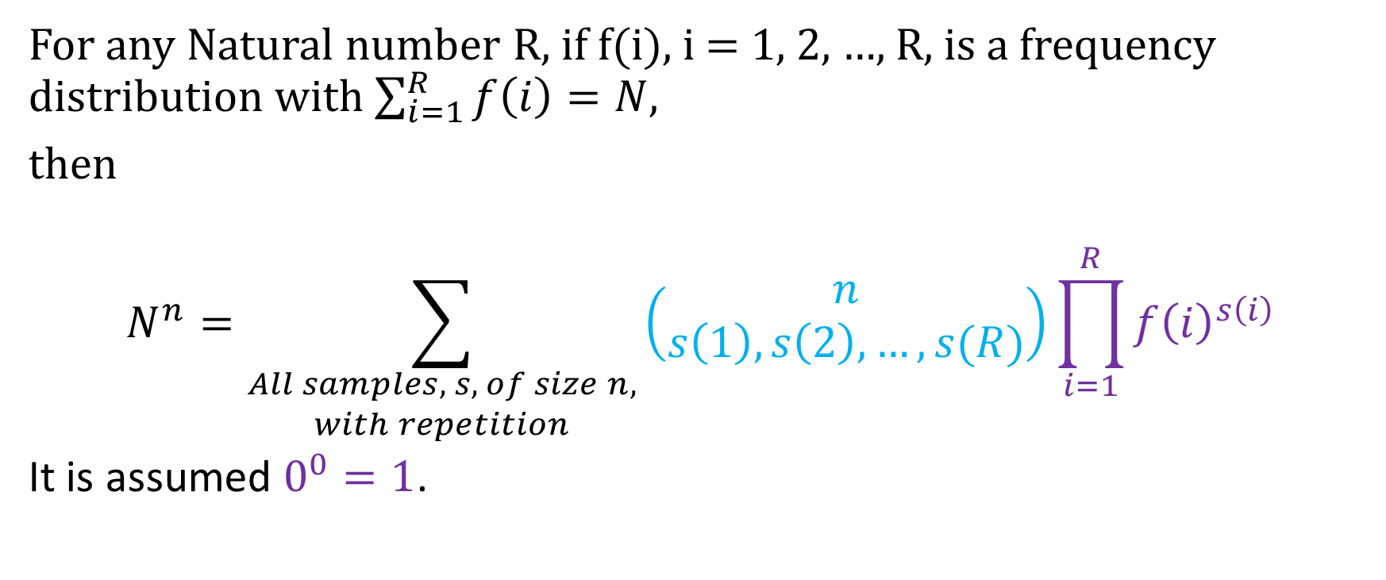
Recreational Exponentiation Theorem
For any Natural number R, if f(i), i = 1, 2, …, R, is a frequency distribution with $\sum_{i=1}^{R}{f\left(i\right)=N}$,
then
$$N^{n}=\sum_{\begin{aligned}All samples, s, of size n, \\ with repetition\end{aligned}}{\left(\begin{aligned}n \\ s\left(1\right), s\left(2\right), …, s(R)\end{aligned}\right)\prod_{i=1}^{R}{{f\left(i\right)}^{s\left(i\right)}}}$$
It is assumed $0^{0}=1$.

Slide 3
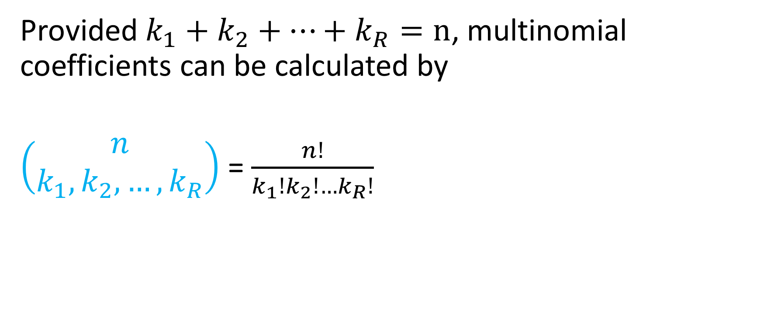
Multinomial Coefficients
Provided $k_{1}+k_{2}+…+k_{R}=n$, multinomial coefficients can be calculated by
$\left(\begin{aligned}n \\ k_{1},k_{2},…,k_{R}\end{aligned}\right)$ = $\frac{n!}{k_{1}!k_{2}!…k_{R}!}$

Slide 4

Example: $5^{3}$
Let R = 4, and f = (1, 2, 1, 1).
The first step is to list all distributions for samples of size 3.
The “Combinatorics Tree” starts with (3, 0, 0, 0) and ends with (0, 0, 0, 3).

Slide 5
Combinatorics Tree
(3, 0, 0, 0)
(2, 1, 0, 0)
(1, 2, 0, 0) (2, 0, 1, 0)
(0, 3, 0, 0) (1, 1, 1, 0) (2, 0, 0, 1)
(0, 2, 1, 0) (1, 0, 2, 0) (1, 1, 0, 1)
(0, 1, 2, 0) (0, 2, 0, 1) (1, 0, 1, 1)
(0, 0, 3, 0) (0, 1, 1, 1) (1, 0, 0, 2)
(0, 0, 2, 1) (0, 1, 0, 2)
(0, 0, 1, 2)
(0, 0, 0, 3)

Slide 6
The “one bumps”
(3, 0, 0, 0)
(2, 1, 0, 0)
(1, 2, 0, 0)
(0, 3, 0, 0)

Slide 7

The “two bumps”
(3, 0, 0, 0)
(2, 1, 0, 0)
(1, 2, 0, 0) (2, 0, 1, 0)
(0, 3, 0, 0) (1, 1, 1, 0)
(0, 2, 1, 0) (1, 0, 2, 0)
(0, 1, 2, 0)
(0, 0, 3, 0)

Slide 8


The “three bumps”
(3, 0, 0, 0)
(2, 1, 0, 0)
(1, 2, 0, 0) (2, 0, 1, 0)
(0, 3, 0, 0) (1, 1, 1, 0) (2, 0, 0, 1)
(0, 2, 1, 0) (1, 0, 2, 0) (1, 1, 0, 1)
(0, 1, 2, 0) (0, 2, 0, 1) (1, 0, 1, 1)
(0, 0, 3, 0) (0, 1, 1, 1) (1, 0, 0, 2)
(0, 0, 2, 1) (0, 1, 0, 2)
(0, 0, 1, 2)
(0, 0, 0, 3)

Slide 9
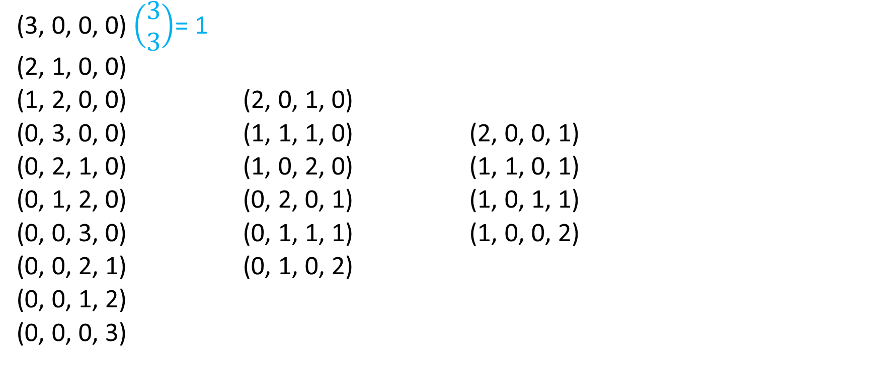

Coefficients:$\left(\begin{aligned}n \\ s\left(1\right), s\left(2\right), …, s(R)\end{aligned}\right)$
(3, 0, 0, 0) $\left(\begin{aligned}3 \\ 3\end{aligned}\right)$= 1
(2, 1, 0, 0)
(1, 2, 0, 0) (2, 0, 1, 0)
(0, 3, 0, 0) (1, 1, 1, 0) (2, 0, 0, 1)
(0, 2, 1, 0) (1, 0, 2, 0) (1, 1, 0, 1)
(0, 1, 2, 0) (0, 2, 0, 1) (1, 0, 1, 1)
(0, 0, 3, 0) (0, 1, 1, 1) (1, 0, 0, 2)
(0, 0, 2, 1) (0, 1, 0, 2)
(0, 0, 1, 2)
(0, 0, 0, 3)

Slide 10
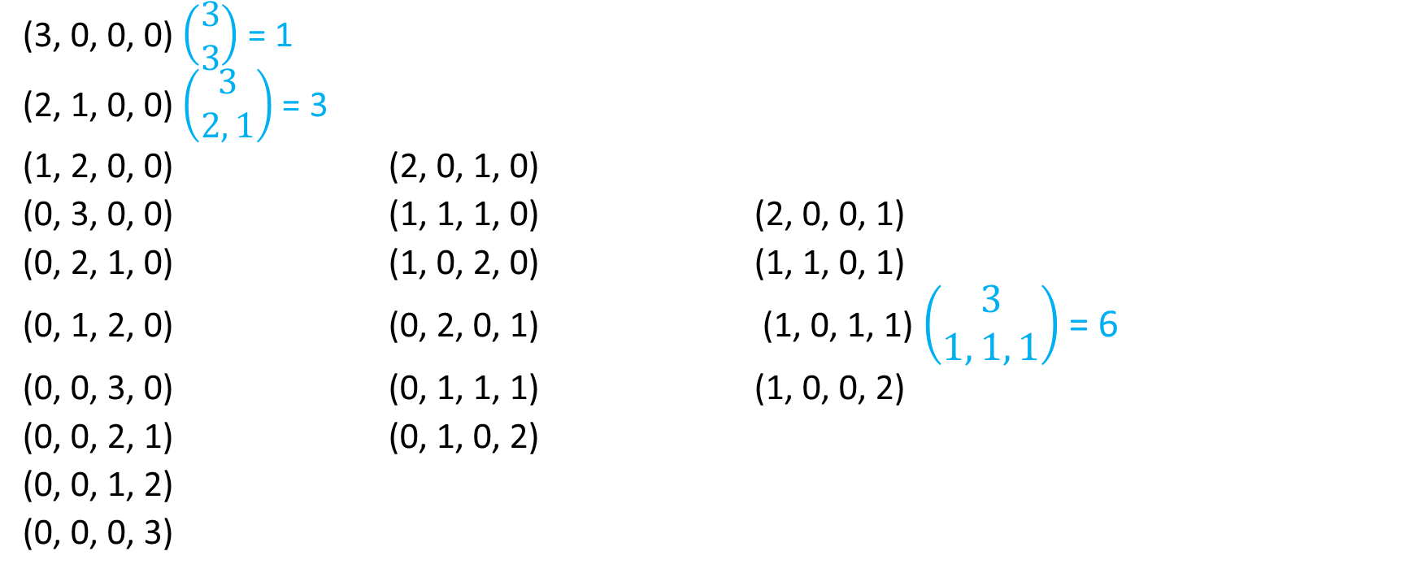
Coefficients:$\left(\begin{aligned}n \\ s\left(1\right), s\left(2\right), …, s(R)\end{aligned}\right)$
(3, 0, 0, 0) $\left(\begin{aligned}3 \\ 3\end{aligned}\right)$ = 1
(2, 1, 0, 0) $\left(\begin{aligned}3 \\ 2, 1\end{aligned}\right)$= 3
(1, 2, 0, 0) (2, 0, 1, 0)
(0, 3, 0, 0) (1, 1, 1, 0) (2, 0, 0, 1)
(0, 2, 1, 0) (1, 0, 2, 0) (1, 1, 0, 1)
(0, 1, 2, 0) (0, 2, 0, 1) (1, 0, 1, 1) $\left(\begin{aligned}3 \\ 1, 1, 1\end{aligned}\right)$ = 6
(0, 0, 3, 0) (0, 1, 1, 1) (1, 0, 0, 2)
(0, 0, 2, 1) (0, 1, 0, 2)
(0, 0, 1, 2)
(0, 0, 0, 3)

Slide 11
Coefficients:$\left(\begin{aligned}n \\ s\left(1\right), s\left(2\right), …, s(R)\end{aligned}\right)$
(3, 0, 0, 0) 1
(2, 1, 0, 0) 3
(1, 2, 0, 0) 3 (2, 0, 1, 0) 3
(0, 3, 0, 0) 1 (1, 1, 1, 0) 6 (2, 0, 0, 1) 3
(0, 2, 1, 0) 3 (1, 0, 2, 0) 3 (1, 1, 0, 1) 6
(0, 1, 2, 0) 3 (0, 2, 0, 1) 3 (1, 0, 1, 1) 6
(0, 0, 3, 0) 1 (0, 1, 1, 1) 6 (1, 0, 0, 2) 3
(0, 0, 2, 1) 3 (0, 1, 0, 2) 3
(0, 0, 1, 2) 3
(0, 0, 0, 3) 1

Slide 12

Coefficients Sum to 64, $4^{3}$ not $5^{3}$
(3, 0, 0, 0) 1
(2, 1, 0, 0) 3
(1, 2, 0, 0) 3 (2, 0, 1, 0) 3
(0, 3, 0, 0) 1 (1, 1, 1, 0) 6 (2, 0, 0, 1) 3
(0, 2, 1, 0) 3 (1, 0, 2, 0) 3 (1, 1, 0, 1) 6
(0, 1, 2, 0) 3 (0, 2, 0, 1) 3 (1, 0, 1, 1) 6
(0, 0, 3, 0) 1 (0, 1, 1, 1) 6 (1, 0, 0, 2) 3
(0, 0, 2, 1) 3 (0, 1, 0, 2) 3
(0, 0, 1, 2) 3
(0, 0, 0, 3) 1

Slide 13

$$\left(\begin{aligned}n \\ s\left(1\right), s\left(2\right), …, s(R)\end{aligned}\right)\prod_{i=1}^{R}{{f\left(i\right)}^{s\left(i\right)}}$$
(3, 0, 0, 0) 1
(2, 1, 0, 0) 3(2)
(1, 2, 0, 0) 3(4) (2, 0, 1, 0) 3
(0, 3, 0, 0) 1(8) (1, 1, 1, 0) 6(2) (2, 0, 0, 1) 3
(0, 2, 1, 0) 3(4) (1, 0, 2, 0) 3 (1, 1, 0, 1) 6(2)
(0, 1, 2, 0) 3(2) (0, 2, 0, 1) 3(4) (1, 0, 1, 1) 6
(0, 0, 3, 0) 1 (0, 1, 1, 1) 6(2) (1, 0, 0, 2) 3
(0, 0, 2, 1) 3 (0, 1, 0, 2) 3(2)
(0, 0, 1, 2) 3
(0, 0, 0, 3) 1

Slide 14
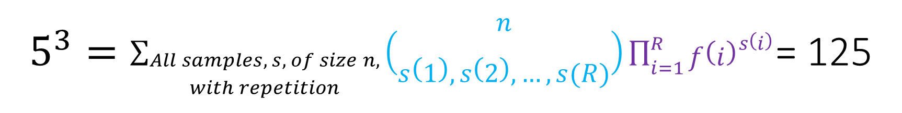
$5^{3}=\sum_{\begin{aligned}All samples, s, of size n, \\ with repetition\end{aligned}}{\left(\begin{aligned}n \\ s\left(1\right), s\left(2\right), …, s(R)\end{aligned}\right)\prod_{i=1}^{R}{{f\left(i\right)}^{s\left(i\right)}}}$= 125
(3, 0, 0, 0) 1
(2, 1, 0, 0) 6
(1, 2, 0, 0) 12 (2, 0, 1, 0) 3
(0, 3, 0, 0) 8 (1, 1, 1, 0) 12 (2, 0, 0, 1) 3
(0, 2, 1, 0) 12 (1, 0, 2, 0) 3 (1, 1, 0, 1) 12
(0, 1, 2, 0) 6 (0, 2, 0, 1) 12 (1, 0, 1, 1) 6
(0, 0, 3, 0) 1 (0, 1, 1, 1) 12 (1, 0, 0, 2) 3
(0, 0, 2, 1) 3 (0, 1, 0, 2) 6
(0, 0, 1, 2) 3
(0, 0, 0, 3) 1

Slide 15

Example: $3^{5}$
Let R = 4, and f = (1, 0, 1, 1).
The first step is to list all distributions for samples of size 5.
The “Combinatorics Tree” starts with (5, 0, 0, 0) and ends with (0, 0, 0, 5).

Slide 16
Combinatorics Tree
(5, 0, 0, 0)
(4, 0, 1, 0)
(3, 0, 2, 0) (4, 0, 0, 1)
(2, 0, 3, 0) (3, 0, 1, 1)
(1, 0, 4, 0) (2, 0, 2, 1) (3, 0, 0, 2)
(0, 0, 5, 0) (1, 0, 3, 1) (2, 0, 1, 2)
(0, 0, 4, 1) (1, 0, 2, 2) (2, 0, 0, 3)
(0, 0, 3, 2) (1, 0, 1, 3)
(0, 0, 2, 3) (1, 0, 0, 4)
(0, 0, 1, 4)
(0, 0, 0, 5)

Slide 17

$3^{5}$ = 243
(5, 0, 0, 0) 1
(4, 0, 1, 0) 5
(3, 0, 2, 0) 10 (4, 0, 0, 1) 5
(2, 0, 3, 0) 10 (3, 0, 1, 1) 20
(1, 0, 4, 0) 5 (2, 0, 2, 1) 30 (3, 0, 0, 2) 10
(0, 0, 5, 0) 1 (1, 0, 3, 1) 20 (2, 0, 1, 2) 30
(0, 0, 4, 1) 5 (1, 0, 2, 2) 30 (2, 0, 0, 3) 10
(0, 0, 3, 2) 10 (1, 0, 1, 3) 20
(0, 0, 2, 3) 10 (1, 0, 0, 4) 5
(0, 0, 1, 4) 5
(0, 0, 0, 5) 1

Slide 18
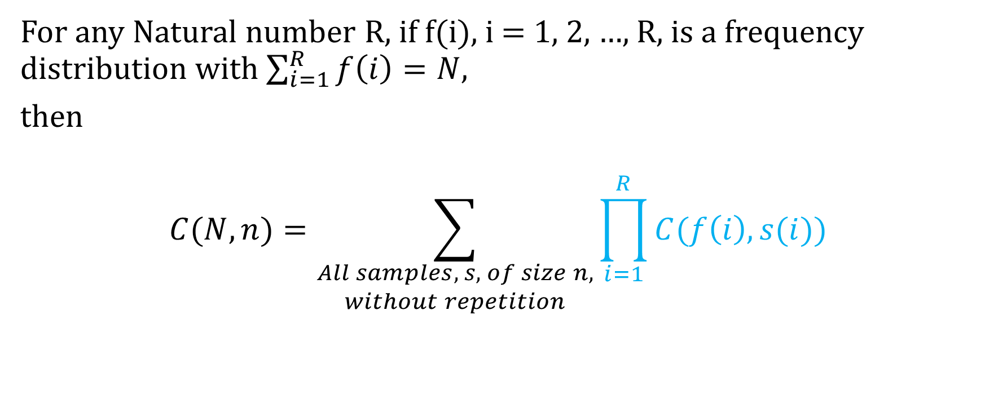
Recreational Combination Theorem
For any Natural number R, if f(i), i = 1, 2, …, R, is a frequency distribution with $\sum_{i=1}^{R}{f\left(i\right)=N}$,
then
$$C(N, n)=\sum_{\begin{aligned}All samples, s, of size n, \\ without repetition\end{aligned}}{\prod_{i=1}^{R}{C(f\left(i\right),s(i}}))$$

Slide 19

Example: $C(5, 3)$
Let R = 4, and f = (1, 2, 1, 1).
The first step is to list all distributions for samples of size 3.
The “Combinatorics Tree” starts with (1, 2, 0, 0) and ends with (0, 1, 1, 1).

Slide 20
Combinatorics Tree
(1, 2, 0, 0)
(1, 1, 1, 0)
(0, 2, 1, 0) (1, 1, 0, 1)
(0, 2, 0, 1) (1, 0, 1, 1)
(0, 1, 1, 1)

Slide 21

Coefficients:$\prod_{i=1}^{R}{C(f\left(i\right),s\left(i\right))}$
(1, 2, 0, 0) C(1, 1) C(2, 2) C(1, 0) C(1, 0) = 1
(1, 1, 1, 0) C(1, 1) C(2, 1) C(1, 1) C(1, 0) = 2
(0, 2, 1, 0) C(2, 2) C(1, 1) = 1 (1, 1, 0, 1) C(1, 1) C(2, 1) C(1, 1) = 2
(0, 2, 0, 1) C(2, 2) C(1, 1) = 1 (1, 0, 1, 1) C(1, 1) C(1, 1) C(1, 1) = 1
(0, 1, 1, 1) C(2, 1) C(1, 1) C(1, 1) = 2
They sum to 10 = C(5,3).

Slide 22

Example: $C(6, 3)$
Let R = 2, and f = (2, 4).
The first step is to list all distributions for samples of size 3.
The “Combinatorics Tree” starts with (2, 1) and ends with
(0, 3).

Slide 23
Combinatorics Tree
(2, 1)
(1, 2)
(0, 3)

Slide 24
Coefficients
(2, 1) C(2, 2) C(4, 1) = 4
(1, 2) C(2, 1) C(4, 2) = 12
(0, 3) C(2, 0) C(4, 3) = 4
They sum to 20 = C(6, 3)

Slide 26
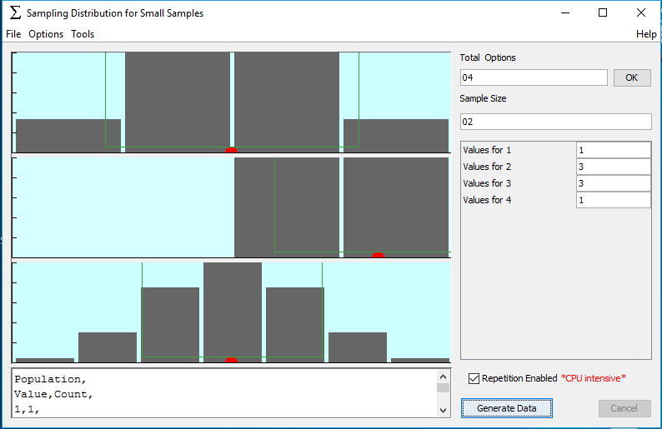

Slide 28
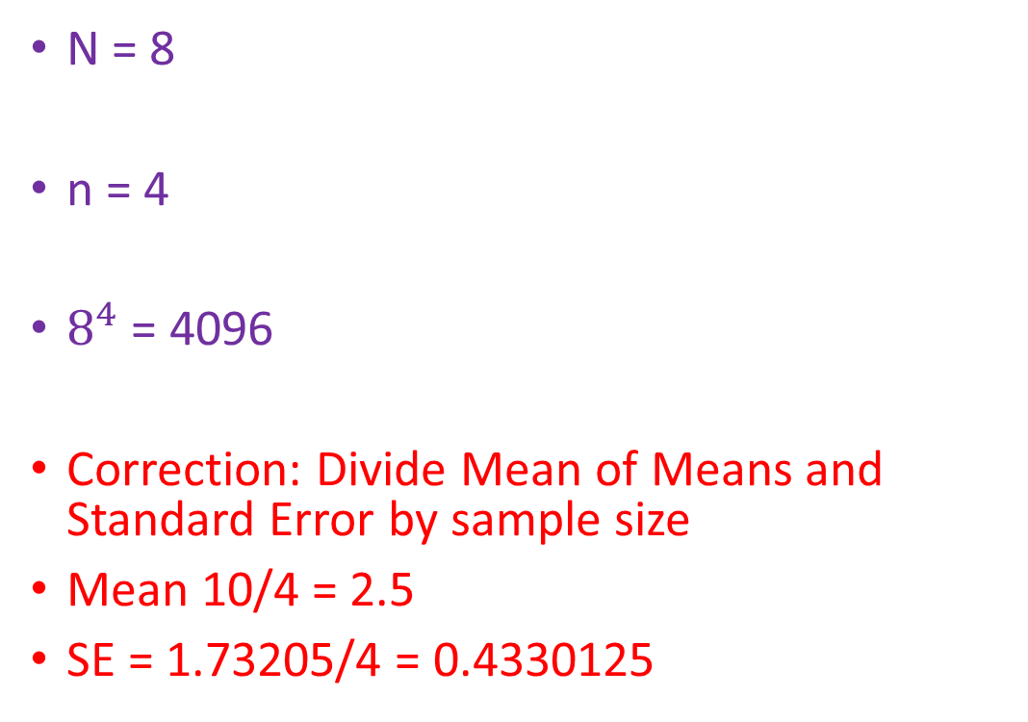
Left Clicks on Distributions
N = 8
n = 4
$8^{4}$ = 4096
Correction: Divide Mean of Means and Standard Error by sample size
Mean 10/4 = 2.5
SE = 1.73205/4 = 0.4330125

Slide 29
S
σ
s
SE
Mean

Slide 30
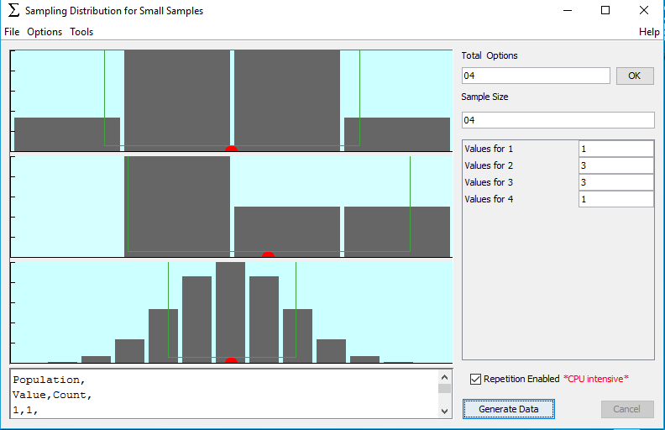
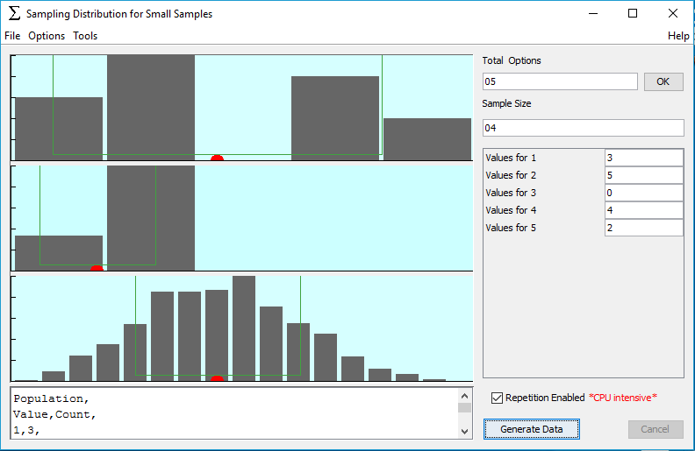

Slide 31
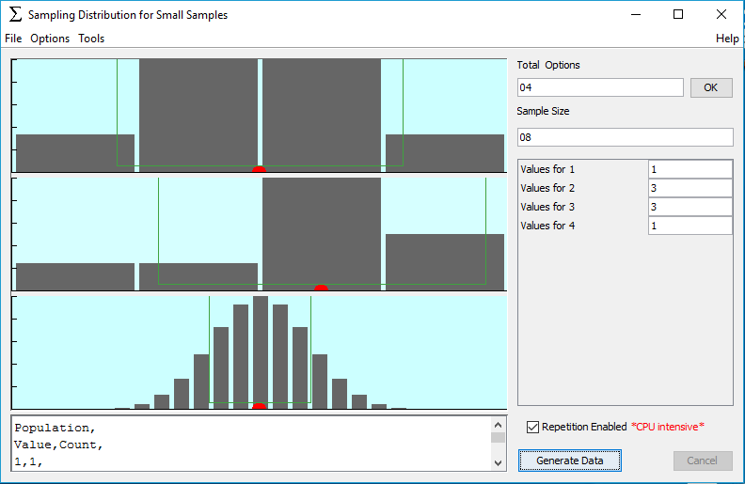

Slide 32
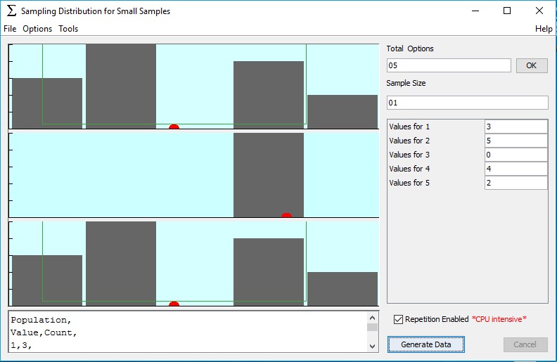

Slide 33
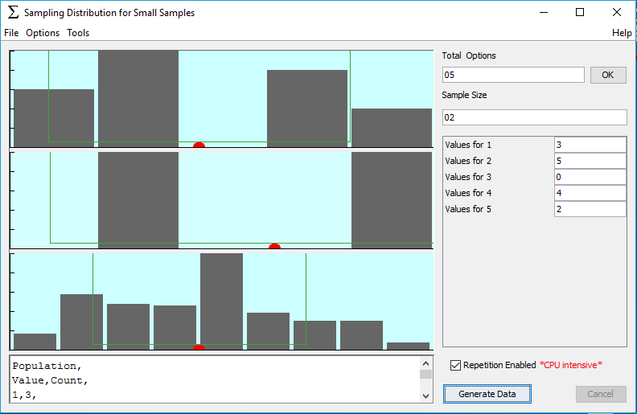

Slide 35
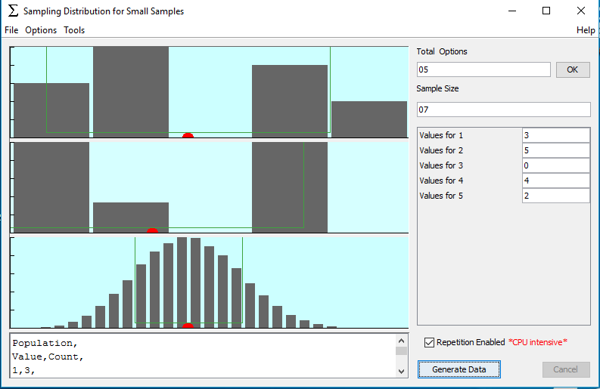

Slide 38
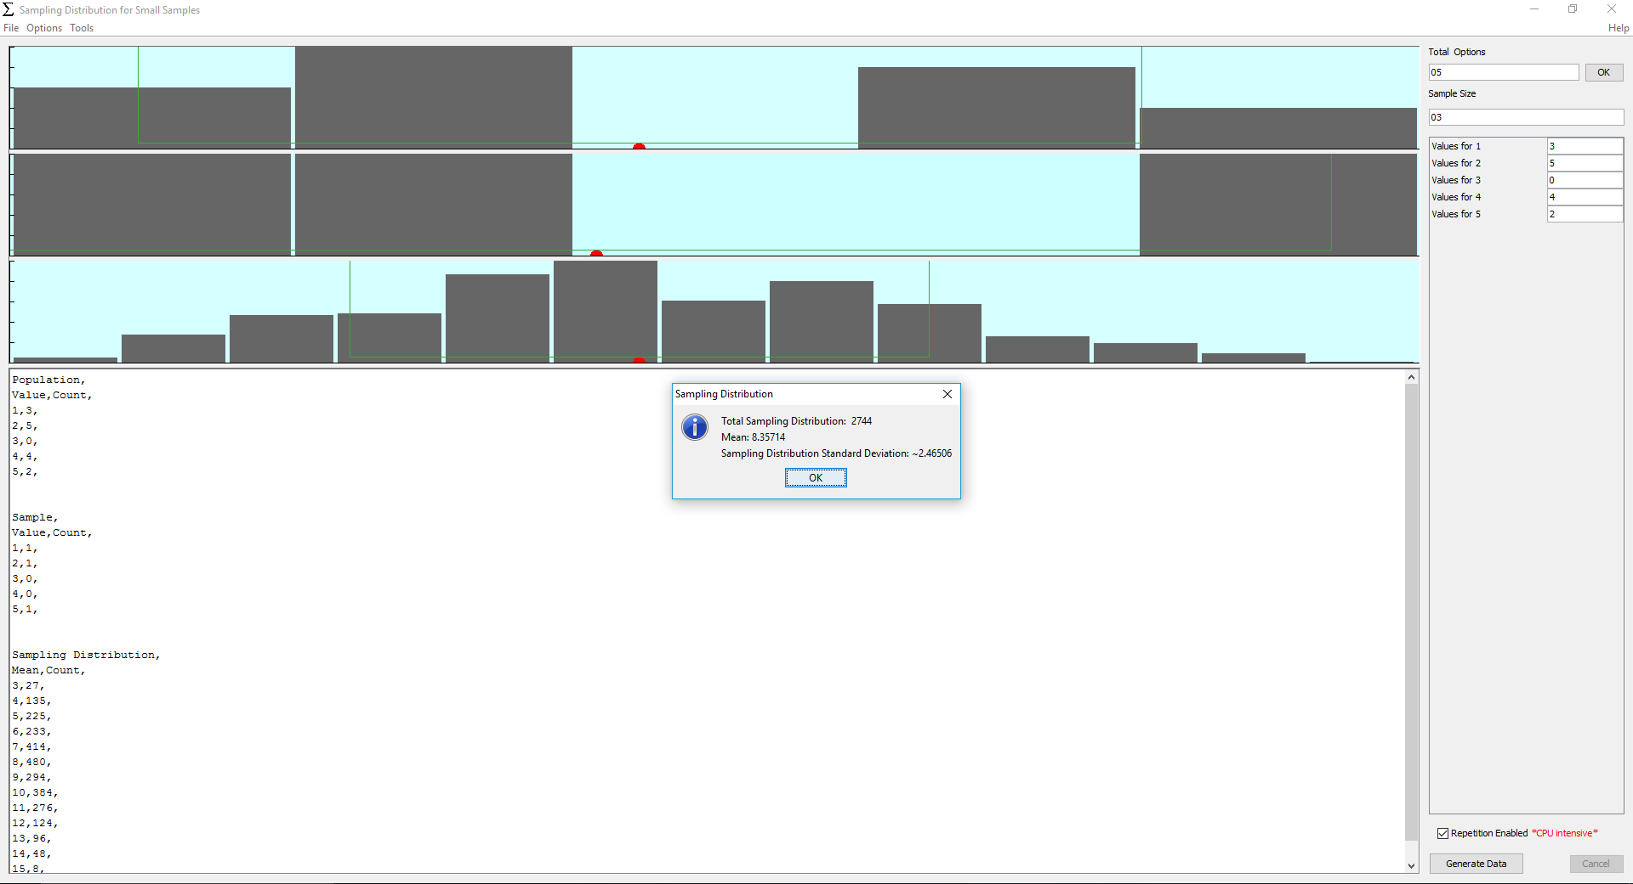

Slide 39
Pascal’s Triangle
Level 0 1
Level 1 1 1
Level 2 1 2 1
Level 3 1 3 3 1
Level 4 1 4 6 4 1
Level 5 1 5 10 10 5 1

Slide 40

Level 4 of Pascal’s Triangle
1 4 6 4 1
${(a+b)}^{4}$ = 1$a^{4}+$4$a^{3}b+$6$a^{2}b^{2}+$4${ab}^{3}+\text{1}b^{4}$
$a$ = 10, $b$ = 1
${11}^{4}$ = 14,641

Slide 41

Level 5 of Pascal’s Triangle
1 5 10 10 5 1
Double digits
01 05 10 10 05 01
$a$ = 100, $b$ = 1
${101}^{5}$ = 10,510,100,501

Slide 42

Level 5 of Pascal’s Triangle
1 5 10 10 5 1
Triple digits
001 005 010 010 005 001
$a$ = 1000, $b$ = 1
${1001}^{5}$ = 1,005,010,010,005,001

Slide 43

Binomial Coefficients
$\left(\begin{aligned}n \\ k\end{aligned}\right)$ = $\frac{n!}{k!\left(n−k\right)!}$
$\left(\begin{aligned}n \\ k\end{aligned}\right)$ = $\left(\begin{aligned}n−1 \\ k−1\end{aligned}\right)$+ $\left(\begin{aligned}n−1 \\ k\end{aligned}\right)$

Slide 44
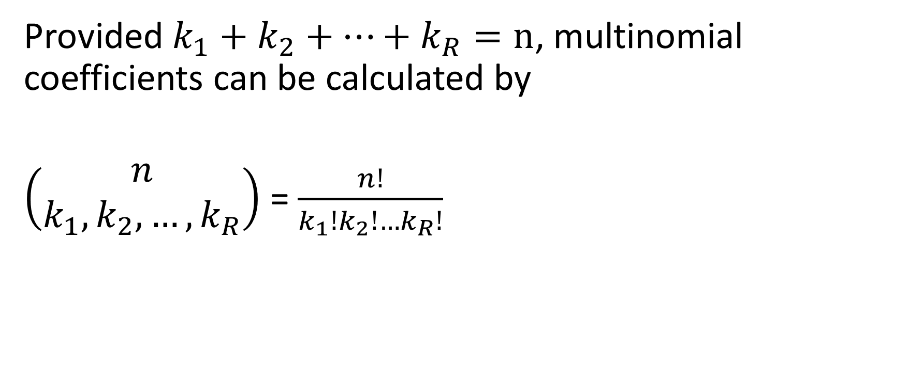
Multinomial Coefficients
Provided $k_{1}+k_{2}+…+k_{R}=n$, multinomial coefficients can be calculated by
$\left(\begin{aligned}n \\ k_{1},k_{2},…,k_{R}\end{aligned}\right)$ = $\frac{n!}{k_{1}!k_{2}!…k_{R}!}$

Slide 45
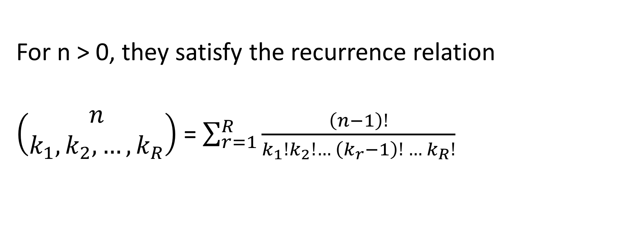
Multinomial Coefficients
For n > 0, they satisfy the recurrence relation
$\left(\begin{aligned}n \\ k_{1},k_{2},…,k_{R}\end{aligned}\right)$ = $\sum_{r=1}^{R}{\frac{\left(n−1\right)!}{k_{1}!k_{2}!… \left(k_{r}−1\right)! … k_{R}!}}$

Slide 46
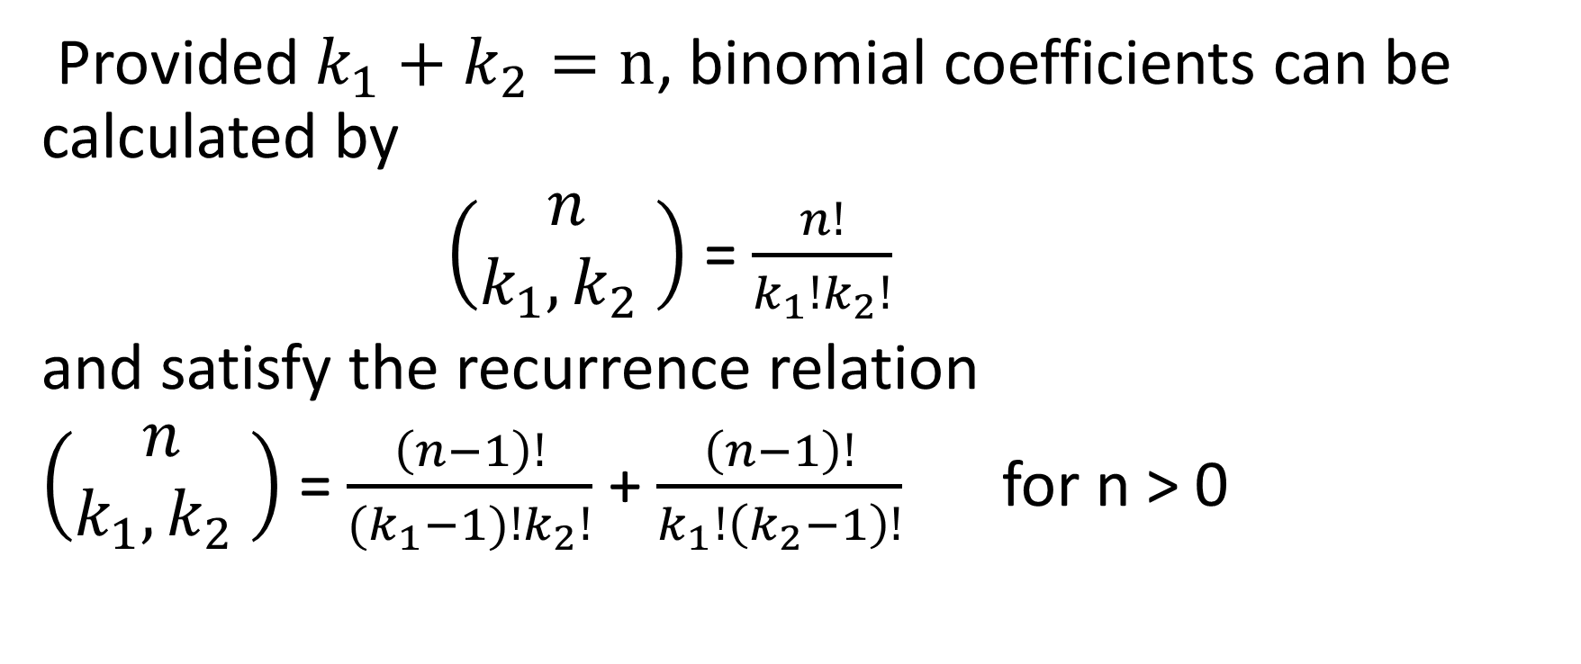
Binomial Coefficients
Provided $k_{1}+k_{2}=n$, binomial coefficients can be calculated by
$\left(\begin{aligned}n \\ k_{1},k_{2} \end{aligned}\right)$ = $\frac{n!}{k_{1}!k_{2}!}$
and satisfy the recurrence relation
$\left(\begin{aligned}n \\ k_{1},k_{2} \end{aligned}\right)$ = $\frac{\left(n−1\right)!}{{(k}_{1}−1)!k_{2}!}$ + $\frac{\left(n−1\right)!}{k_{1}!\left(k_{2}−1\right)!}$ for n > 0

Slide 47
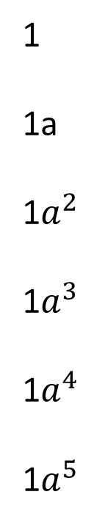
Pascal’s Ray
Level 0
Level 1
Level 2
Level 3
Level 4
Level 5
1
1a
1$a^{2}$
1$a^{3}$
1$a^{4}$
1$a^{5}$

Slide 48

Level 4 of Pascal’s Ray
1
${(a)}^{4}$ = $a^{4}$
$a$ = 1
$1^{4}$ = 1

Slide 49
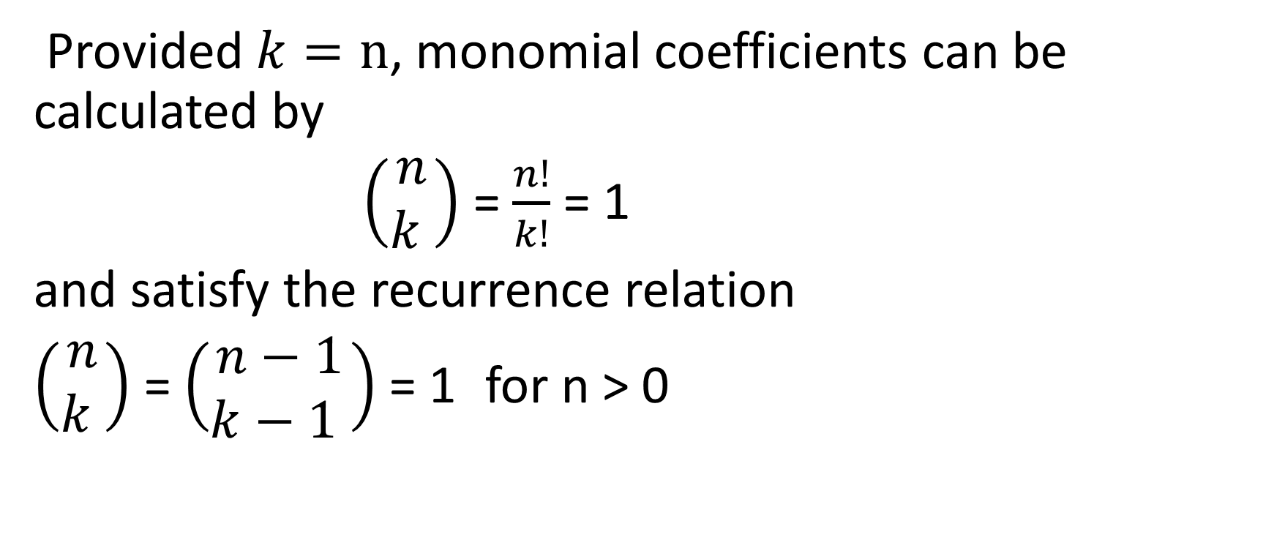
Monomial Coefficients
Provided $k=n$, monomial coefficients can be calculated by
$\left(\begin{aligned}n \\ k \end{aligned}\right)$ = $\frac{n!}{k!}$ = 1
and satisfy the recurrence relation
$\left(\begin{aligned}n \\ k \end{aligned}\right)$ = $\left(\begin{aligned}n−1 \\ k−1 \end{aligned}\right)$ = 1 for n > 0

Slide 50

Pascal’s Point
1
level 0
“It is assumed $0^{0}=1$.”

Slide 51


Pascal’s Pyramid
level 0 1
1$c$
level 1 1$a$
1b
level 2 1$a^{2}$ 1$c^{2}$
$2ab$ $2bc$
1$c^{3}$
level 3 1$a^{3}$ 3${bc}^{2}$
3$a^{2}b$
3${ab}^{2}$ 3$b^{2}c$
1$b^{3}$
1$b^{2}$

Slide 52

Level 2 of Pascal’s Pyramid
1$a^{2}$ 2$ac$ 1$c^{2}$
2$ab$ 2$bc$
1$b^{2}$

Slide 53

$${(a+b+c)}^{2}= \\ a^{2}+b^{2}+c^{2}+2(ab+ac+bc)$$
1$a^{2}$ 2$ac$ 1$c^{2}$
2$ab$ 2$bc$
1$b^{2}$

Slide 54

$${(111)}^{2}=12,321$$
a = 100
b = 10
c = 1
1$a^{2}$ 2$ac$ 1$c^{2}$
2$ab$ 2$bc$
1$b^{2}$
+ (coefficients)
1 2 3 2 1

Slide 55









Levels 2 & 3 of Pascal’s Pyramid
1$a^{3}$
3$a^{2}c$
3${ac}^{2}$
1$c^{3}$
1$a^{2}$ 2$ac$ 1$c^{2}$
2$ab$ 2$bc$
1$b^{2}$
$${3a}^{2}b$$
6
$${3bc}^{2}$$
$${3ab}^{2}$$
$${3b}^{2}c$$
1$b^{3}$

Slide 56

Level 3 of Pascal’s Pyramid
1$a^{3}$
3$a^{2}c$
3${ac}^{2}$
1$c^{3}$
$${3a}^{2}b$$
$$6abc$$
$${3bc}^{2}$$
$${3ab}^{2}$$
$${3b}^{2}c$$
1$b^{3}$

Slide 57

Level 3 of Pascal’s Pyramid
1$a^{3}$
3$a^{2}c$
3${ac}^{2}$
1$c^{3}$
$${3a}^{2}b$$
$${3bc}^{2}$$
$$6abc$$
$${3ab}^{2}$$
$${3b}^{2}c$$
1$b^{3}$

Slide 58
Level 3 of Pascal’s Pyramid
1$a^{3}$
3$a^{2}c$
3${ac}^{2}$
1$c^{3}$
12
12
$${3a}^{2}b$$
$${3bc}^{2}$$
$$6abc$$
12
$${3ab}^{2}$$
$${3b}^{2}c$$
1$b^{3}$

Slide 59









Level 4 of Pascal’s Pyramid
1
$$4$$
$$6$$
$$4$$
1
$$4$$
$$4$$
12
12
$$6$$
$$6$$
12
$$4$$
$$4$$
1

Slide 60
Level 4 of Pascal’s Pyramid
1
$$4$$
$$6$$
$$4$$
1
20
30
20
$$4$$
$$4$$
12
12
30
30
$$6$$
$$6$$
12
20
$$4$$
$$4$$
1

Slide 61












Level 5 of Pascal’s Pyramid
1
$$5$$
$$10$$
$$10$$
$$5$$
1
$$5$$
$$5$$
20
30
20
$$10$$
$$10$$
30
30
$$10$$
20
$$10$$
$$5$$
$$5$$
1

Slide 62
01 05 15 30 45 51 45 30 15 05 01
1
$$5$$
$$10$$
$$10$$
$$5$$
1
$$5$$
$$5$$
20
30
20
$$10$$
$$10$$
30
30
$$10$$
20
$$10$$
$$5$$
$$5$$
1

Slide 63
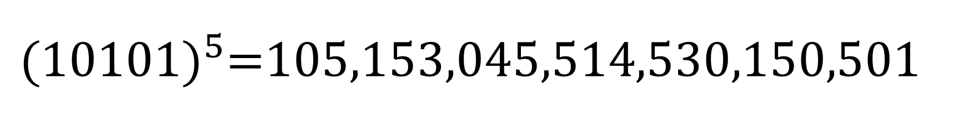
${(10101)}^{5}$=105,153,045,514,530,150,501
1
$$5$$
$$10$$
$$10$$
$$5$$
1
$$5$$
$$5$$
20
30
20
$$10$$
$$10$$
a = 10000
b = 100
c = 1
30
30
$$10$$
20
$$10$$
$$5$$
$$5$$
1

Slide 64

Trinomial Theorem Example
${(a+b+c)}^{5}$=?
5 = 5
= 4 + 1
= 3 + 2
= 3 + 1 + 1
= 2 + 2 + 1

Slide 65

Trinomial Coefficients
$\left(\begin{aligned}5 \\ 5\end{aligned}\right)$ = 1
$\left(\begin{aligned}5 \\ 3,1,1\end{aligned}\right)$ = 20
$\left(\begin{aligned}5 \\ 4,1\end{aligned}\right)$ = 5
$\left(\begin{aligned}5 \\ 2,2,1\end{aligned}\right)$ = 30
$\left(\begin{aligned}5 \\ 3,2\end{aligned}\right)$ = 10

Slide 66
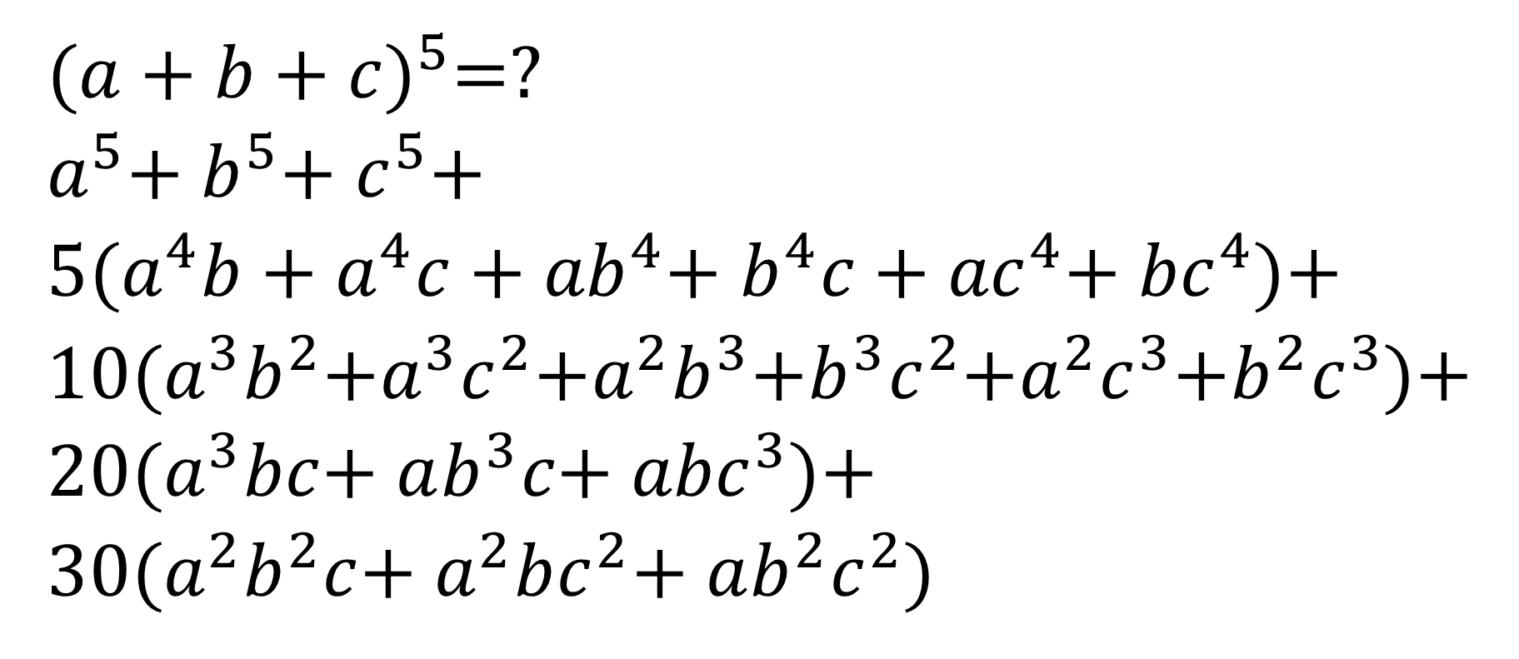
Trinomial Theorem Example
${(a+b+c)}^{5}$=?
$a^{5}$+ $b^{5}$+ $c^{5}$+
5($a^{4}b$+ $a^{4}c$+ ${ab}^{4}$+ $b^{4}c$+ ${ac}^{4}$+ ${bc}^{4}$)+
10($a^{3}b^{2}$+$a^{3}c^{2}$+$a^{2}b^{3}$+$b^{3}c^{2}$+$a^{2}c^{3}$+$b^{2}c^{3}$)+
20($a^{3}bc$+ $ab^{3}c$+ ${abc}^{3}$)+
30($a^{2}b^{2}c$+ $a^{2}bc^{2}$+ $ab^{2}c^{2})$

Slide 67

Multinomial Theorem Example
${(a+b+c+d)}^{3}$=?
3 = 3 $\left(\begin{aligned}3 \\ 3\end{aligned}\right)$ = 1
= 2 + 1 $\left(\begin{aligned}3 \\ 2, 1\end{aligned}\right)$ = 3
= 1 + 1 + 1 $\left(\begin{aligned}3 \\ 1 ,1 ,1\end{aligned}\right)$ = 6

Slide 68
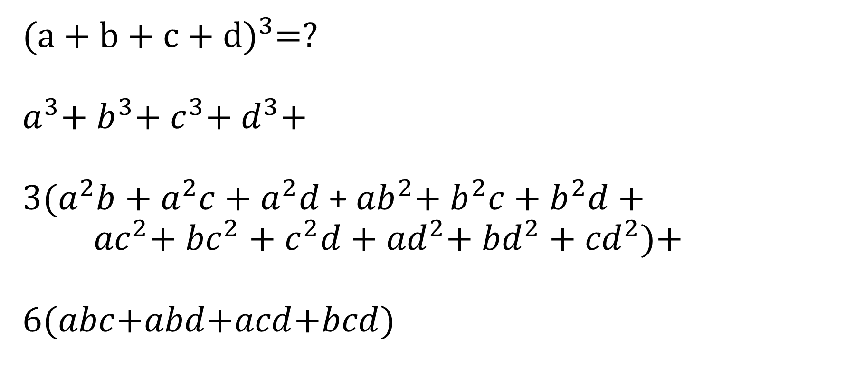
Multinomial Theorem Example
${(a+b+c+d)}^{3}$=?
$a^{3}$+ $b^{3}$+ $c^{3}$+ $d^{3}$+
3($a^{2}b$+ $a^{2}c$+ $a^{2}d$ + ${ab}^{2}$+ $b^{2}c$+ $b^{2}d$ +
${ac}^{2}$+ ${bc}^{2}$ + $c^{2}d$ + ${ad}^{2}$+ ${bd}^{2}$ + ${cd}^{2}$)+
6($abc$+$abd$+$acd$+$bcd$)

Slide 69
0th Level of the 4th Dimensional Hyper-Pascal’s Pyramid
1

Slide 70
0th & 1st Level
1a
1d
1
1b 1c

Slide 71
1st Level
1a
1d
1b 1c

Slide 72

1st & 2nd Level
1$a^{2}$ 2ad
2ab
2ac 2bd
2bc
1$b^{2}$ 1$c^{2}$
2cd
1$d^{2}$

Slide 73

2nd Level of the 4th Dimensional Hyper-Pascal’s Pyramid
1$a^{2}$ 2ad
2ab
2ac 2bd
2bc
1$b^{2}$ 1$c^{2}$
2cd
1$d^{2}$

Slide 74


${(1111)}^{2}$ = 1,234,321
1$a^{2}$ 2ad
2ab
2ac 2bd
2bc
1$b^{2}$ 1$c^{2}$
2cd
+ (coefficients) 1$d^{2}$
1 2 3 4 3 2 1

Slide 75
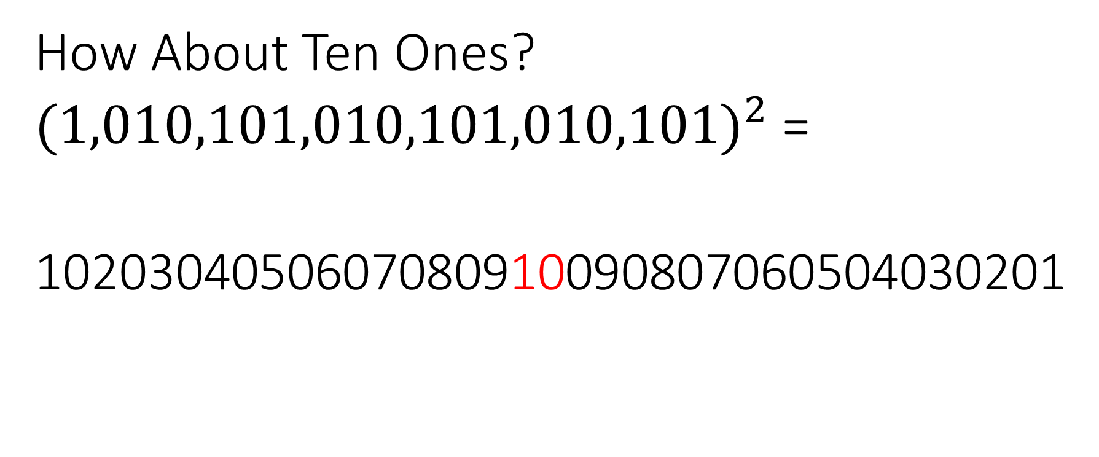
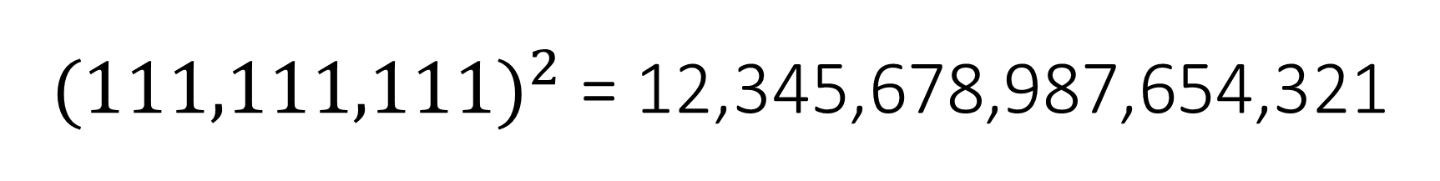
${(111,111,111)}^{2}$ = 12,345,678,987,654,321
How About Ten Ones?
${(1,010,101,010,101,010,101)}^{2}$ =
1020304050607080910090807060504030201

Slide 76
Third Level of the 4th Dimensional Hyper-Pascal’s Pyramid
(3,0,0,0) (2,1,0,0) (1,2,0,0) (0,3,0,0) (0,2,1,0) (0,1,2,0) (0,0,3,0) (0,0,2,1) (0,0,1,2) (0,0,0,3)
(2,0,1,0) (1,1,1,0) (1,0,2,0) (0,2,0,1) (0,1,1,1) (0,1,0,2)
(2,0,0,1) (1,1,0,1) (1,0,1,1) (1,0,0,2)

Slide 77
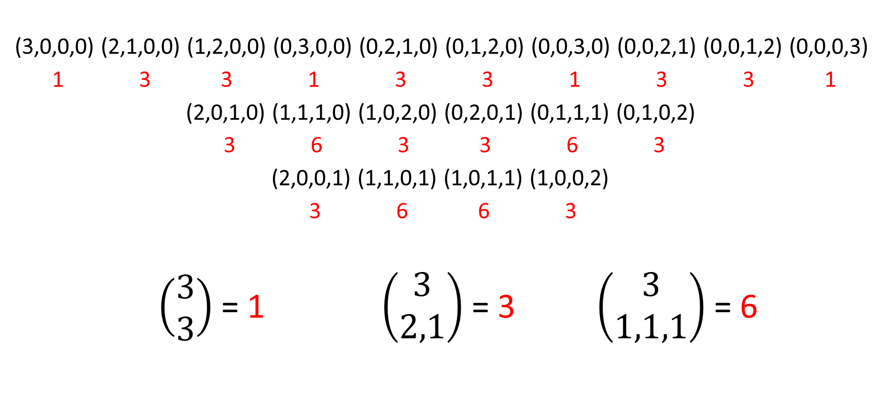
Multinomial Coefficients
(3,0,0,0) (2,1,0,0) (1,2,0,0) (0,3,0,0) (0,2,1,0) (0,1,2,0) (0,0,3,0) (0,0,2,1) (0,0,1,2) (0,0,0,3)
1 3 3 1 3 3 1 3 3 1
(2,0,1,0) (1,1,1,0) (1,0,2,0) (0,2,0,1) (0,1,1,1) (0,1,0,2)
3 6 3 3 6 3
(2,0,0,1) (1,1,0,1) (1,0,1,1) (1,0,0,2)
3 6 6 3
$\left(\begin{aligned}3 \\ 3\end{aligned}\right)$ = 1 $\left(\begin{aligned}3 \\ 2,1\end{aligned}\right)$ = 3 $\left(\begin{aligned}3 \\ 1,1,1\end{aligned}\right)$ = 6

Slide 78
Third Level of the 4th Dimensional Hyper-Pascal’s Pyramid
(3,0,0,0) (2,1,0,0) (1,2,0,0) (0,3,0,0) (0,2,1,0) (0,1,2,0) (0,0,3,0) (0,0,2,1) (0,0,1,2) (0,0,0,3)
1 3 3 1 3 3 1 3 3 1
(2,0,1,0) (1,1,1,0) (1,0,2,0) (0,2,0,1) (0,1,1,1) (0,1,0,2)
3 6 3 3 6 3
(2,0,0,1) (1,1,0,1) (1,0,1,1) (1,0,0,2)
+ 3 6 6 3 (double digit)
01 03 06 10 12 12 10 06 03 01

Slide 79
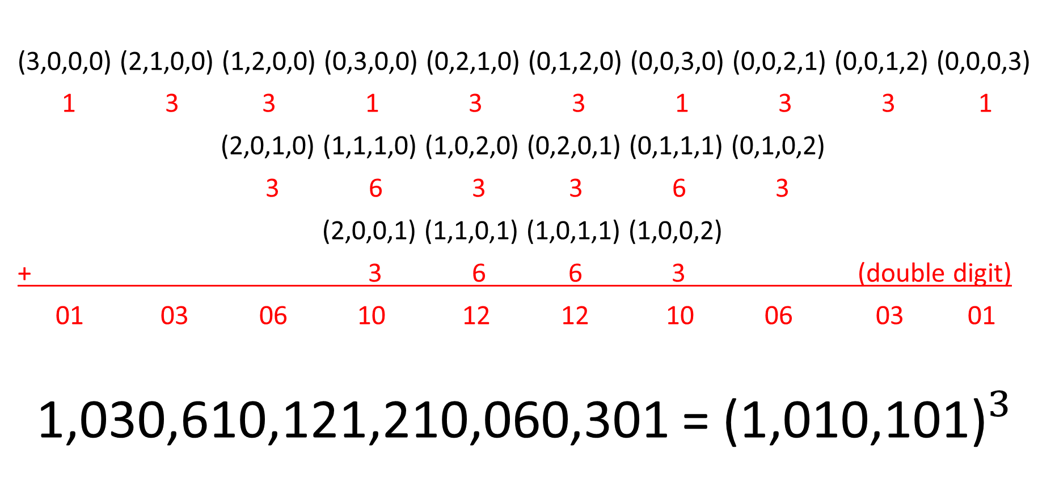
Third Level of the 4th Dimensional Hyper-Pascal’s Pyramid
(3,0,0,0) (2,1,0,0) (1,2,0,0) (0,3,0,0) (0,2,1,0) (0,1,2,0) (0,0,3,0) (0,0,2,1) (0,0,1,2) (0,0,0,3)
1 3 3 1 3 3 1 3 3 1
(2,0,1,0) (1,1,1,0) (1,0,2,0) (0,2,0,1) (0,1,1,1) (0,1,0,2)
3 6 3 3 6 3
(2,0,0,1) (1,1,0,1) (1,0,1,1) (1,0,0,2)
+ 3 6 6 3 (double digit)
01 03 06 10 12 12 10 06 03 01
1,030,610,121,210,060,301 = ${\text{(1}\text{,}\text{010}\text{,}\text{101)}}^{3}$

Slide 80
References
Paul Kinion & Dustin Haxton’s Free Copy of βeta: Sampling Distributions for Small Samples http://www.rctc.edu/academics/math/sdss.html
https://en.wikipedia.org/wiki/Pascal%27s_pyramid
https://en.wikipedia.org/wiki/Multinomial_theorem

