Slide 1
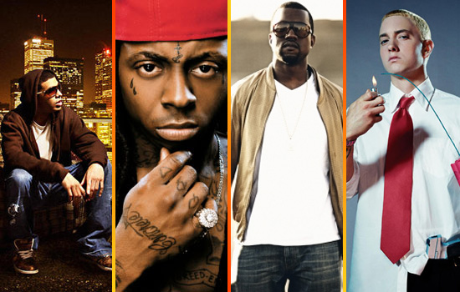
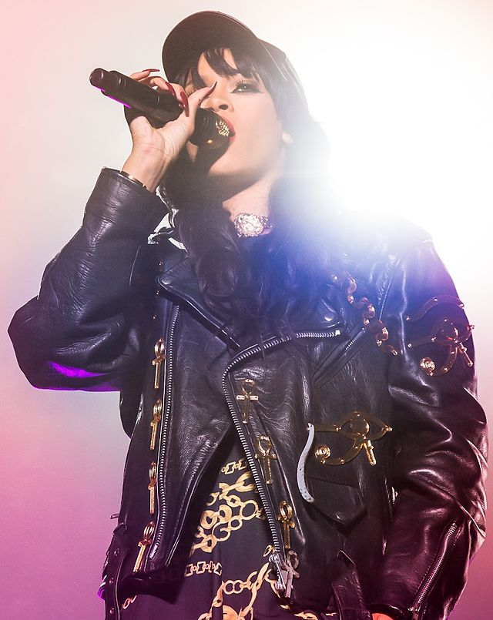
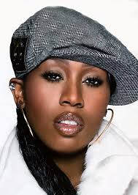
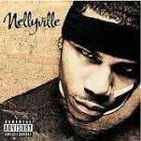
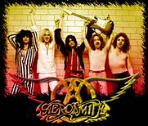
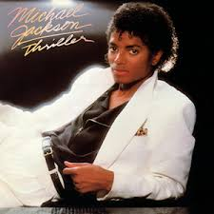
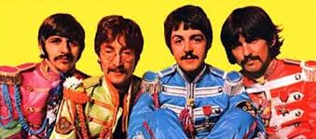
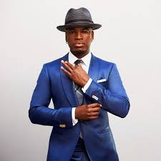
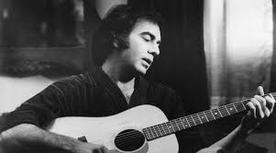
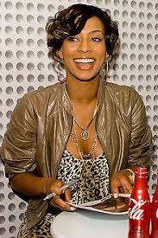
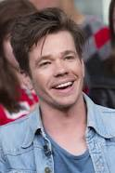
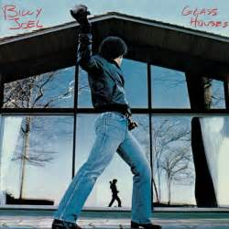
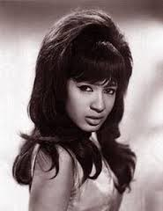
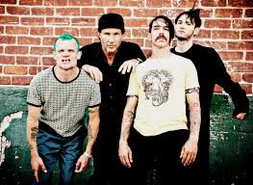

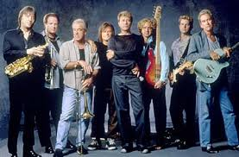
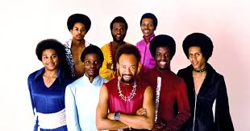
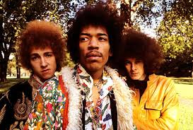

Slide 2
The Math of Rock and Pop Music
April 22, 2017
CMC³ Tahoe
Presented by Helene Nehrebecki,
Assistant Professor of Mathematics,
American River College

Slide 3
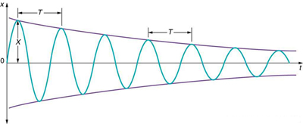
The frequency is the number of complete vibrations per second. (Middle C frequency ≈ 261.6 Hertz)
The period is the amount of time (in seconds) it takes for one complete vibration.
Period = 1/frequency. (Middle C period ≈ .0038 seconds)
The waves decrease in amplitude (height) with weaker sound, but they stay in the same frequency.

Slide 4
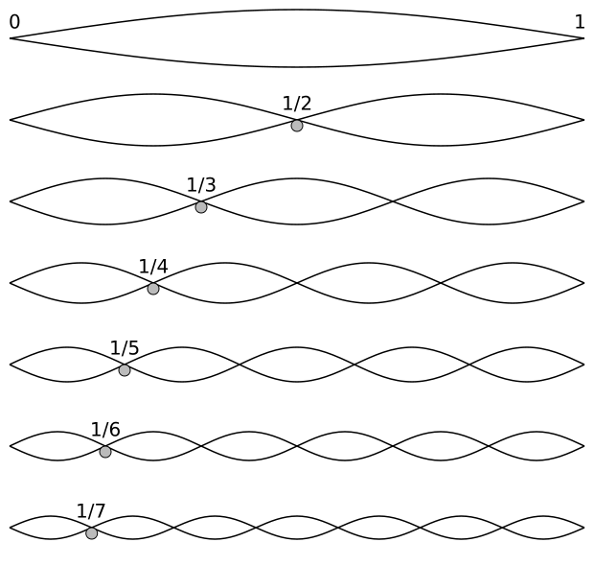
1:1 Tonic
2:1 Octave
3:2 Fifth
4:3 Fourth
5:4 Major Third
6:5 Minor Third

Slide 5
Combining Ratios
A minor third combined with a major third:
6:5 x 5:4 ➔ 6:5:4 ➔ 6:4 ➔ 3:2
The result is a fifth.
The difference between a fifth and a fourth:
3:2 ÷ 4:3 ➔ 3:2 x 3:4 ➔ 9:8
The result, 9:8, is called a whole tone.

Slide 6
International Conference in
London, 1939
It was decided that the A following Middle C would have a frequency of 440 Hertz. Then by using intervals of 2^{1/12} (the twelfth root of 2), known as well tempering, the rounded results in Hertz were determined to be…
C: | 261.6 | G: | 292.0 ≈ 261.6 x (3/2)
C#: | 277.2 | G#: | 415.3 = 440.0 ÷ (¹²√2)
D: | 293.6 ≈ 261.6 x (9/8) | A: | 440.0
D#: | 311.1 | A#: | 466.2 = 440.0 x (¹²√2)
E: | 329.6 | B: | 493.9
F: | 349.2 ≈ 261.6 x (4/3) | C’: | 523.2 = 261.6 x 2
F#: | 370.0 | C#’ | 554.4 = 277.2 x 2

Slide 7
An Octave:
Period ratio is 2:1
Example: 2 Represents .0038 (period for C)
4 Represents .0076 (period for a lower C)
A Fifth:
Period ratio is 3:2
Example: 3 Represents .0038 (period for C)
2 Represents .0025 (period for G)

Slide 8
This represents a major chord.
Assume the lowest note is Middle C (blue). Then this is C – E – G.
12 would represent 4 times .0038 = .0152.
All three tones match up after .0152 seconds.
This represents a minor chord
Assume the lowest note is Middle C (blue). Then this is C – D# – G.
Tones intersect at .0076, .0123, and .0191.
All three tones match up after .0382 seconds.

Slide 9
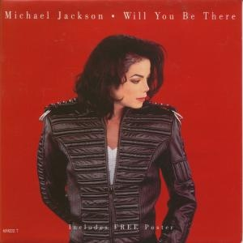
June 28, 1993
Dangerous
US Billboard Peak: #7
US Pop Songs:
#3
US Hot R&B/Hip-Hop Songs: #53

Slide 10
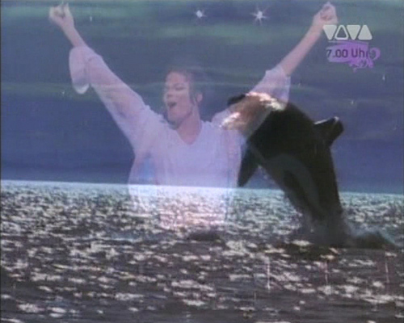
D Major
Will You Be There
Hold Me
Like The River Jordan
And I Will Then Say To Thee
You Are My Friend
D | E | F# | G | A | B | C#
1 | 2 | 3 | 4 | 5 | 6 | 7
1
2 | 1 | 2 | 3
4 | 3 | 4 | 5
6 | 5 | 4 | 3 | 2 | 1

Slide 11

Honesty
May 1979
52nd Street
US Billboard Hot 100
#24
France
(French Single)
#1

Slide 12
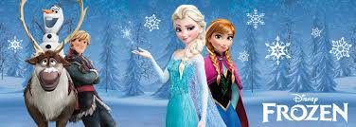
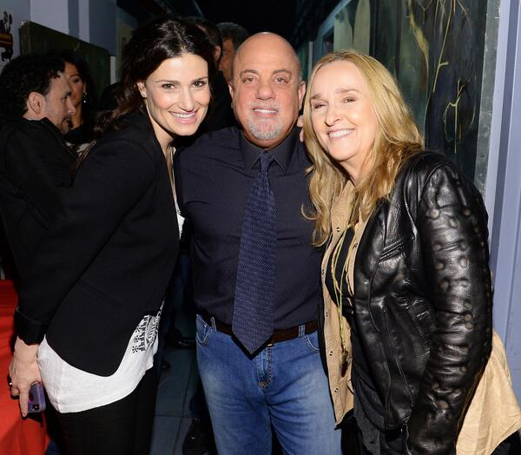
Billy Joel’s original version is played in the key of B_{b}
Idina Menzel’s
live cover version is played in the key of D

Slide 13
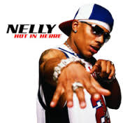
Hot In Herre
By Nelly
April 16, 2002
Nellyville
US Billboard Peak
#1
US Billboard (2000-2009)
#32

Slide 14
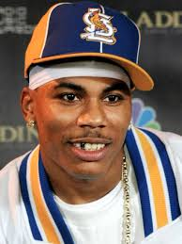
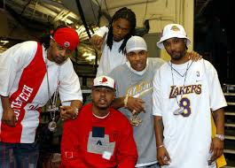
E E - G - B 6:5 5:4 3:2
F F - A - C 5:4 6:5 3:2
G G - B - D 5:4 6:5 3:2
F# F# - A# - C# 5:4 6:5 3:2

Slide 15
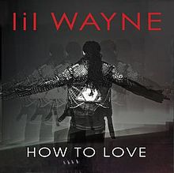
May 26, 2011
Tha Carter IV
US Billboard Peak:
#5
US Rhythmic Peak:
#1
US Hot Rap Songs
#2

Slide 16
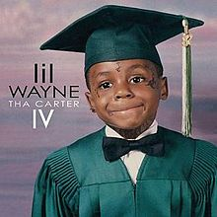
“How To Love”
You had a lot of crooks tryna steal your heart
Never really had luck, couldn't ever figure out
How to love
How to love
You had a lot of moments that didn't last forever
Now you're in a corner tryna put it together
How to love
How to love
For a second you were here now you over there
It’s hard not to stare, the way you moving your body
Like you never had a love
Never had a love
1
2
3

Slide 17
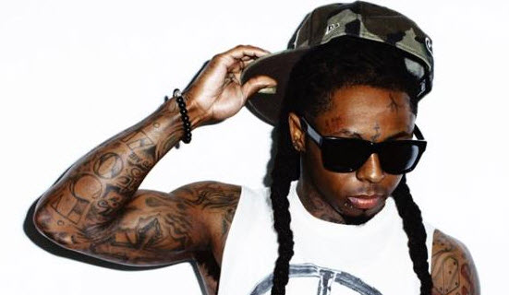
B D# - F# - B 6:5 4:3 8:5
B D# - F# - A# 6:5 5:4 3:2
E B - E - G# 4:3 5:4 5:3
E B - E - G 4:3 6:5 8:5 E E - G - B 6:5 5:4 3:2

Slide 18
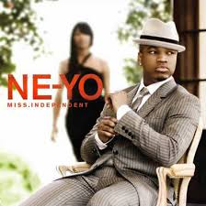
Miss
Independent
September 2, 2008
Year Of The Gentleman
US Billboard Peak:
#7
US Rhythmic Peak:
#3
US Hot R&B/ Hip-Hop Songs
#1

Slide 19
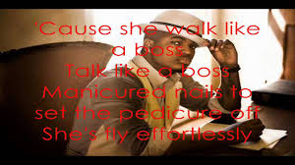
F F# - A# - C# 5:4 6:5
F F - A# - C# 6:5 6:5
F F# - A# - C# 5:4 6:5
C# G# - C - D# 5:4 6:5

Slide 20

April 7, 2009
In A Perfect World…
US Billboard Peak:
#3
US Hot R&B/Hip-Hop Songs: #1
US Rhythmic:
#1

Slide 21
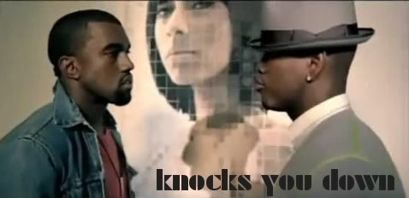
D# D# - G - A# 5:4 6:5 3:2 F F - A - C 5:4 6:5 3:2 A# F - A# - D 4:3 5:4 5:3
D# D# - G - A#
F F - A - C
G G - A# - D 6:5 5:4 3:2

Slide 22
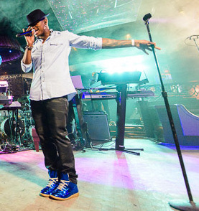
Ne-Yo’s Lyrics
Hey 'til now I'm crashing
I don't know how it happened
But I know it feels so damn good
Said if I could go back, and
make it happen faster
Don't you know I would baby if I could
Miss independent, oh, to the fullest
the load never to much, she helping me pull it
She shot the bullet
that ended that life
I swear to you the pimp in me just died tonight

Slide 23

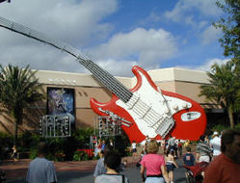
What It Takes
By Aerosmith
December 19, 1989
Pump
Billboard Hot 100
#9

Slide 24
There goes my old girlfriend, there’s another diamond ring
And, uh, all those late night promises I guess they don’t mean a thing
So baby what’s the story, did you find another man
Is it easy to sleep in the bed that we made
When you don’t look back I guess the feelings start to fade away
I used to feel your fire, but now it’s cold inside
And you’re back on the street
Like you didn’t miss a beat yeah
Tell me what it takes to let you go
Tell me how the pain’s supposed to go
Tell me how it is that you can sleep in the night
Without thinking you lost everything that was good
In your life to the toss of the dime
Tell me what it takes to let you go

Slide 25
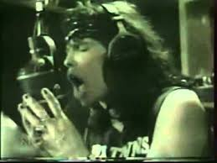
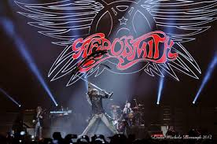
Girl before I met you I was F.I.N.E. fine
But your love made me a prisoner, yeah my heart’s been doing time
You spent me up like money, then you hung me out to dry
Is it easy to keep all your lies in disguise
Cause you had me in deep with the devil in your eyes
Tell me that you're happy, that you're on your own
Yeah yeah, yeah
Tell me that it's better when you're all alone
Tell me that your body doesn't miss my touch
Tell me that my lovin' didn't mean that much
Tell me you ain't dyin' when you're cryin' for me

Slide 26
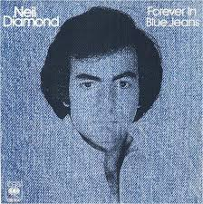
Forever In Blue Jeans
By Neil Diamond
February 1979
You Don’t Bring
Me Flowers
US Billboard Hot 100
#20
US Adult Contemporary
#2

Slide 27
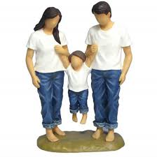
THE VERSES
B Money talks
C# But it don’t sing and dance
A And it don’t walk
C# As long as I can have you here with me
E I’d much rather be
B Forever in blue jeans
B Honey’s sweet
C# But it ain’t nothing
A Next to baby’s treat
C# And if you pardon me I’d like to say
E We’ll do okay
B Forever in blue jeans

Slide 28
THE CHORUS
Maybe tonight
Maybe tonight GF# E
You and I F# ED
All alone by the fire FEDC#
Nothing around BAG
But the sound AGF#
Of my heart and your sighs GF#DE

Slide 29
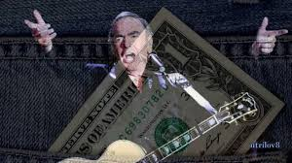
Song Structure
Verse 1 (low octave)
Verse 2 (low octave)
Chorus (higher than start)
Verse 1 (middle octave)
Verse 2 (middle octave)
Chorus (same as above chorus)
Verse 1 (middle octave)
Verse 2 (middle octave)

Slide 30
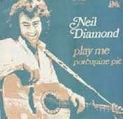
PLAY ME
May 1972
Moods
US Billboard Hot 100
#11

Slide 31
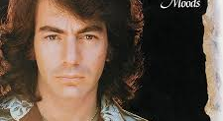
You are the sun D – G – B
I am the moon E – A – C#
You are the words G – B – D
I am the tune E – A – C#
Play me D – D – D
This song has a timing
of 3/4, which is
unusual for a pop
song, but it works!

Slide 32
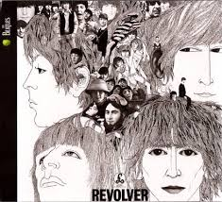

Slide 33
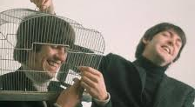
And Your Bird Can Sing
Revolver, 1966 Track 9

Slide 34
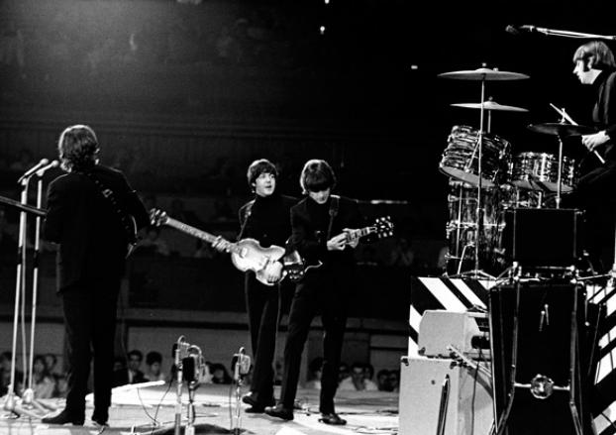
Dual Epiphone Casinos
In the key of E
Played by McCartney
And Harrison
The dual guitar solo:
E F#m B E
“Half” is played at the song’s start
The whole thing is played twice in the song
Pieces are played periodically throughout the song

Slide 35
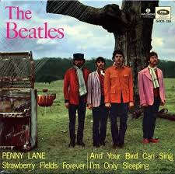
The opening is played in an E scale: Two notes apart
E | F# | G# | A | B | C# | D#
For example, if Guitar L is playing E, Guitar R is playing G# 3:2
It moves into an F#m scale
F# | G# | A | B | C# | D | E
Then a B scale
B | C# | D# | E | F# | G# | A
Finally, back to E

Slide 36
The Second “Half”
In F# Minor
In B Major
Guitar L | Guitar R
A | F#
B | G#
C# | A
D | B
C# | A
B | G#
A | F#
G# | E
Guitar L | Guitar R
F# | D#
G# | E
A | F#
B | G#
C# | A
D# | B
E | C#
F# | D#

Slide 37
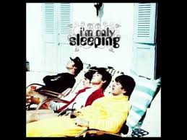
I’m Only Sleeping
Revolver, 1966 Track 3

Slide 38
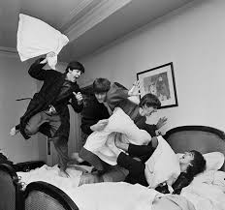
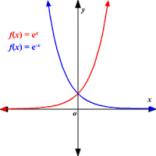
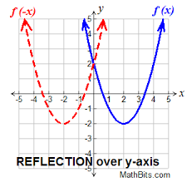
Backwards Guitar Solo
Performed by Harrison
The solo was written forward,
Notes were re-written backwards,
Recorded in the backwards writing,
Flipped back forward for the song

Slide 39
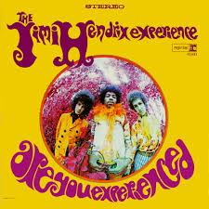

Other important songs that use this strategy
“Are You Experienced” by The Jimi Hendrix Experience
“Give It Away” by The Red Hot Chili Peppers

Slide 40

Got To Get You Into My Life
Revolver, 1966 Track 13

Slide 41
I was alone, I took a ride
I didn’t know what I would find there
Another road where maybe I
Could see another kind of mind there
Ooh, then I suddenly see you
Ooh, did I tell you I need you
Every single day of my life
You didn’t run you didn’t lie
You knew I wanted just to hold you
And had you gone you knew in time
We’d meet again for I have told you
Ooh, you were meant to be near me
Ooh, and I want you to hear me
Say we’ll be together every day
Got to get you into my life

Slide 42
What can I do what can I be
When I’m with you I want to stay there
If I am true I’ll never leave
And if I do I know the way there
Ooh, then I suddenly see you
Ooh, did I tell you I need you
Every single day of my life
Got to get you into my life
Got to get you into my life
I was alone I took a ride
I didn’t know what I would find there
Another road where maybe I
Could see another kind of mind there
Then suddenly I see you
Did I tell you I need you

Slide 43




Influenced by the song
The band Chicago
Earth Wind and Fire

Slide 44

Tomorrow Never Knows
Revolver, 1966 Track 14

Slide 45
The Loops
Seagull
(McCartney laughing, superimposed and accelerated)
:07
Orchestral chord of B flat major
:19
3) Mellotron played on flute setting
:22
4) Mellotron oscillating in 6/8 from B flat to C on string setting
:38
5) Rising scalar phase on sitar? With heavy saturation and acceleration
:56

Slide 46

Taxman (in connection to Tommorow Never Knows)
Revolver, 1966 Track 1

Slide 47
Interesting Facts
“Taxman” is in the key of D major
“Tomorrow Never Knows” is basically all played in the key of C major, except for in one of the loops (Indian music is always played in the same key)
The solo in “Tomorrow Never Knows” contains all the loops discussed earlier, Ringo’s drums (close miked and heavily compressed), and one more thing:
Part of McCartney’s guitar solo in “Taxman” transposed up to C major, cut up, and reversed!
“Tomorrow Never Knows” also features a tamboura played by Harrison in the intro, a tambourine played by Starr, and a Leslie Speaker on Lennon’s voice

Slide 48





Slide 49

Work It
By Missy Elliott
September 9, 2002
Under Construction
US Billboard Peak
#2
US Billboard (2000-2009)
#96

Slide 50



Is it worth it, let me work it
I put my thing down, flip it and reverse it
Ti esrever dna ti pilf nwod gniht ym tup I
Ti esrever dna ti pilf nwod gniht ym tup I

Slide 51

February 5, 2014
The Marshall Mathers LP 2
Billboard Peak:
#45
Hot Rap Songs:
#5
Hot R&B/Hip-Hop Songs: #11
Headlights
Featuring Nate Ruess

Slide 52

3:2
Headlights:
in B Major
B B - D# - F# 5:4 6:5
G# G# - B - D# 6:5 5:4
F# F# - A# - C# 5:4 6:5
A# | B | G# | F# | E | D# | E | F# | G# | B | A# | B | A#
5 | 6 | 4 | 3 | 2 | 1 | 2 | 3 | 4 | 6 | 5 | 6 | 5

Slide 53

Don’t Cha
By The Pussycat Dolls
April 26, 2005
US Billboard Hot 100
#2
US Pop 100
#1

Slide 54


Lead Singer: Nicole Scherzinger sings 4 notes throughout the song:
A# C# D# F
In the chorus, the backup singers sing 4 notes, exactly 3 half notes higher than Nicole: C# E F# G# 4:5
In the verses, the backup singers sing in the chords
C# -- F – G# and D# -- F# -- A#
There is an instrumental chord, which is
F – A# -- C#

Slide 55

October 29, 2013
The Marshall Mathers LP 2
US Billboard Peak:
#1
US Hot Rap Songs:
#1
US Hot R&B/Hip-Hop Songs: #1

Slide 56
C# C# - E - G# 6:5 5:4 3:2
B B - D# - F# 4:3 6:5 8:5
A A - C# - E 5:4 6:5 3:2
The Monster: in C# Minor
3 | 3 | 4 | 3 | 7 | 5 | 3 | 4 | 3 | 5 | 1
3 | 3 | 4 | 3 | 7 | 5 | 3 | 4 | 3 | 5 | 5 | 4 | 3
3 | 3 | 4 | 3 | 7 | 5 | 3 | 4 | 3 | 5 | 1
3 | 3 | 4 | 3 | 7 | 5
3 | 3 | 4 | 3 | 7 | 5 | 5 | 6 | 6 | 5 | 6

Slide 57

The Monster: Verse 3
Call me crazy but I have this vision
One day that I'd walk amongst you a regular civilian
But until then drums get killed and
I'm coming straight at
MC’s blood get spilled and
I'll take you back to the days that
I'd get on a Dre track
Give every kid who got played that
Pumped up feeling and shit to say back
To the kids who played him
I ain't here to save the fucking children
But if one kid out of a hundred million
Who are going through a struggle feels it
and then relates
that's great
It's payback
Russell Wilson
falling way back
In the draft, turn nothing into something,
still can make that
Straw into gold chump
I will spin
Rumpelstiltskin
in a haystack /Maybe I need a straightjack-
et, face facts
I am nuts for real, but I’m okay with that
It's nothing, I'm still friends with the

Slide 58

October 2, 2007
Graduation
US Billboard Peak:
#7
US Hot Rap Songs:
#1
US Hot R&B/Hip-Hop Songs: #3

Slide 59


September 19, 1983
Thriller
“PYT” Chipmunks
Period: 4.0 seconds
“Good Life” Chipmunks
Period: 5.5 seconds
Since 5.5 ÷ 4.0 = 11/8, the horizontal axis (measured as time in seconds) was stretched by a factor of 11/8 (1.375 times as long).

Slide 60

October 15, 2013
The Marshall Mathers LP 2
US Billboard Peak:
#7
US Hot Rap Songs:
#1
US Hot R&B/Hip-Hop Songs: #2

Slide 61
Eminem’s Guinness World Record!!!
Greatest number of words per second in a hit single.
1,560 words in 6 minutes, 4 seconds
1560 words/ 364 second
= 4.3 words per second

Slide 62
In the verse that begins at 4:26,Eminem raps 97 words in 15 seconds — an average of 6.5 words per second.
Uh, summa lumma dooma lumma you assuming I'm a human
What I gotta do to get it through to you I'm superhuman
Innovative and I'm made of rubber, so that anything you say is
Ricochet in off a me and it'll glue to you And I'm devastating more than ever demonstrating How to give a motherfuckin' audience a feeling like it's levitating Never fading, and I know that haters are forever waiting For the day that they can say I fell off, they'll be celebrating’ Cause I know the way to get 'em motivated I make elevating music
—Eminem, "Rap God”

Slide 63

August 27, 2009
More Than
A Game
US Billboard Peak:
#8
US R&B/Hip-Hop
Songs: #2
US Rap Songs:
#1

Slide 64
Forever Chorus
It may not mean nothing to y'all
But understand nothing was done for me
So I don't plan on stopping at all
I want this shit forever mine, ever mine, ever mine
I'm shutting shit down in the mall
And telling every girl she the one for me
And I ain't even planning to call
I want this shit forever mine, ever mine, ever mine, ever mine

Slide 65
Chorus 29
Drake 49 (horn at 25; siren at 36)
Chorus 29
Kanye 59 (horn at 25; siren at 36)
10 seconds longer
Chorus 29
Lil Wayne 49 (horn at 25; siren at 36)
Piano loops at certain parts
Chorus 29
Eminem 49 (horn around each quarter)
No siren
Chorus 26

Slide 66



1976
1963
1986

