Slide 1
Re-thinking Statistical Independence in the Introductory Statistics Course
Lori Maloney, PhD
Sacramento City College Math Department
malonel@scc.losrios.edu

Slide 2
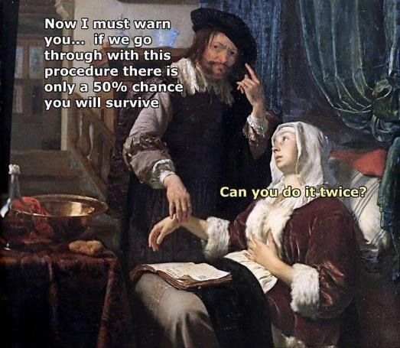
Talk Overview

Slide 3
Overview
Research on teaching independence.
GAISE recommendations.
Constructivist epistemology.
Curricular Design.
Teaching Statistics for Social Justice (TSSJ)
TSSJ Goals
Social Justice Context (SJC)
Statistical Tasks
Student Responses
Questions and discussion

Slide 4
A CLASSROOM NOTE ON: STUDENT MISCONCEPTIONS REGARDING PROBABILISTIC INDEPENDENCE VS. MUTUAL EXCLUSIVITY by Manage & Scariano
“…it is common pedagogical practice to explore the concept of conditional probability and study its relationship to independence. “
“…this is a critical juncture and instructors must be very careful at this point in the course development.”

Slide 5
A CLASSROOM NOTE ON: STUDENT MISCONCEPTIONS REGARDING PROBABILISTIC INDEPENDENCE VS. MUTUAL EXCLUSIVITY Manage & Scariano
“ Surprisingly, we have noticed that many students, even those in graduate courses, have a persistent misunderstanding of independence.”
“Strangely, students tend to impose an artificial separation between the concepts of mutual exclusivity and independence that is not present in their definitions.”

Slide 6
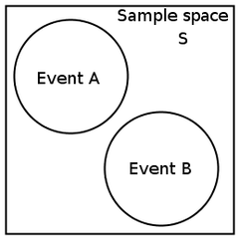
A CLASSROOM NOTE ON: STUDENT MISCONCEPTIONS REGARDING PROBABILISTIC INDEPENDENCE VS. MUTUAL EXCLUSIVITY Manage & Scariano
Presented with this figure and the statement that the probabilities of events A and B are nonzero, many students typically conclude that events A and B are "automatically" independent because they are "separated" as the figure clearly shows. Contrary to "student intuition", these two events are dependent.

Slide 7
GAISE College Report (Guidelines for Assessment and Instruction in Statistics Education)
The Executive Summary cited six main recommendations:
Emphasize statistical literacy and develop statistical thinking.
Use real data.
Stress conceptual understanding, rather than mere knowledge of procedures.
Foster active learning in the classroom.
Use technology for developing conceptual understanding and analyzing data.
Use assessments to improve and evaluate student learning.

Slide 8
Constructivist Approach
Bottom up – Students become agents in their own learning.
Challenges Instructor to Link Topics to Purpose.
Generates more Q than A.
Move to Formative Assessment.
More than one answer possible/Open ended questions.
Classroom Culture – group dynamics; active learning.

Slide 9
Curricular Design: Progression over Time
Pre-assessment: Students use intuition without prior instruction.
Whole-class Discussion: Instructor led Socratic discussion supports student learning statistical concepts.
Small Group Discussion: Students come together in small groups to engage in discussion about the statistical concepts and SJC.
Students are taught Chi-square test of hypothesis.
Project and final exam: Students are allowed to choose method of solution for contingency table tasks.

Slide 10
Teaching Statistics for Social Justice (TSSJ)
Lesser (2007) defines “TSSJ as the teaching of statistics with nontrivial inclusion of examples related to (our previously defined version of) social justice, offering opportunities for students to reflect upon the context of these examples as the learn or apply the associated statistical content.”
Dearth the literature specifically on TSSJ; however there is precedent in the more general realms of teaching using social justice and teaching mathematics using social justice (TMSJ).

Slide 11
TSSJ Goals
“TSSJ can be viewed as a way of teaching statistics that includes the conceptual and computational proficiency goals recommend buy most leading statistics educators, but also has a critical perspective that incorporates and facilitates awareness of issues of social justice and prepares students not only to be competitive workers in the economy but also engaged participants in a democracy, able to be critically reflective about the role statistics has played and can play in our society.” (Lesser, 2007, p. 3)
Specifically, the datasets that form these “social justice contexts” have not been fully tapped as a means to unpack the ways TSSJ can potentially lead students to achieve the stated dual statistics and social justice goals.

Slide 12
TMSJ Goals and Objectives
Goals of Teaching for Social Justice | Specific Mathematics-Related Objectives
Develop Sociopolitical Consciousness | Read the World Using Mathematics
Develop Sense of Agency | Develop Mathematical Power
Develop Positive Social/Cultural Identities | Change Dispositions Toward Mathematics
{From Gutstein (2003, p.44)}

Slide 13
Social Justice Context (SJC)
I created a term called a Social Justice Context (SJC), which would have the following characteristics:
1. It is situated in a real-world context.
2. It shows a radical departure away from the equitable or just situation.
3. It affords the appropriate mathematical rigor for the statistical construct being studied.
4. It is supported by instruction that can increase students’ awareness of and ability to evaluate social justice issues.

Slide 14
Statistical Tasks
Pre-assessment: Supermarket Employee Problem
Whole–class Discussion: Race and the Death Penalty
Group Work: Race and Difficulty Paying for Basic Necessities
Project: Firefighters’ Promotional Exam
Final Exam: Supermarket Employee Problem (re-visited)
Interviews of Focal Students

Slide 15
Pre-assessment: Supermarket Employees Task
The context for this activity concerned gender equality in the workplace, which highlights a social justice issue (Gutstein, 2003).
The data also showed a radical departure from the equitable situation. For example, 64% of the supervisors were male while only one-third of the employees were male, yet only 36% of the supervisors were female even though two-thirds of the employees were female.

Slide 16
Part 1: Expected Frequencies
Table 1: ‘Job Category’ and ‘Gender’ for 180 Supermarket employees.
 |  | Gender
Job Category | Male | Female | Total
Supervisor |  |  | 33
Shelf stacker |  |  | 51
Cashier |  |  | 42
Maintenance |  |  | 54
Total | 60 | 120 | 180

Slide 17
Part 2: Observed frequencies
Table 2: Random sample of 180 staff from the whole workforce of the supermarket chain.
 |  | Gender
Job Category | Male | Female | Total
Supervisor | 21 | 12 | 33
Shelf stacker | 20 | 31 | 51
Cashier | 9 | 33 | 42
Janitor | 10 | 44 | 54
Total | 60 | 120 | 180

Slide 18
Supermarket Employees Task Questions
Part 1: Expected frequencies
Question #1: Fill in the missing cells of Table 1 to demonstrate the situation in which ‘job category’ and ‘gender’ are unrelated.
Part 2: Observed frequencies
Question #2: (a) Using the information from the table, do ‘job category’ and ‘gender’ appear to be related? Explain the reasoning you used to justify your conclusion.
(b) Write a sentence that summarizes what you found in part (a) as it relates to the real-world problem.

Slide 19
Whole Class Discussion: Race and the Death Penalty
The second activity is a whole class discussion around a set of contingency table tasks regarding a Supreme Court case, which analyzed 2475 Capital cases by comparing the two dichotomous variables “race of victim” and “outcome of trial”.
The formulas for computing the expected values for the cells in a contingency table are developed.

Slide 20
Race and the Death Penalty
The topic of death penalty and race is an important social justice topic that can be a powerful tool for teaching students about associations in contingency tables (Lesser, 2007).
Also, since it was comprised of two dichotomous variables, I felt it would lend itself more easily to a class discussion on the novel topic.
The radical difference between the observed and expected values was such that a defendant who killed a white person was eleven more times likely to receive a guilty verdict in the capital case than was a defendant who killed a black person.
This topics leads to a good discussion of possible confounding variables.

Slide 21
Race and the Death Penalty
Table 3:‘Race of the victim’ and ‘verdict’ for 2475 murder cases.
 |  | Verdict
Race of Victim | Guilty (death penalty) | Not Guilty | Total
Black | 20 | 1482 | 1502
White | 108 | 865 | 973
Total | 128 | 2347 | 2475

Slide 22
Poster: Race/Ethnicity and Financial Hardship
The American Public Health Association commissioned a large study of 3015 adult women. They collected data on the race/ethnicity of the participants and found there were five categories represented in the study: White, African American, Hispanic, Chinese, and Japanese. Then they asked the women “How difficult is it for you to pay for basic necessities?” Participants could answer from the choices: not very hard, somewhat hard, and very hard.

Slide 23
A blank table with the marginal totals filled out is given below. Fill out the chart as though the two variables race/ethnicity and difficulty paying for basic necessities are not related.
 | Difficulty paying for basic necessities
Race/ethnicity | Not Very Hard | Somewhat Hard | Very Hard | Total
White |  |  |  | 1449
African American |  |  |  | 831
Hispanic |  |  |  | 249
Chinese |  |  |  | 224
Japanese |  |  |  | 262
Total | 1839 | 911 | 265 | 3015

Slide 24
The actual survey data published in the American Journal of Public Health is listed in the following table:
 | Difficulty paying for basic necessities
Race/ethnicity | Not Very Hard | Somewhat Hard | Very Hard | Total
White | 996 | 375 | 78 | 1449
African American | 451 | 280 | 100 | 831
Hispanic | 43 | 140 | 66 | 249
Chinese | 161 | 50 | 13 | 224
Japanese | 188 | 66 | 8 | 262
Total | 1839 | 911 | 265 | 3015

Slide 25
Race/Ethnicity and Financial Hardship
Q1: Looking at the table as a whole, please give some general observations. In other words, do you have any interesting/striking/ pertinent/surprising observations about the any of the data values in the table?
Q 2: Do the two variables two variables race/ethnicity and difficulty paying for basic necessities appear to be related? Justify your claim.
Q 3: Make a poster to share with the class in order to answer and justify your answer to the question: According to the study, do race/ethnicity and difficulty paying for basic necessities appear to be related?

Slide 26
Project: Firefighter’s Promotional Exam
These data are from the City of New Haven, Connecticut Fireman’s exam for promotion to captain or lieutenant. There are several steps in the process of being promoted, the first of which is passing the promotional exam. This data is from an actual case taken to the Supreme Court Ricci v. DeStefano (2009).
This was assigned as a take-home project.

Slide 27
Project: Firefighter’s Promotional Exam
Race | Pass | Fail | Total
Black | 9 | 18 | 27
Hispanic | 6 | 17 | 23
White | 41 | 27 | 68
Total | 56 | 62 | 118

Slide 28
Final Exam: Supermarket Employee Problem re-visited
 |  | Gender
Job Category | Male | Female | Total
Supervisor | 21 | 12 | 33
Shelf stacker | 20 | 31 | 51
Cashier | 9 | 33 | 42
Janitor | 10 | 44 | 54
Total | 60 | 120 | 180

Slide 29
Data Analysis
Types of data: Audiotapes, videotape, written work, and posters.
Methodology: Pre-assessment task compilation, Consideration of Evidence Hierarchy, mini-case studies, group transcription, interview transcription, coding for themes, cross-case analysis, verification of observed phenomena with student interview
Result: Two individuals and one group of four were selected for final analysis.

Slide 30
Interplay Between Statistical Concepts and SJC
A: Hmhmmm… so then like we could just look at it like what’s the probability … …so then regular probability would just be look at it like what’s the probability … conditional and regular probability. No the probability of white people who don’t think it’s very hard which would be 54% percent.
S: I thought that was black…
A: Yeah I know I’m reading it wrong.
S: Hispanics only have a 17% chance of saying it’s not very hard so that’s really low. Right?
A; Yeah.
S: Yeah, 17
A: I get it. I look at it like the probability that you think it’s not very hard given you’re white is 69% but the probability that white people don’t think it’s hard over the total is 54% so there’s still like..
S: Oh yeah, I see what you’re saying, yeah…

Slide 31
Interplay Between Statistical Concepts and SJC
A: So it’s still gonna be the highest. Right will be black… blacks 25% so they go up..
A: So they go up together so aren’t they related then? Or no?
S: I see what your saying but I think its confusing to say they relate because the numbers like go up together but… this is saying pretty much if you’re white there’s a 54% chance you think it’s not very hard and this is saying if you’re white…
A: No, no…this is saying that out of everybody who thinks its not very hard white people
S: 54% of them are white ..It’s backwards
A: If you don’t think its very hard
S: given that your white
A: Yeah
S: You’re on the right track
S: You just gotta make that last step.

Slide 32
Interplay Between Statistical Concepts and SJC
S: So should we start with if you’re white what are the chances you think you don’t think it’s very hard or something?
A: Yeah, what is the probability it is not very hard given that you’re white.
S: Yeah, there you go. So p(not very hard)
A: So if you’re white then that is … and you found those percentages right? So like 69%? So what was the probability for black, 54%?
SH: That you would expect black people… that it’s harder
A: Yeah. So what does that tell you?
SH: I guess it’s just like the white is way more than the blacks because you would expect the blacks its harder
A: Yeah.
S: So the probability that you don’t think it’s very hard given that you’re white is 69 so you have a higher chance thinking that it’s not very hard to pay for basic necessities if you’re white…which makes sense. Hard and black which is historically grounded.

Slide 33
Interplay Between Statistical Concepts and SJC
S: Are there any that have a significantly lower…?
A: Hispanics, 43%, that would be very hard…
S: So what is that saying?
A: That the Japanese find it very hard. Yeah, I would think In America the Japanese population finds it very hard to pay for basic necessities.
S: They find it very hard?
SH: No they don’t find it very hard.
S: Because it’s only 8…
A: Yeah? No they don’t.
S: Not very hard?
A: Oh yeah, not very hard. Sorry, sorry.

Slide 34
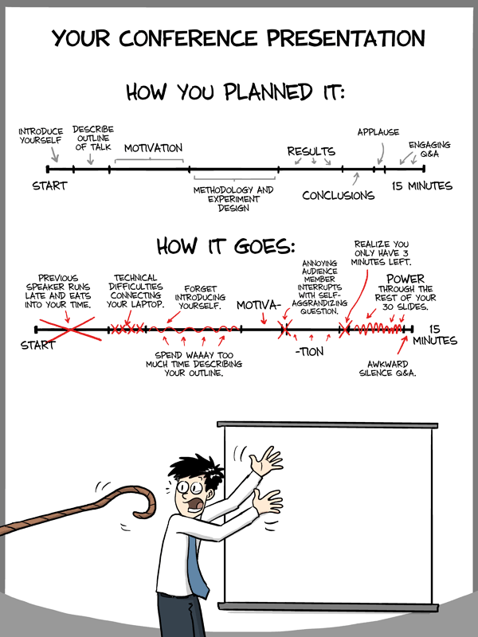
Thank you!

