Slide 1
OEI and OER for Math
Larry Green
Lake Tahoe Community College

Slide 2
California Community Colleges Initiative
Canvas
Course Exchange: Accessibility Difficult for Math
Just Statistics Approved so Far
State Course Designer Assistance

Slide 3
OEI Math Resources: Canvas Commons

Slide 4
Homepage Model

Slide 5
Sample Modules

Slide 6
CC-By
You can take or leave any of the components
Community of faculty
Always improving

Slide 7
Open Educational Resources (OER)

Slide 8
What Students at Moorpark College Say
https://www.youtube.com/watch?v=FamhgNyx310&feature=youtu.be

Slide 9
Reasons for OER
Equity: Shall we fail students because they are not financially privileged?
Community: We can be the decision makers.

Slide 10
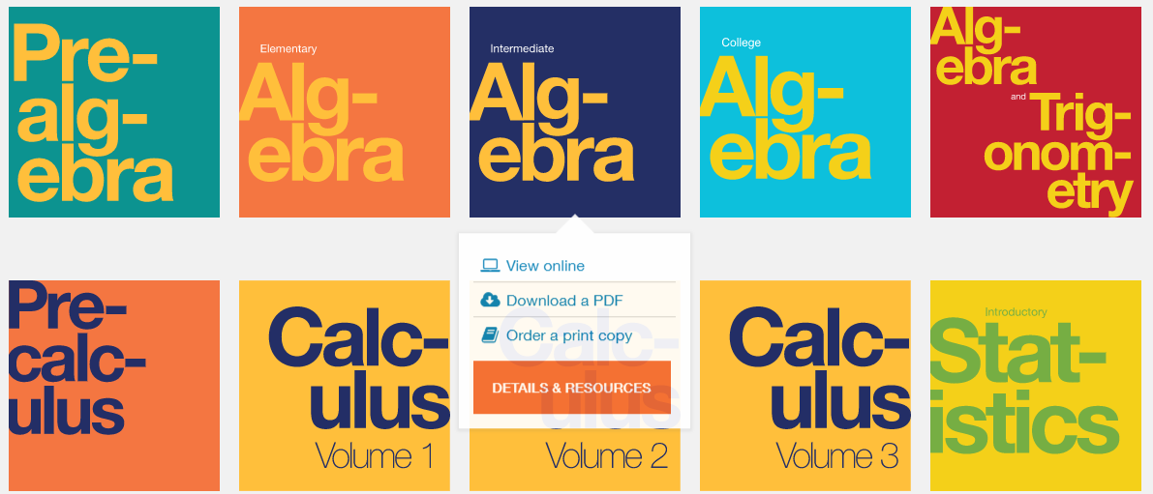
Resources: Textbooks
OpenStax
LibreTexts
Cool4Ed
MERLOT
OpenOregon
Many Others

Slide 11
Ancillaries
PowerPoints
Test Banks
Online Homework Systems

Slide 12
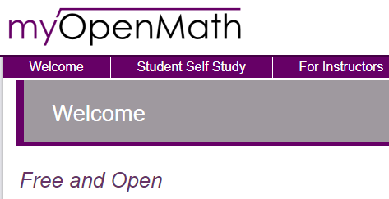
MyOpenMath
Written for Math Homework Systems
Free and Open
Tens of Thousands of Questions already written.
Complete Courses Available
Integrates Into Canvas
https://www.myopenmath.com/

Slide 13
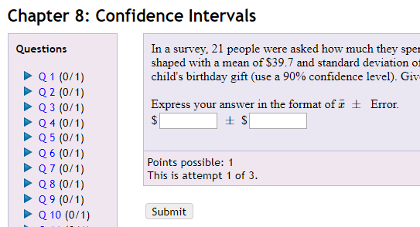
MyOpenMath Pilot Statistics Project
Cindy Moss: Skyline College
Jessica Kuang: Oxnard College
Larry Green: Lake Tahoe Community College

Slide 14
Statistics MyOpenMath Details
Separated by Chapter or Section
Questions Contain Links to:
Videos
Textbook Pages
Hints
Numbers Randomly generated
Question Pool for Each Question
Ongoing Project

Slide 15
Join/Use the System
Video Instructions: https://youtu.be/wD3pTG6drNg
Just in Second Stage of Pilot: Be Patient
Cost: Be Part of the Community and Help Us Improve

Slide 16
ZTC Grant
Beginning Algebra through Differential Equations
From Admission to Graduation: Not Cost
Includes GE Courses
Jan 1 – Dec 31, 2018
$150,000 Funded by Chancellor’s Office

Slide 17
Andres Bazos: Sierra College
Christopher Wu: College of Alameda
George Rothbart: College of Marin
Cindy Moss: Skyline College
Jacqueline Anderson: Sierra College
Jay Kesler: Sierra College
Jessica Kuang: Oxnard College
John Gee: Evergreen Valley College
Julie Harlsnd: Mira Costa College
Karl Ting: Mission College
Linda Hoang: Cosumnes River College
Mark Harbison: Sac City College
Peter Rankenburg: CC of San Francisco
Rick Hough: Skyline College
Roy Shahbazian: Santa Ana College
Sean Nguyen: CC of San Francisco
Sherry Sharufa: Contra Costa College
Larry Green: Lake Tahoe CC

Slide 18
Project Details
Teams for Beginning and Intermediate Algebra, PreCalculus, Calculus, Vector Calculus, Linear Equations/Differential Equations
Find the Best MyOpenMath Questions Out There
Develop New Questions Where Needed
Links to Videos, Hints, and Textbook Pages
Other Ancillaries
Accuracy Checker: Mark Harbison

Slide 19
How Can We Do Better?

Slide 20
Larry Green: DrLarryGreen@gmail.com

