Slide 1
Dogged by bad luck? Me too!
Charles S. Barnett
Formerly Adjunct Instructor
Las Positas College
Presented at the 45th annual Fall Conference
California Mathematics Council, Community Colleges
Monterey, California
December 8 and 9, 2017

Slide 2
Abstract
Pick the most-promising checkout line at the supermarket. What happens?
Someone’s credit card doesn’t work, or the checker has to go pick up a forgotten item, or the customer discusses his or her grandchild ad nauseam.
In the meantime the lines to left and right move smoothly.
And many other similar situations arise.
^{Familiar?}
^{Are you and I paranoid? No!}
A moderate dose of probability theory followed by a small injection of pop psychology justifies our complaint.

Slide 3
Attribution
Feller, William, An Introduction to Probability Theory and Its Applications, Vol. 1,
3rd edition (John Wiley & Sons, NY, 1968) (Chapter III)
Feller, William, An Introduction to Probability Theory and Its Applications, Vol. 2,
2nd edition (John Wiley & Sons, NY, 1971) (Section I.5, page 15)
Karlin and Taylor, A First Course in Stochastic Processes, 2nd edition (Academic Press, NY, 1974) (Section 5.6, page 192)
“Originality is the fine art of remembering what you hear but forgetting where you heard it.”
(Laurence J. Peter, Canadian-American educator)

Slide 4
Outline
1. Record values: Why are my losses so high?
2. Ratios: My loss divided by your loss.
3. Two lines, discrete moves, coin flips: Who is ahead?
4. Feel-good trap.
5. It’s so hard to predict, especially the future.

Slide 5
My tale of woe: First Example (Record Values)
Situation: Each of us in this room is exposed to some chance event that has a numerical outcome. Large outcomes are unfavorable.
Waiting time at a checkout point.
Financial loss for some investment.
Any situation in which big numbers are bad.
Index each of us with an element of {0, 1, 2, …}. I will take 0 and you will be numbered 1, 2, 3, …
RV X_{n} represents the outcome for person n. So, X₀ is my case.
Let RV N = the first index n in {1, 2, 3, …} such that X_{n} > X_{0.}
It turns out that E[N] = ∞. See why I can complain?
And it does not help that you can make the same argument!

Slide 7
My tale of woe: First Example (cont’d)
I treated the case in which maxima are undesirable. If you treat the case in which minima are undesirable, you find that the math goes through as before. So, record values, not just maxima, have these noisy and chaotic gaps between them.
Hence, I can complain in either case! Once again, it does not help that you too can complain.

Slide 8
Please appreciate two points about the previous construction.
The generality of the assertion: the IID random variables need only possess a continuous CDF.
The simplicity of the argument: invokes only symmetry. No reference to the common distribution function.

Slide 9
That argument is short and sweet, but…
It seems to be almost too clever. Is it legitimate? Yes, but allow me to display another, less slick, argument that might be more satisfying.
On the next slide
⬇

Slide 10
Alternate proof that mean waiting time is infinite
(remove conditioning)

Slide 11
I am still not sure that I believe it, but I cannot find a flaw in the arguments.

Slide 12
My tale of woe: Second Example (Ratios)
Situation: Two teller windows are open at our bank. You are the next to be served at your window. I am the next to be served at the other window. X represents your wait time: Y represents my wait time. RVs X and Y are IID exponentially distributed RVs. (the so called “pure random” case)
It turns out that P[ Y/X > t ] = 1/(1+t) 0 ≤ t < ∞ (✪)
Surely I have a right to complain if I have to wait three times longer than you, but (✪) assigns probability 1/4 to that event.
So, on average, you or I have reason to complain in one out of two cases.
And E[Y/X] = ∞.
Enter pop psychology:
Our perceptions are worse. We do not notice or remember short wait times.

Slide 13
Number of times that Y/X>3 for 20 cases of 100-sample Monte Carlo runs
Window: [0,21] by [0,50]
Blue line: Y = 25 (theoretical number of times that my result is 3 times yours)
See why I can complain!

Slide 15
This third example involves the moving sum of a sequence of {1, -1} fair coin-flips. So, timeout to see what the sample paths of such a process look like.

Slide 16
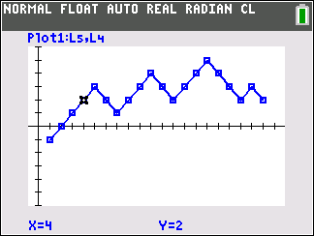
Moving sum of 20 flips of a {1,-1} fair coin
Illustrates sample-path representation
Window: [0, 21]×[-6, 6]
Sum sequence: {-1,0,1,2,3,2,1,2,3,4,3,2,3,4,5,4,3,2,3,2}

Slide 17
The next three slides display several sample paths generated by Monte Carlo simulations of a {1,-1} fair coin. Note the intervals of times spent well away from the zero line.

Slide 18
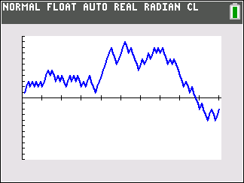
Moving sum of 100 flips of a (1,-1) fair coin
Window: [0, 101]×[-11, 11]

Slide 19
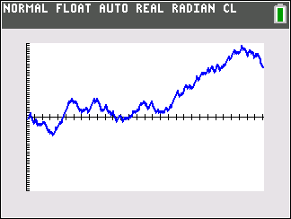
Moving sum of 300 flips of a (1,-1) fair coin
Window: [0, 301]×[-36, 36]
12 visits to zero
Max: 35 Min: -9

Slide 20
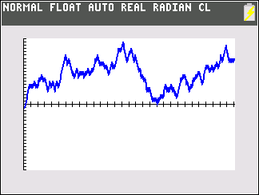
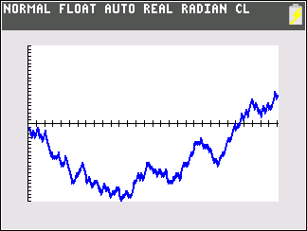
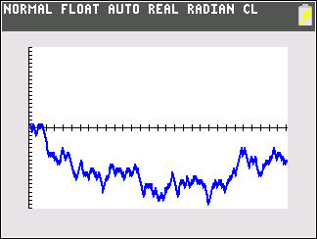
Three more 300-flip cases
m= -22 M= 9
3 visits to zero
m= -1 M= 19
2 visits to zero
m= -19 M= 1
7 visits to zero

Slide 21
We have just viewed a few {1,-1}-coin-flip moving sums,
so back to my third tale of woe: Parallel waiting lines

Slide 22
Pretty, but a bit refractory; perhaps a picture will illuminate.

Slide 23
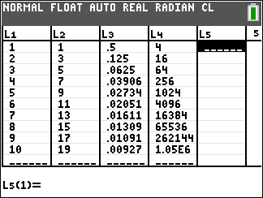
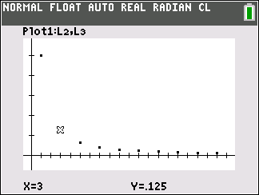
A plot of P[T=k] vs k for k ε {1,3,5,7, … }.
T=wait time for first visit to “1”.
⬆
⬆
Window
(1,11)×(-.1,.6)
E[T] = ∞

Slide 24
As we just saw, wait-time-for-the-first-visit-to -“1” RV has peculiar properties.
The-number-of-changes-of-sign RV has even more shocking properties.
Let RV N_{n} = the number of sign changes of S_{n}
and
let p(k,n) = P[N_{n} = k] for k = 0, 1, 2 ,3, … n
Then p(0,n) > p(1,n) > p(2,n) > p(3,n) > p(4,n) > …
Observe that 0 is the most probable and that k is more probable than k+1 for all relevant k!

Slide 25
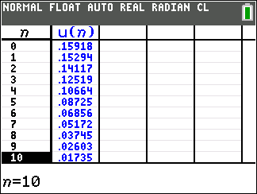
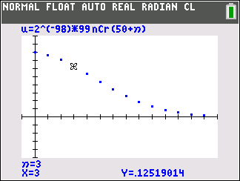
PDF that describes N₉₉ ,the number of sign changes in 99 flips
Probability of n changes of sign in 99 tosses. 0 ≤ n ≤ 13.
Observe that the most probable is 0 .
Window: (0,13) ×(-.1,.2)

Slide 26
Next four slides show Monte Carlo Samples generated to illustrate visits to 1 and sign changes for the
Moving Sum Process

Slide 27
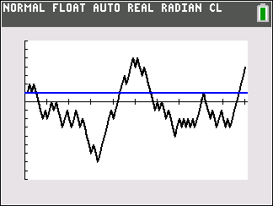
100 {1,-1} coin flips
Sample path showing sign changes and visits to “1”
Sign changes: 6
Visits to “1”: 7
Blue line: Y=1

Slide 28
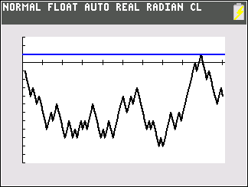
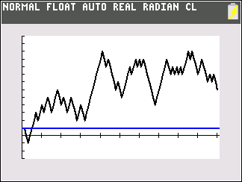
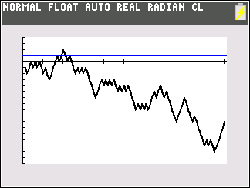
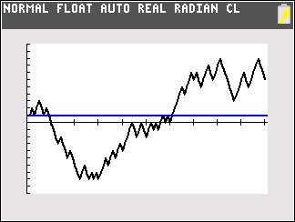
Continuation

Slide 29
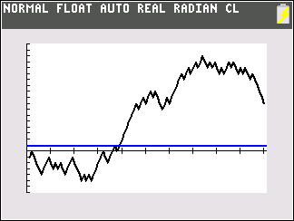
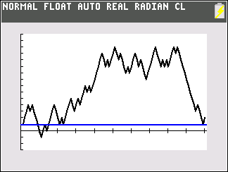
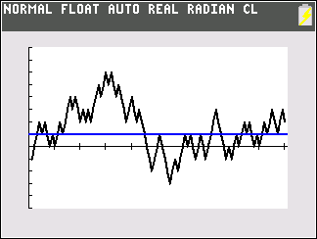
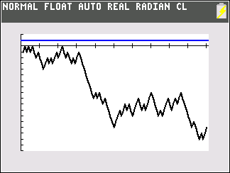
Continuation II
For you “Law-of-averages” enthusiasts

Slide 30
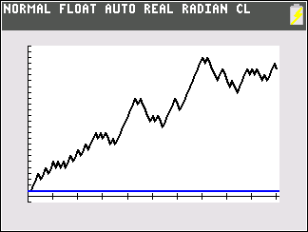
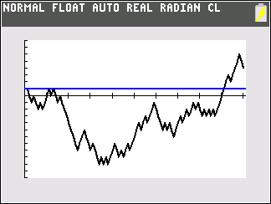
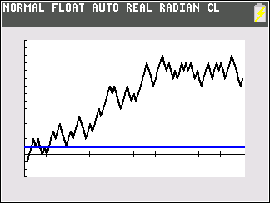
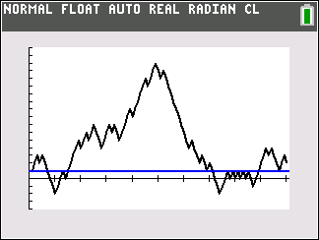
Continuation III

Slide 31
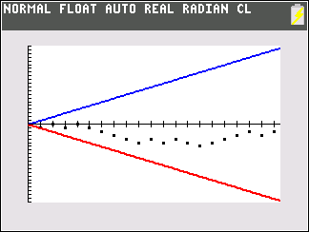
The number of randomly generated paths that stay near the zero line is small because the number of available such paths is small.
20 (-1,1) coin flips. Cumulative sum.
Blue line: upper limit of possible paths.
Red line: lower limit of possible paths.
2²⁰ = 1,048,576 paths.
Path shown: 2 zeros, 0 crossings

Slide 32
The Bernoulli Process is full of strangeness
I have shown sample paths for the {1,-1} coin-flip process on eight previous slides.
I find them counter intuitive. Do you?
It seems that more should remain closer to the zero line.
Incidentally, I did not cherry pick.
Analysis, done mostly in mid 20th century, shows that the process behaves in very strange ways and that our intuition regarding the law of averages misleads us.
And the above cases, and many others that I have generated, but did not show, are consistent with that peculiar behavior.

Slide 33
My Fourth Tale of Woe: Well, more a tale of misplaced satisfaction.
Situation: you are head of M & O at your college. You have 100s, perhaps 1000s of a certain type of light bulb in service at your facility.
You become interested in the average lifetime of such a bulb.
Your bulb installer is a meticulous (obsessive?) record keeper. She, or he, has a record of the times that the each now-in-service bulb was installed to replace its burned-out predecessor.
So, you ask the installer to record the burnout times of the in-service bulbs and to give you a list of lifetimes.
You will be rather more pleased than you should.

Slide 34
To illustrate Length-biased Sampling ( Inspection Paradox), consider the
Poisson Process case.
Assumptions:
Lifetimes are IID Exponential(mean 1) RVs.
Failures are immediately replaced with new devices.
Then
E[length of interval that captures time t]
tends to 2 as t tends to ∞.
Next slide shows some Monte Carlo cases.
⬇

Slide 35
Illustration of length-biased sampling: Poisson Process
30 cases of interval that captures t=15
Poisson Process (“Pure Random”)
Scatter Plot: 30-sample of length of intervals that straddle 15.
Red line: Theoretical mean of a single interval = 1
Black line: mean of the 30-sample = 1.80
(Theoretical value = 2)
Window: (0,31) by (0,5)

Slide 36
My fifth and final tale, not of woe, but of the limited value of hindsight (sometimes called Monday morning quarterbacking)
“The study of randomness tells us that the crystal ball view of events is possible, unfortunately, only after they happen. And so we believe we know why a film did well, a candidate won an election, a storm hit, a stock went down, a soccer team lost, a new product failed, or a disease took a turn for the worse, but
such expertise is empty in the sense that it is of little use in predicting when a film will do well, a candidate will win an election, a storm will hit, a stock will go down, a soccer team will lose, a new product will fail, or a disease will take a turn for the worse.”
Mlodinow, The Drunkard’s Walk
(How Randomness Rules Our Lives)

Slide 37
An example from the investment area illustrates the near futility of crystal-ball gazing.
Performance of 800 mutual funds over two sequential 5-year epochs.
Next two slides
⬇

Slide 38
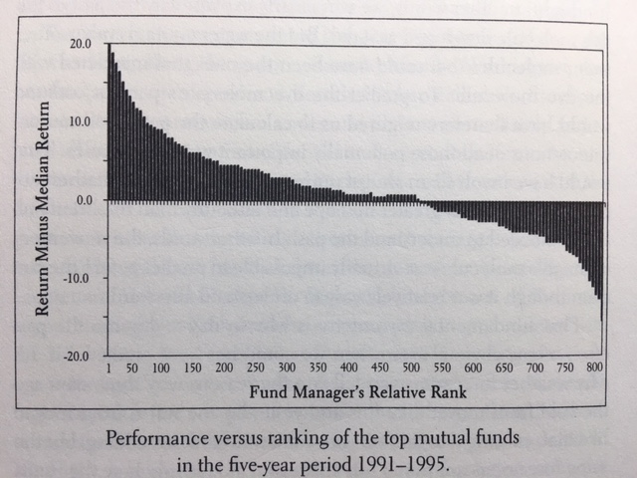
From Mlodinow’s book titled The Drunkard’s Walk
p
e
r
c
e
n
t
⬅

Slide 39
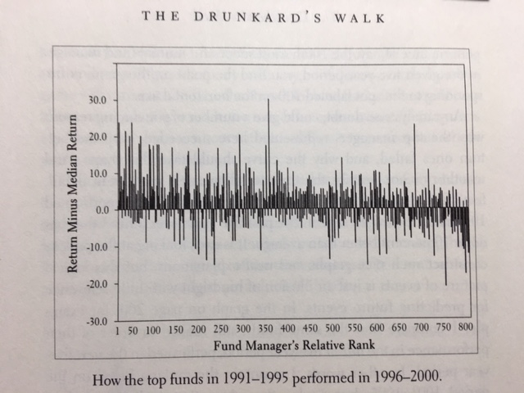
Same funds, next five-year performance
⬅

Slide 40
Models vs Reality
We do not encounter an infinity of waiting lines.
We do not enter lines that are infinitely long.
Our models, almost all mathematical models of physical situations, contain convenient, simplifying assumptions.
Shining example: widespread use of the normal distribution in statistical analysis.
But the models shed some light on experience, and once built lead to interesting, purely mathematical, sometimes counter-intuitive results. You have seen some peculiar cases above.
And: The classical CLTs do not apply to RVs that have infinite expectation.
But, those models do support my claim that bad luck follows us everywhere!

Slide 41
Closure
So you see, you are not paranoid and I am not paranoid.
But I do not care what you say! I have worse luck than you!
Thank you for attending!

