Slide 1
#1 Really is Number One
Charles S. Barnett
Formerly Adjunct Instructor
Las Positas College
Presented at the 44th annual Fall Conference
California Mathematics Council, Community Colleges
Monterey, California
December 9 and 10, 2016

Slide 3
Abstract*
In many real-world data sets the integers 1 through 9 occur with unequal frequency as first significant digits. Digit 1 occurs with highest frequency and digit 9 occurs with lowest frequency. The frequency decays monotonically from 1 through 9. The above assertions are not universally true; fairly simple sufficient conditions exist for their validity. Bring your favorite paradox to enliven our discussion.
_____________________________________________________________________
*From the summary in the program outline

Slide 4
The phenomenon is called Benford’s Law
The name overstates the phenomenon as you will see. However, that name is
widely used for this first-significant-digit peculiarity, and I will use it in this
presentation.

Slide 5
Attribution
Feller, William, An Introduction to Probability Theory and Its Applications, Vol. 2,
2nd edition (John Wiley & Sons, NY, 1971) (Section II.8, page 61)
A. Berger, T. P. Hill. Benford’s law strikes back: No simple explanation in sight for mathematical gem. Math Intelligencer. 33(1):85-91, 2011
Various online articles. Phrases such as “Benford’s Law” and “first significant digit distribution” yield a deluge of relevant results. Caveat Emptor
__________________________________________________________________________
Online Bibliography: (benfordonline.net) contains about 800 references.
Newly published book: An Introduction to Benford’s Law, Berger and Hill (Princeton University Press, 2015)

Slide 6
The Observation
In many real-world data sets, the first significant digit is not uniformly distributed over 1 to 9. The density of the first digit is highest at 1 and decreases monotonically from 1 through 9.
The theoretical Benford distribution
P(D₁=k)=Log(k+1)-Log(k)
Benford
k | P[D₁=k]
1 | 0.3010
2 | 0.1761
3 | 0.1249
4 | 0.0969
5 | 0.0792
6 | 0.0669
7 | 0.0580
8 | 0.0512
9 | 0.0458

Slide 7
Some examples of empirical evidence for and usage of BL
Commonly used physical constants
Half lives of alpha emitters
Census of 3141 U.S. counties
Interest received and interest paid as reported on income tax returns
Fraud detection in forensic accounting
Admittance as evidence in court cases

Slide 8
A Bit of Early History
  1881 Simon Newcomb and his log tables
1938 Frank Benford and his 20000 entries from 20 tables
Astronomer Simon Newcomb called attention to the non-uniform distribution of first significant digits in a paper published in 1881. He noticed “how much faster the first pages [of books of logarithmic tables] wear out than the last ones.” Many years later physicist Frank Benford rediscovered the phenomenon, studied 20,000 entries from 20 tables, and published his empirical results in a 1938 paper. The phenomenon surfaces in applications and continues to evoke theoretical interest.

Slide 9
Newcomb’s Statement
The law of probability of the occurrence of numbers is such that all mantissas of their logarithms are equally likely.

Slide 10
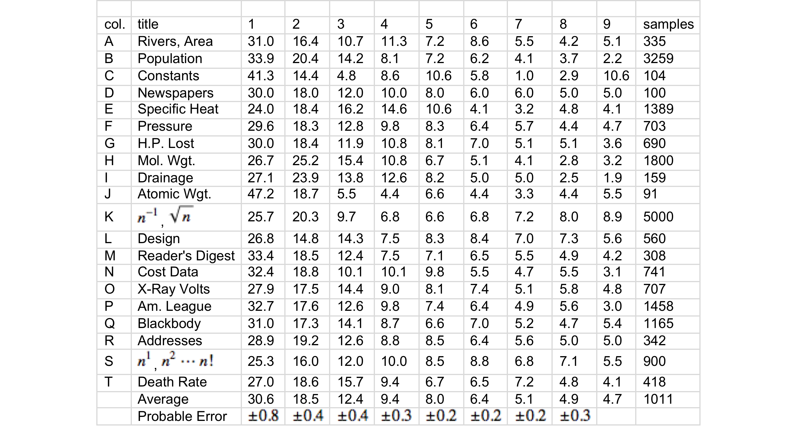
Benford’s Table
➔

Slide 11
First significant digits and base-10 logarithms
Consider numbers .00453, .0453, 4.53, 453. The first significant digit of each is 4. Let “Log” represent the base-10 logarithm function.
Then Log(.00453) = Log[(10⁻³)(4.53)] = -3 + Log(4.53) = -3 + .6561,
Log(.0453) = Log[(10⁻²)(4.53)] = -2 + Log(4.53) = -2 + .6561,
Log(4.53) = Log[(10⁰)(4.53)] = 0 + Log(4.53) = 0 + .6561,
Log(453) = Log[(10²)(4.53)] = 2 + Log(4.53) = 2 + .6561.
The “characteristics” vary but the “mantissas” do not. Tables of Common Logarithms display only the mantissas.

Slide 12
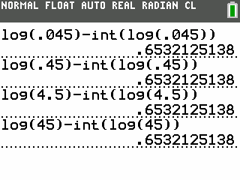
Never heard of a table of common logarithms? You are not that old?
No problem. Turn to your graphing calculator.
M=Log(x)-Floor(Log(x))
Incidentally: no more log tables or slide rules? Good riddance.
I speak from experience.

Slide 13
Needed technical result
We need the concept of a “random variable mod 1” or a “wrapped probability density function”. The unit-circumference circle, not the unit-circle, comes into play.

Slide 14
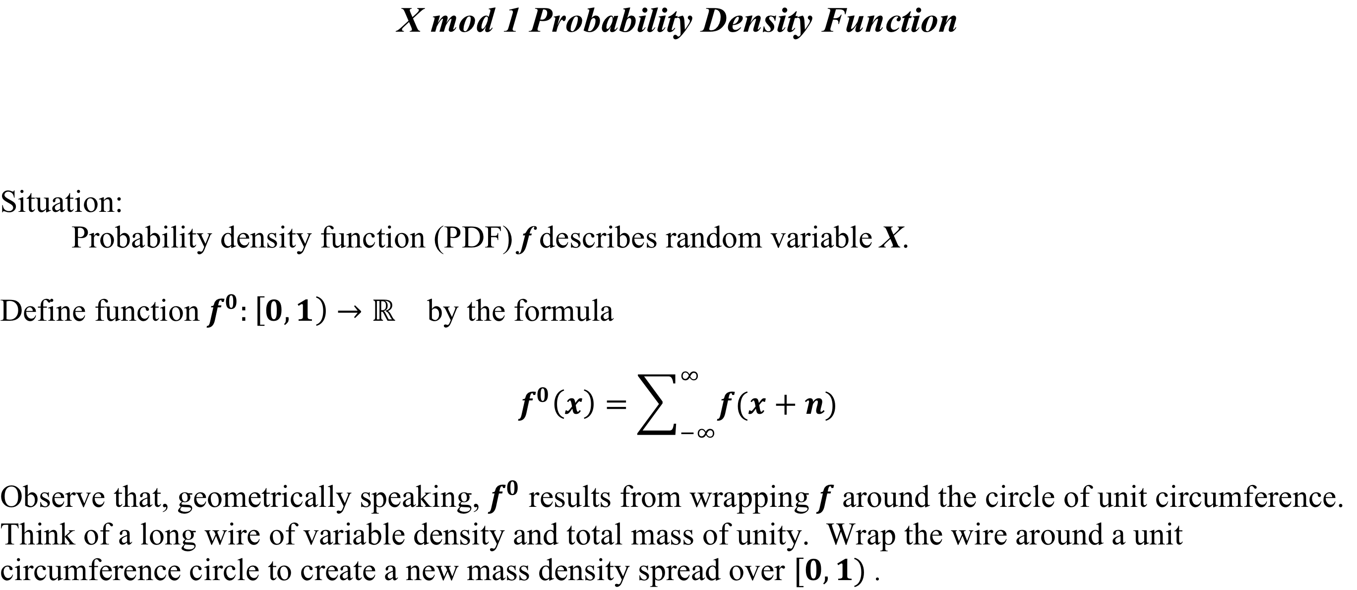
Concept of a “wrapped” random variable

Slide 15
Wrap a PDF
fº(.2)=…+f(-2.8)+f(-1.8)+f(-.8)+f(.2)+f(1.2)+f(2.2)+...

Slide 16
Distribution of the mantissa determines the distribution of the first significant digit
Situation:
  Y > 0 is a random variable.
  Observe that we can express Y as Y = (10^{C}) Z where C is an integer and 1 ≤ Z <10.
  [.00453 = (10⁻³) 4.53]
  Let D₁ (Y) = the first significant digit of Y. Then D₁ (Y) = k iff k ≤ Z < k+1 iff
  Log (k) ≤ Log (Z ) < Log(k+1).
  But Log (Y) = C + Log (Z) = C + M where C = characteristic of Log Y and
  M = mantissa of Log (Y).
  So M = Log (Y) – C. Therefore the PDF that describes M is the PDF that describes [Log (Y)]⁰ where [Log (Y)]⁰ represents Log (Y) reduced Mod 1,
Therefore if M is approximately uniformly distributed over [0, 1), then
P[ D₁ (Y) = k] ≈ Log (k+1) – Log (k).

Slide 17
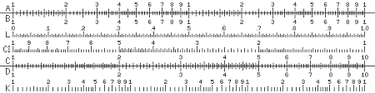
The image of a slide rule may shed some light
⬅
➔
➔
If M (the mantissa of Log(Y)) is uniformly distributed over the L scale, then BL applies. For example, if the mantissa falls between 0 and .301⁺ [Log(2)] on the L scale, then D₁=1 (C-D scales).

Slide 18
Preparation for this presentation took an unanticipated, and rewarding turn
Recall the underlined sentence in Slide 2 (the abstract): “ fairly simple sufficient conditions exist for their validity”. The comment refers to conditions for BL to apply. I based that statement on a passage from Feller that appears on the next slide.

Slide 19
Feller’s Misstatement
“If the spread of Y is very large the reduced variable X⁰ will be
approximately uniformly distributed, and the probability that D₁=k will be close to Log(k+1)-Log(k)”. [p 63 of Feller (slightly edited to conform to notation employed in this presentation)]
Three random variables are in play.
Y, the data random variable
X=Log(Y)
X⁰=X mod 1
The error: (Y has large spread) does not imply that (X has large spread)

Slide 20
Early on, I did some Monte Carlo studies chosen to illustrate Feller’s assertion.
They did not work out. What was I doing wrong? I hesitated to even consider that Feller’s assertion might be incorrect. After all, Feller was, well, Feller. But I began to worry. Feller’s assertion has been quoted in many research and pedagogical publications for the last 45 years. Dare I think that I had uncovered that error? I began to think so. Turns out that I am about 5 years late. Sigh … , short-lived fame. So it took 40 years, not 45. Berger and Hill found it.
Here is a quote from Berger and Hill (Ref. 2 from Attribution): ➔“The online data base [BH] lists about 20 published references since 2000 to Feller’s argument, the crux of which is Feller’s claim (trivially edited) that
If the spread of variable Y is very large, then Log Y will be approximately u.d. mod 1”
The claim is simply false under any reasonable definition of “spread” and any reasonable measure of dispersion,…”⬅

Slide 21
The following slides address the first-significant-digit distributions of several populations.
Some are BL like, some are uniform over digits [1,9]. Some are neither. You will see that Feller’s statement was indeed a misstatement.

Slide 22
(j<k)

Slide 23
An example: Monte Carlo sample of Y=10^{U(2, 4)}
Chi square GOF: Pval=.07

Slide 24
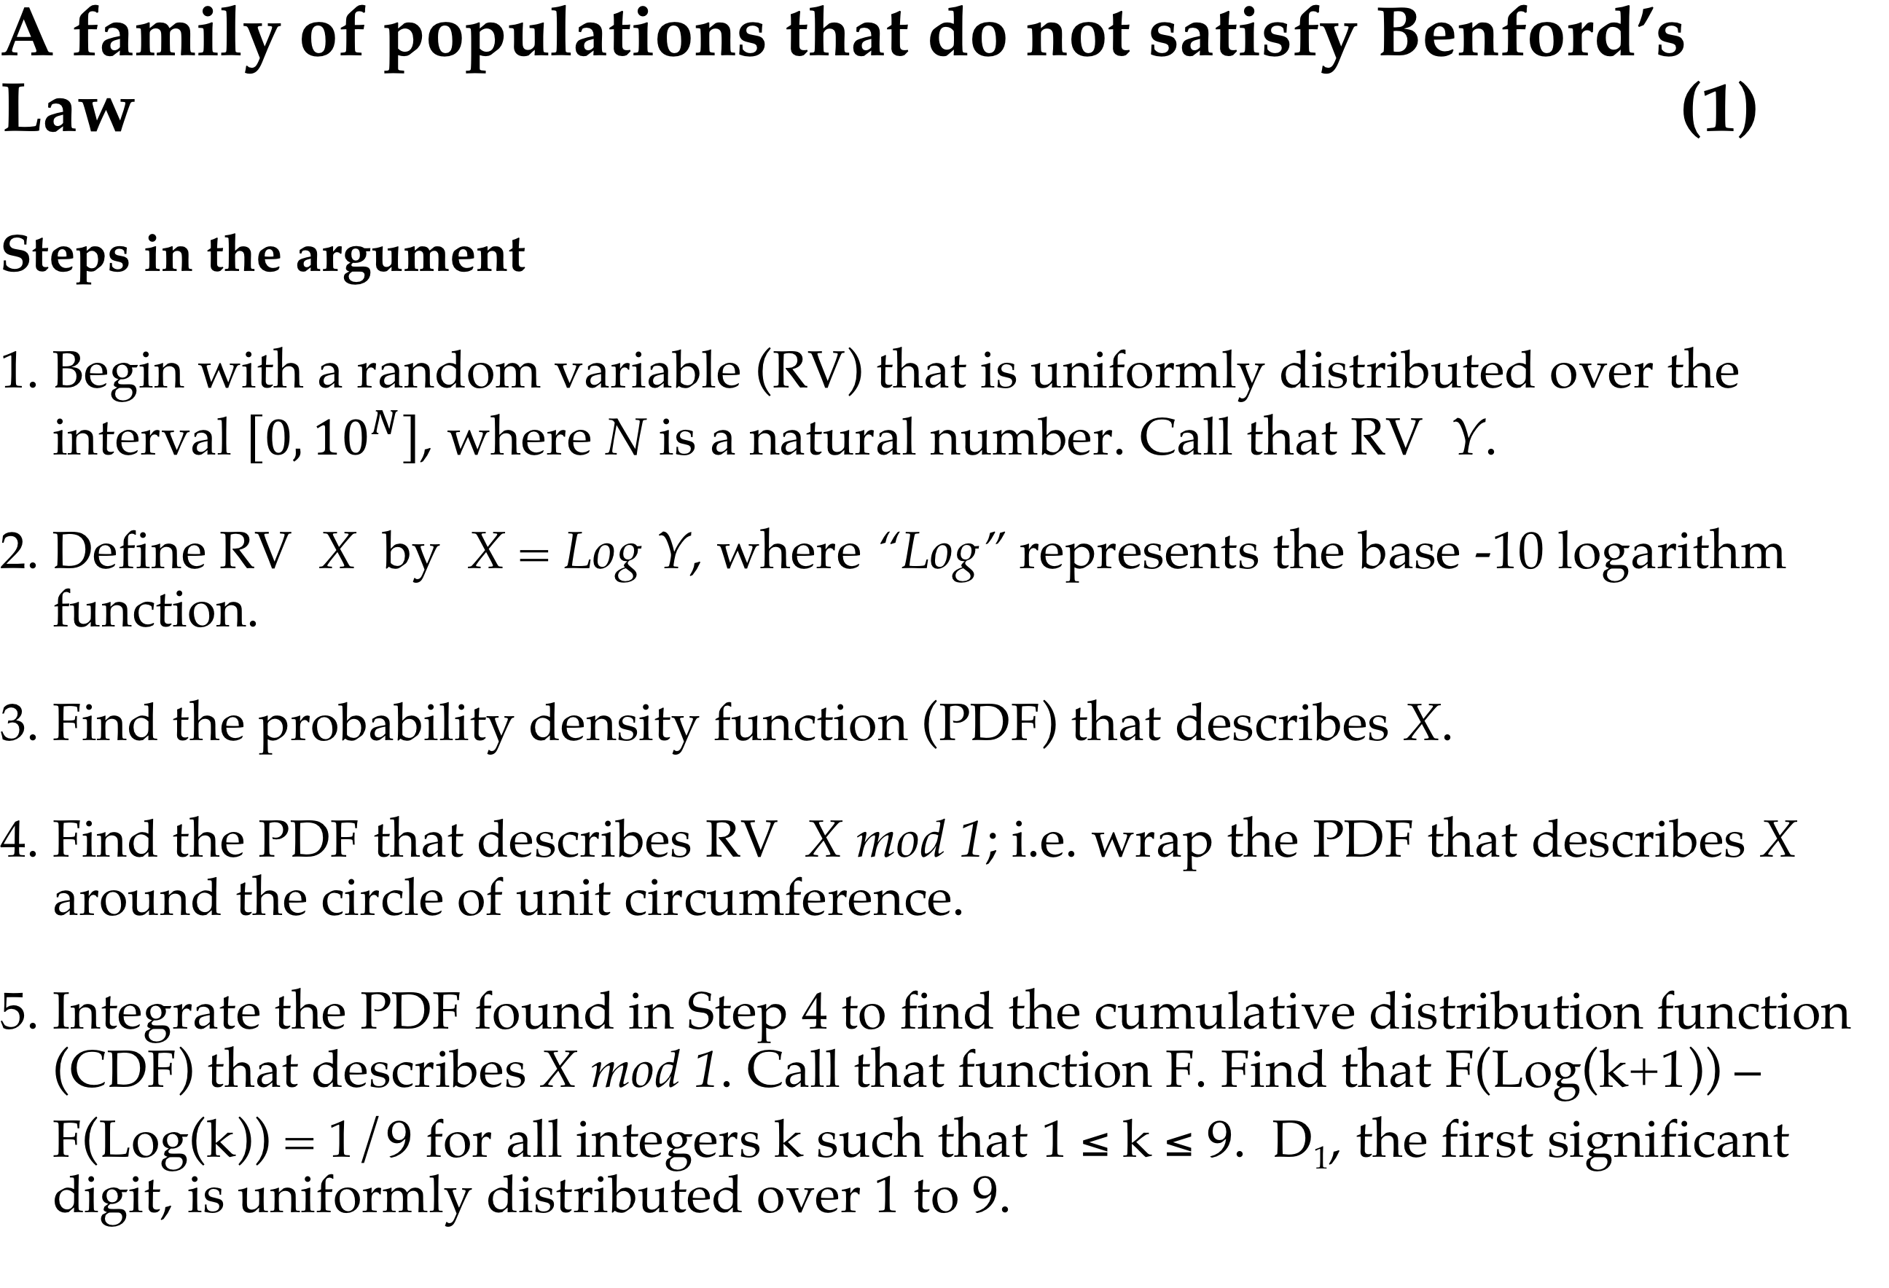
[P(D₁=k)=1/9 for 1≤ k ≤9] case

Slide 25
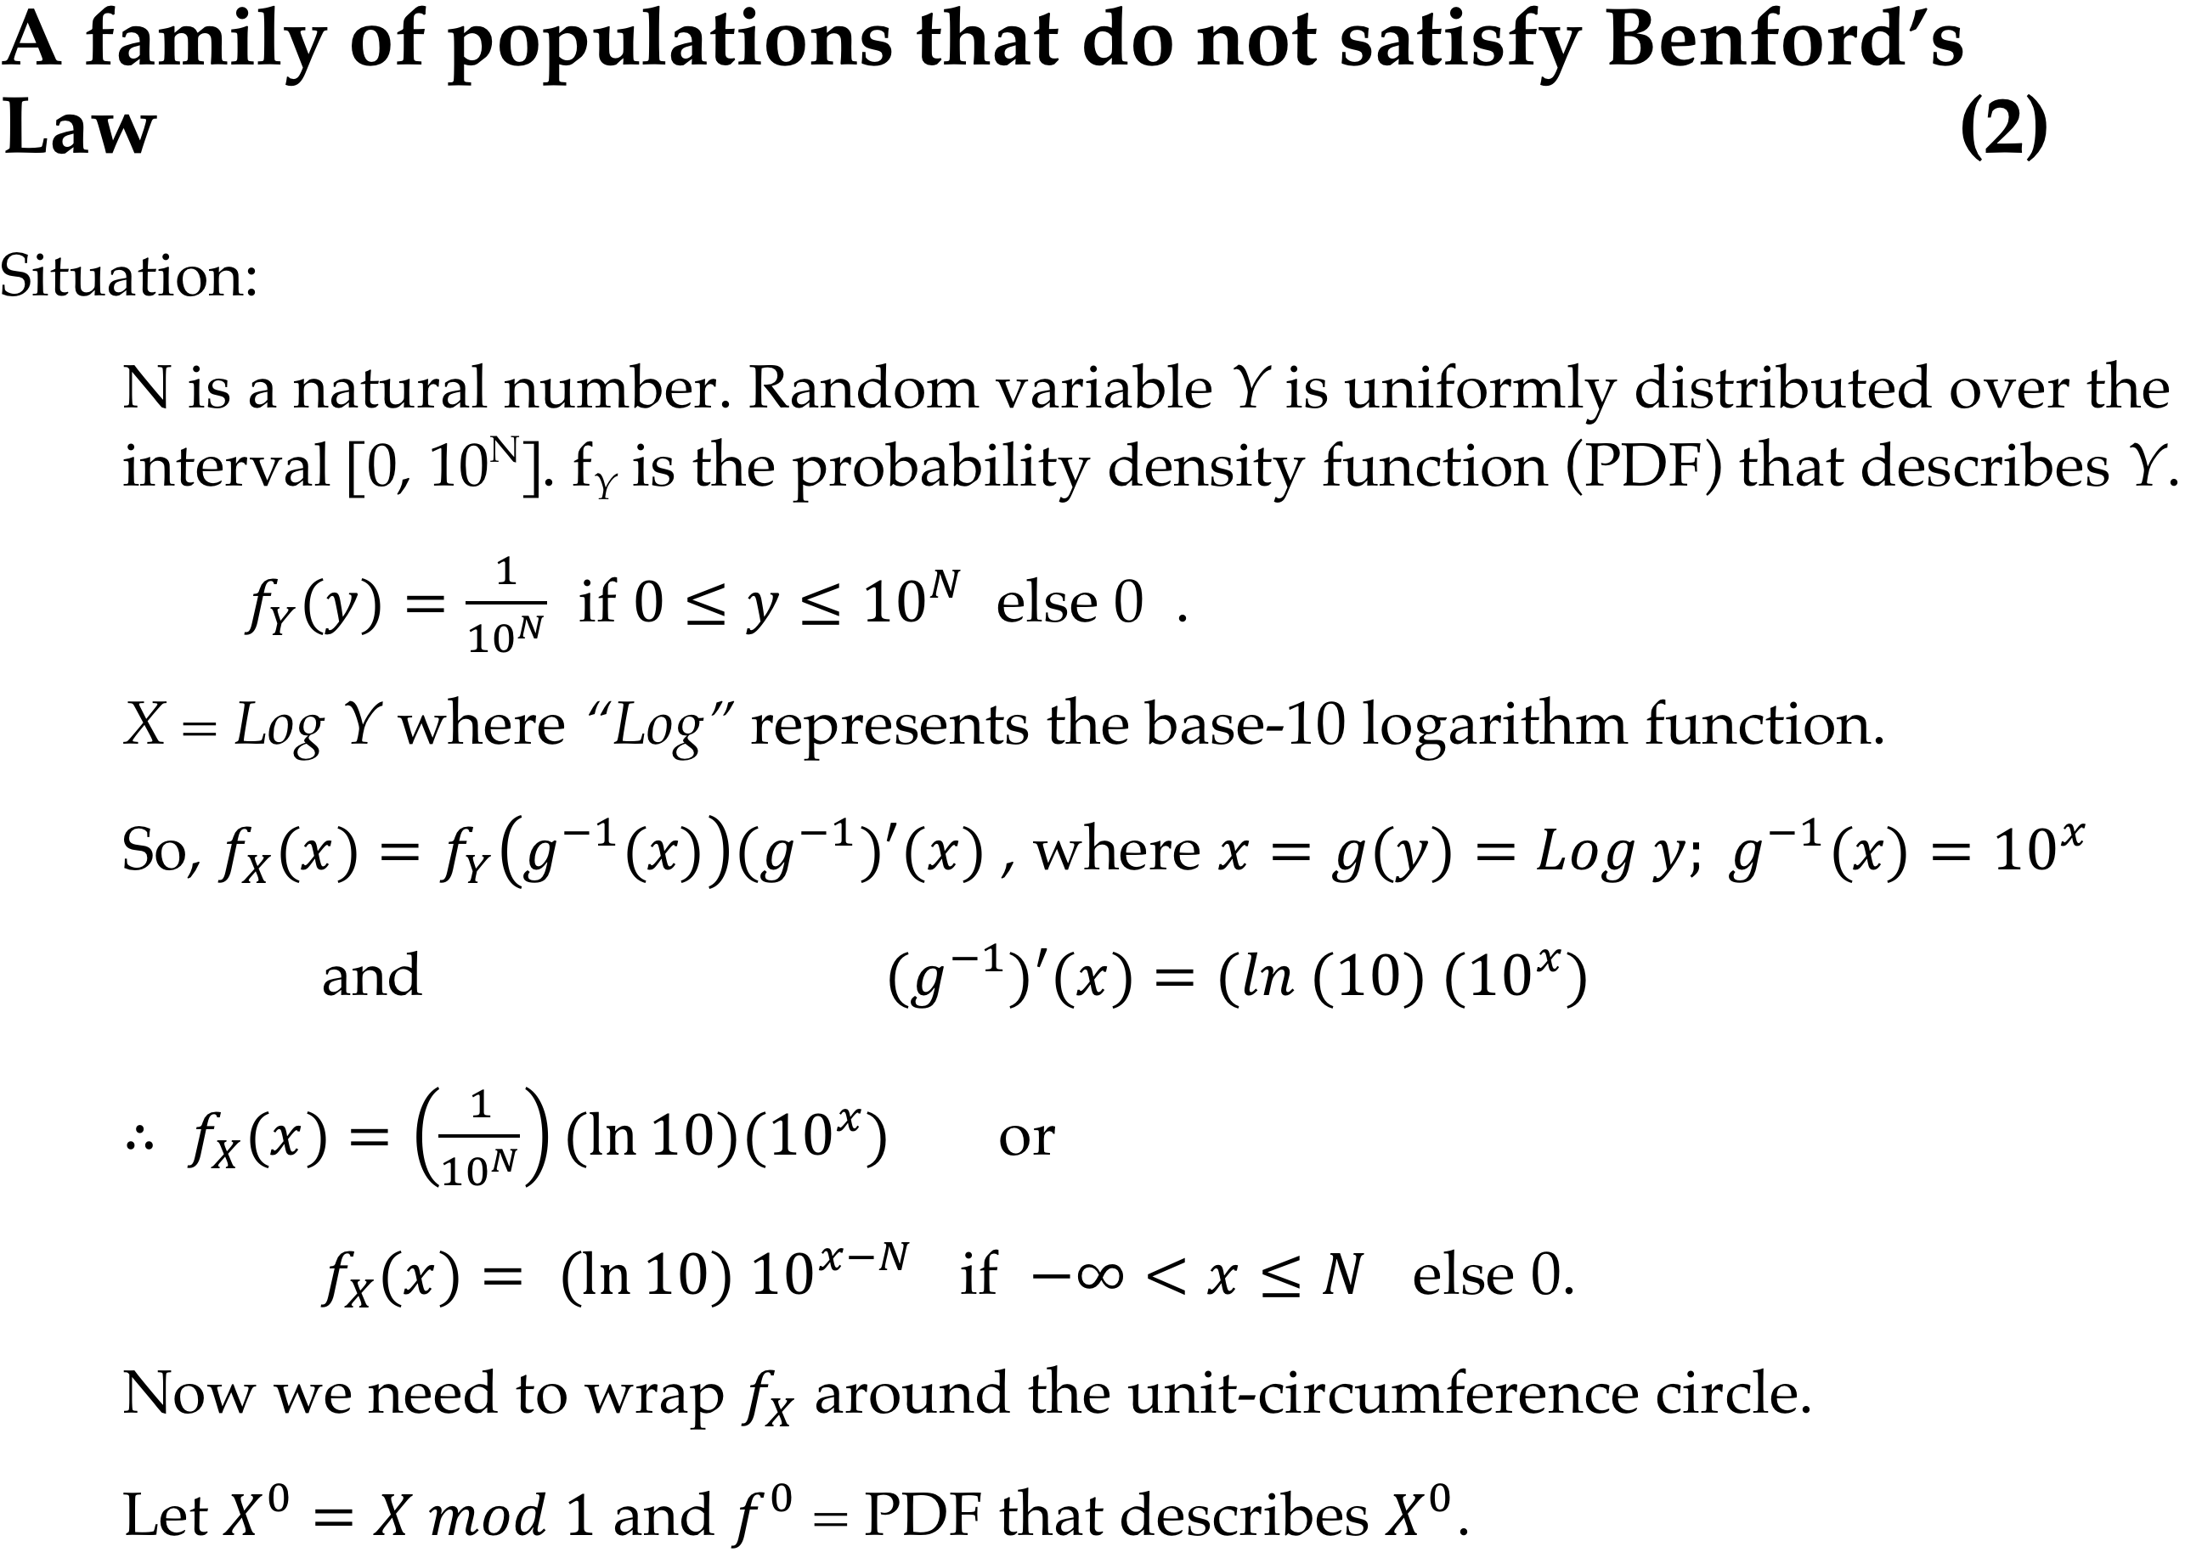

Slide 26
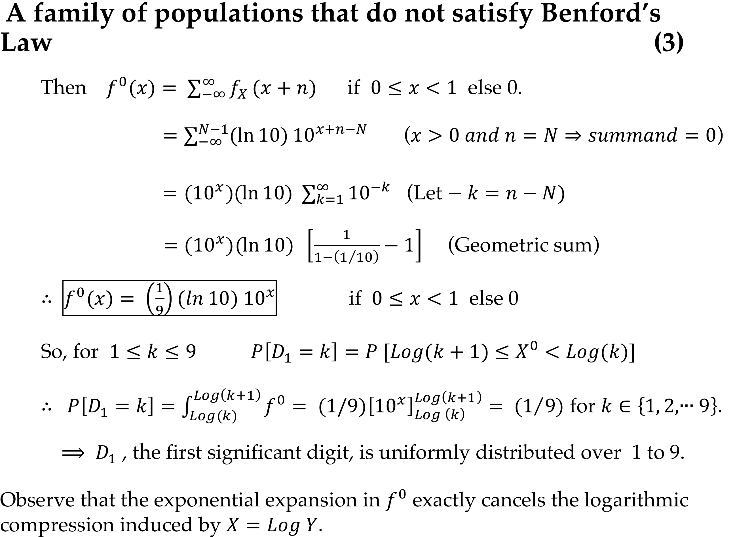

Slide 29
The Exponential Family
It was the study of this family that first shook my faith in Feller’s assertion.

Slide 30
The exponential family of data random variables
The next five slides address random variables described by probability density functions (PDFs)
f_{Y}=(1/μ)e^{-y/μ} if x≥0 else 0
➔
As the mean μ increases the PDFs spread more broadly over R⁺, but the first-digit distributions do not change.

Slide 31
Window: [0,5]✕[-.2,1.2]

Slide 32
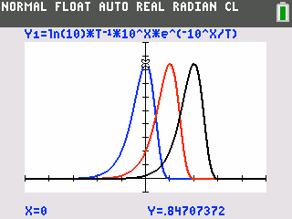
PDF That describes X where X=Log(Y) and Y is Exp(mean μ):Three cases.
Blue: μ=1 Red: μ=10 Black: μ=100 Window: [-5,5] × [-.1,1]
Observe that the curves are identical except for the shift.
Maxima located at Log(μ)
➔When wrapped they all yield the same result in spite of the fact that their parent data random variables were spread very differently over R⁺ .

Slide 33
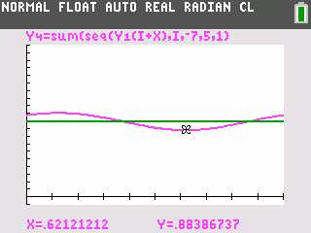
Exponential RV is not BL but not far from it.
Curved line: PDF that describes X⁰. Straight line: y=1 (BL).
Window: [0,1]✕[-.1,2]
X=Log(Y), Y is Exp(mean 1)

Slide 34
■
■
➔

Slide 35
(LogY)⁰
MC
■
■
BL

Slide 37
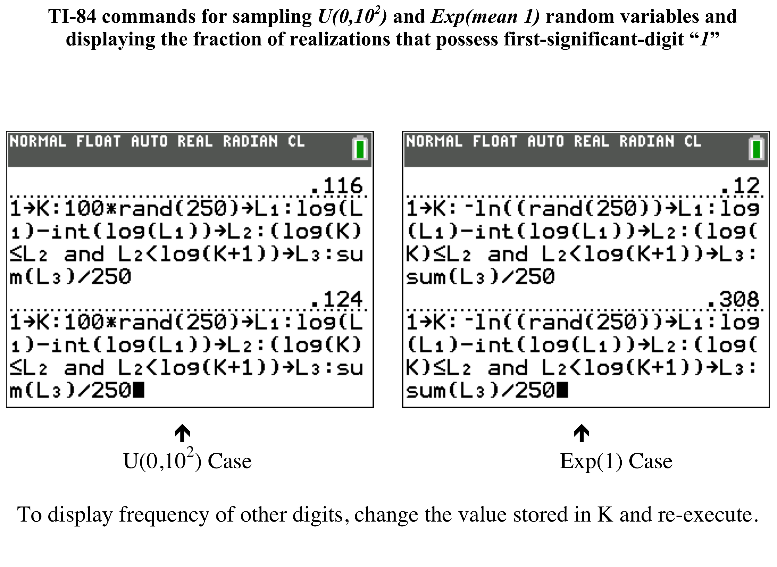

Slide 38
The Gamma(n) Family

Slide 39
Gamma distributed random variables
Special case in which n is a natural number
Y(n) > 0 is Γ(n) if the PDF that describes Y(n) is
Sum of n iid Y(1)s generates Y(n). The PDFs spread as n increases and tend to normal as n gets large. Y(1) is Exp(1).

Slide 40
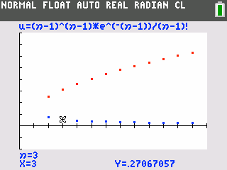
Maxima of Y’s PDFs vs maxima of Log(Y)’s PDFs
Case in which data Y spread increases but Log(Y) spread narrows.
Data are Γ(n) distributed. n=1 is the Exp(1) case. n>1 is the sum of n iid Exp(1) RVs.
Window: [0,13]✕[-1,4]
Y is Γ(n); n runs from 2 through 12 on the graphs. Blue dots: peak value of Y PDF. Red dots: peak value of Log(Y) PDF. Note the inverse relationship.

Slide 41
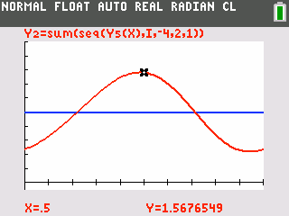
(Log Y)⁰ PDF for the Y-is-Γ(3) case.
Y is Gamma (3); (Log Y)⁰ PDF in red; Y=1 in blue; Window: [0,1]×[-.1,2]
Significant difference between red and blue.

Slide 42
■
■
■
➔

Slide 43
The Lognormal Family
Y = e^{R} or 10^{R} where R is N(μ,σ)

Slide 44
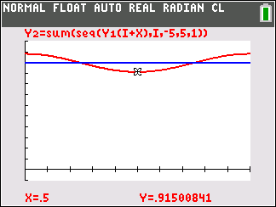
Lognormal departure from BL
In the Lognormal case only the value of σ affects the distribution of the first significant digit. If σ≥1, then the distribution is indistinguishable from BL. I had to reduce σ to .4 to get a noticeable departure from BL. ⬇
σ =.4
Window: [0,1]✕[-.1,1.2]

Slide 45
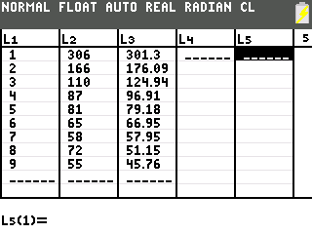
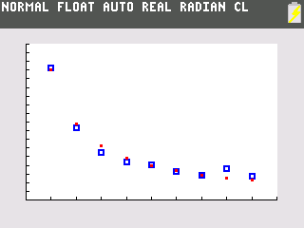
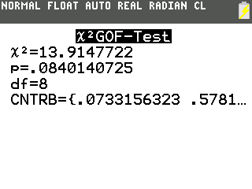
A Lognormal case: Y= e^{Z} and Z is N(0,1); 1000-sample
■
■
Window: [0,10]×[0,360]
Blue: Observed Red: Expected BL

Slide 46
How to embezzle if you must.
A starter kit
 | Benford |  |  | 50-sample
 | k | P[D₁=k] |  | 1 | 4 | 4 | 5 | 1
 | 1 | 0.3010 |  | 1 | 3 | 1 | 4 | 1
 | 2 | 0.1761 |  | 1 | 2 | 4 | 3 | 1
 | 3 | 0.1249 |  | 5 | 1 | 6 | 9 | 7
 | 4 | 0.0969 |  | 4 | 2 | 2 | 9 | 2
 | 5 | 0.0792 |  | 9 | 2 | 1 | 1 | 1
 | 6 | 0.0669 |  | 3 | 5 | 1 | 1 | 1
 | 7 | 0.0580 |  | 7 | 1 | 9 | 1 | 1
 | 8 | 0.0512 |  | 7 | 5 | 4 | 2 | 1
 | 9 | 0.0458 |  | 2 | 2 | 5 | 2 | 4
Pick first significant digits of the values of your disbursements from the table on the right, which contains random samples from BL distribution on the left.

Slide 47
Closure
We have peeked under the Benford Circus Tent and looked at a bit of its mathematical act, but addressed almost none of BL’s mysterious appearances in the real world. The reason for the omission: I have nothing useful to say. And, as far as I can tell, even the experts are still arguing. BL continues to baffle the learned professor and the amateur.
Thank you for attending. Let’s eat!

