Slide 1
The Impact of the Common Core Standards on Mathematics in Community Colleges
Andres Marti, SFUSD
CMC³ Fall Conference
December 10, 2016

Slide 2
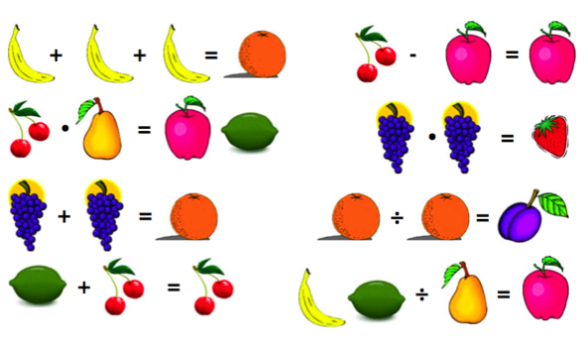
Discuss with a partner to make sense of this...

Slide 3
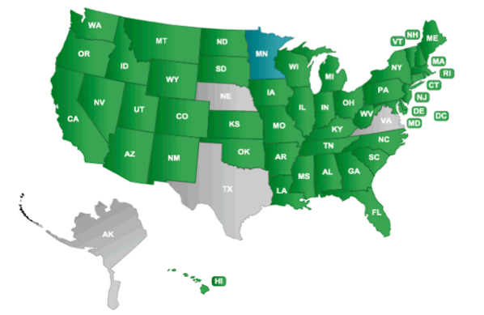
Common Core State Standards for Mathematics (CCSS-M)

Slide 4
CCSS-M Themes
FOCUS – Developing deep conceptual understanding that lays the foundation for future learning.
COHERENCE – Building conceptual understanding over multiple years through research-based learning trajectories.
RIGOR – Balancing conceptual understanding (the ability to access concepts from multiple perspectives and apply them to new situations) with procedural skill and fluency.

Slide 5
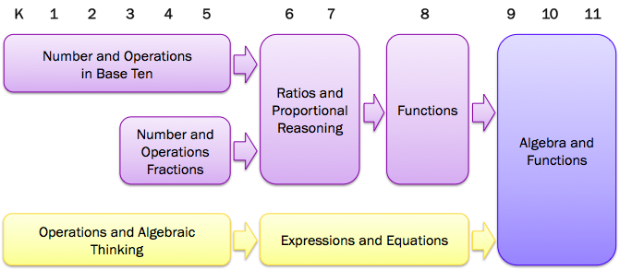
Focus and Coherence in Algebra

Slide 6
Rigor
Rigor is redefined as the ability to access math concepts and apply them to new situations.
Rigorous courses must increase students’ depth of understanding and their ability to communicate this understanding.
All students in every grade should have rigorous courses that balance conceptual understanding with procedural skill and fluency.
No longer means pushing content down into earlier grades.

Slide 7
Standards for Mathematical Practice
Make sense of problems and persevere in solving them.
Reason abstractly and quantitatively.
Construct viable arguments and critique the reasoning of others.
Model with mathematics.
Use appropriate tools strategically.
Attend to precision.
Look for and make use of structure.
Look for and express regularity in repeated reasoning.

Slide 8
High School Content Shifts
Functional approach to algebra.
Transformational approach to geometry.
Integration of statistics and probability throughout secondary grades.
Emphasis on modeling.

Slide 9
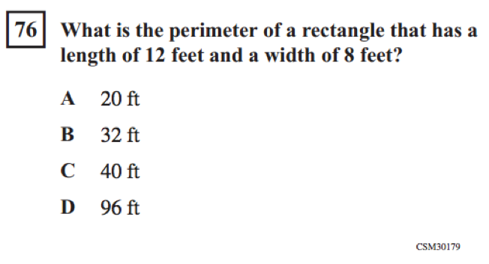
CST Test Item

Slide 10
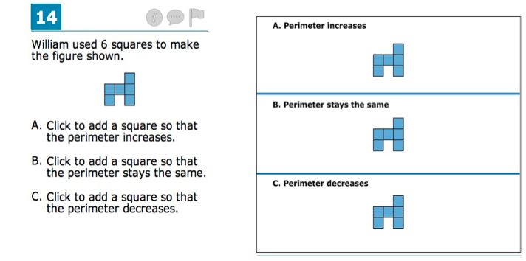
Smarter Balanced (SBAC) Test Item

Slide 11
Rich Math Tasks
A rich math task takes time to solve and lends itself to collaboration and multiple perspectives. Robust use of these tasks creates the context in which students build multiple representations and communicate their reasoning.
Partners:
Silicon Valley Mathematics Initiative
Oakland Unified School District
Complex Instruction Program

Slide 12
Classifying Solutions to Systems of Equations
Norms:
Work in the middle
Everyone touches the cards
Justify your reasoning aloud
Stay together
Notes:
Fomatvie Assessment Lesson from MARS

Slide 13
Card Set A: Equations, Tables, Graphs
Share the cards between you and spend a few minutes, individually, completing the cards so that each has an equation, a completed table of values and a graph.
Record on paper any calculations you do when completing the cards. Remember that you will need to explain your method to your partner.
Once you have had a go at filling in the cards on your own:
Explain your work to your partner.
Ask your partner to check each card.
Make sure you both understand and agree on the answers.
4. When completing the graphs:
Take care to plot points carefully.
Make sure that the graph fills the grid in the same way as it does on Cards C1 and C3.
Make sure you both understand and agree on the answers for every card.

Slide 14
Card Set B: Arrows
You are going to link your completed cards from Card Set A with an arrow card.
Choose two of your completed cards and decide whether they have no common solutions, one common solution, or infinitely many common solutions. Select the appropriate arrow and stick it on your poster between the two cards.
If the cards have one common solution, complete the arrow with the values of x and y where this solution occurs.
Now compare a third card and choose arrows that link it to the first two. Continue to add more cards in this way, making as many links between the cards as possible.

Slide 15
How does this activity help develop math practices?
Make sense of problems and persevere in solving them.
Reason abstractly and quantitatively.
Construct viable arguments and critique the reasoning of others.
Model with mathematics.
Use appropriate tools strategically.
Attend to precision.
Look for and make use of structure.
Look for and express regularity in repeated reasoning.
Notes:
Turn and talk. Share out.

Slide 16
SFUSD Math Principles
All students can and should develop a belief that mathematics is sensible, worthwhile, and doable.
All students are capable of making sense of mathematics in ways that are creative, interactive, and relevant.
All students can and should engage in rigorous mathematics through rich, challenging tasks.
Students’ academic success in mathematics must not be predictable on the basis of race, ethnicity, gender, socioeconomic status, language, religion, sexual orientation, cultural affiliation, or special needs.

Slide 17
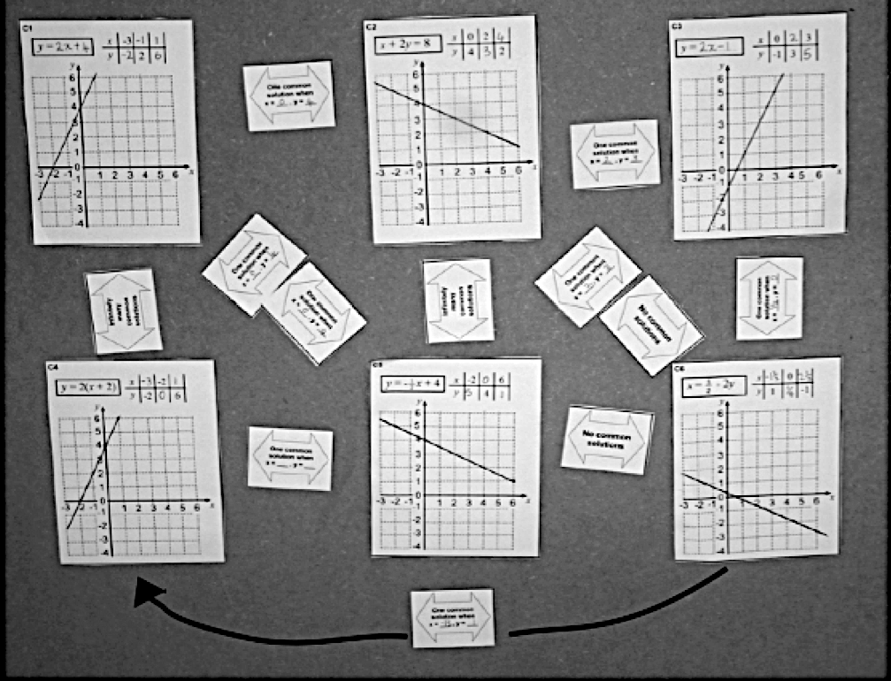
Making sense of Solutions to a System of Equations
Notes:
Example of a rich task that supports changing beliefs about what math is and who can do math.
Rich task means access and rigor that allows for sense making.

Slide 18
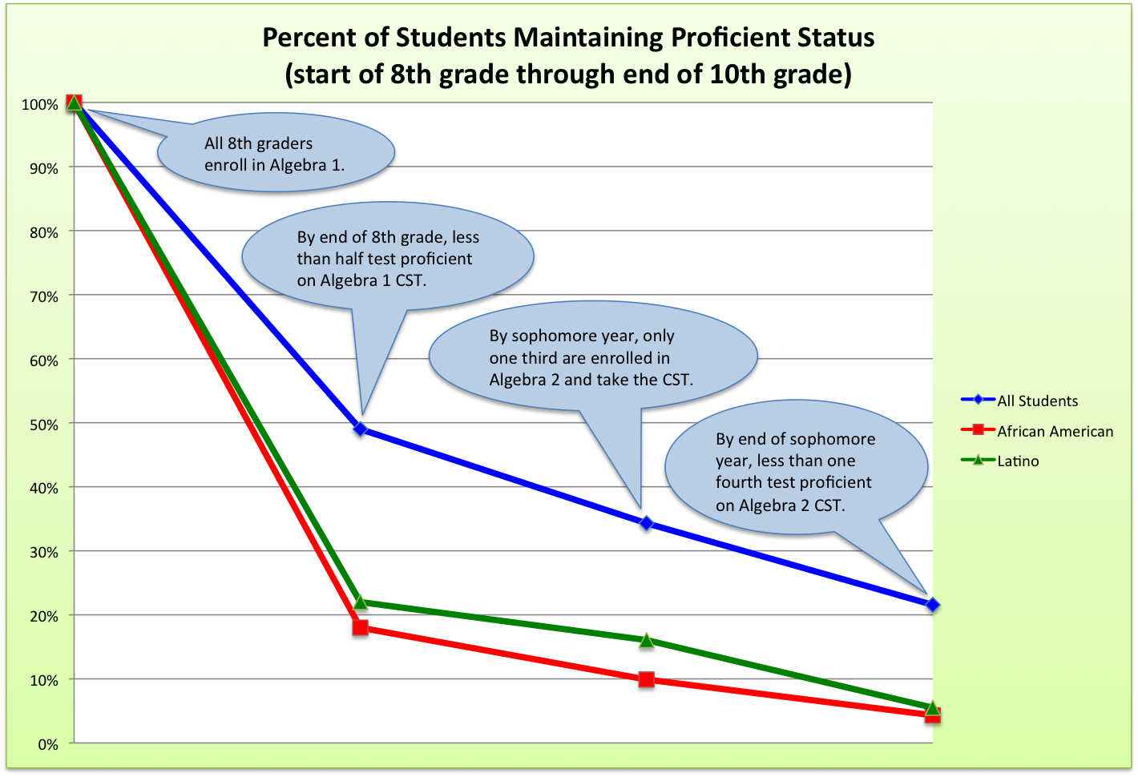
SFUSD Class of 2014
Notes:
Start of SFUSD portion of talk. Conditions at that time were similar to statewide data.

Slide 19
SFUSD Class of 2015
 | All Students | African American | Latino
Enrolled in Algebra 1 in 8th grade | 2,705 | 214 | 525
Enrolled in Algebra 2 in 10th grade | 1,112 | 35 | 96
Tested Proficient on Algebra 2 CST | 516 | 3 | 20

Slide 20
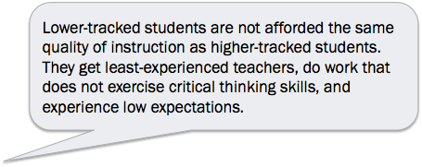
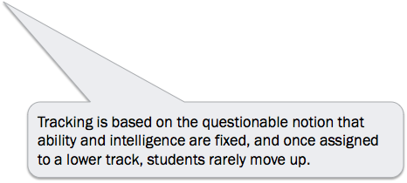
Tracking
Notes:
Turn and talk.

Slide 21
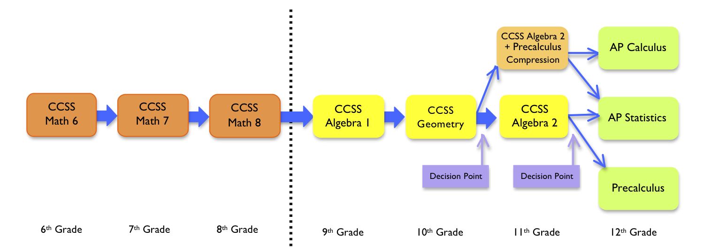
SFUSD Secondary Course Sequence
All secondary schools provide all students the same course sequence aligned to the CCSS-M.
Notes:
Mention other options, like doubling up, but refer to our website for details.

Slide 22
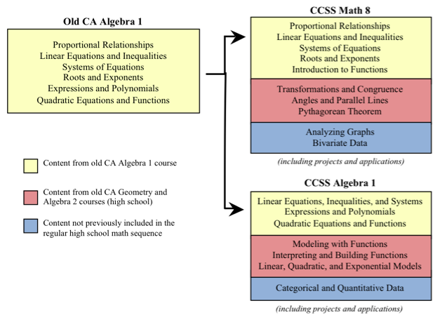
Algebra in 8th and 9th Grade

Slide 23
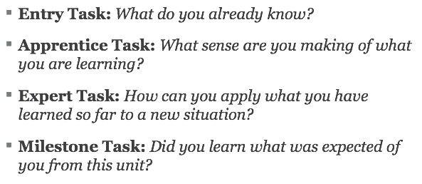
Core Curriculum
SFUSD Math Core Curriculum is based on groups tasks that focus on making sense of the concepts, supporting multiple abilities, and expanding what “doing math” means beyond procedural fluency.
Notes:
Original unit design based on ideas developed by David Foster and OUSD.

Slide 24
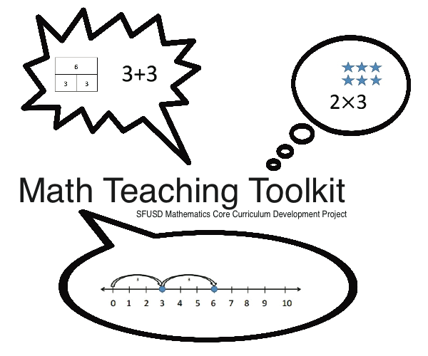
Teaching Strategies to Encourage Discourse
Three-Read Protocol
Support English Learners and other students to make sense of quantities and units in text.
Math Talks
Validate different ways thinking and need to clearly communicate mathematical ideas.
Participation Quiz
Reinforce norms for working collaboratively in groups and having productive discourse.
Multiple Abilities Launch
Identify strengths that expand what it means to do math and to be smart in math.
Notes:
Based on MTT from OUSD, another district supported by SVMI, SERP, Math in Common.

Slide 25
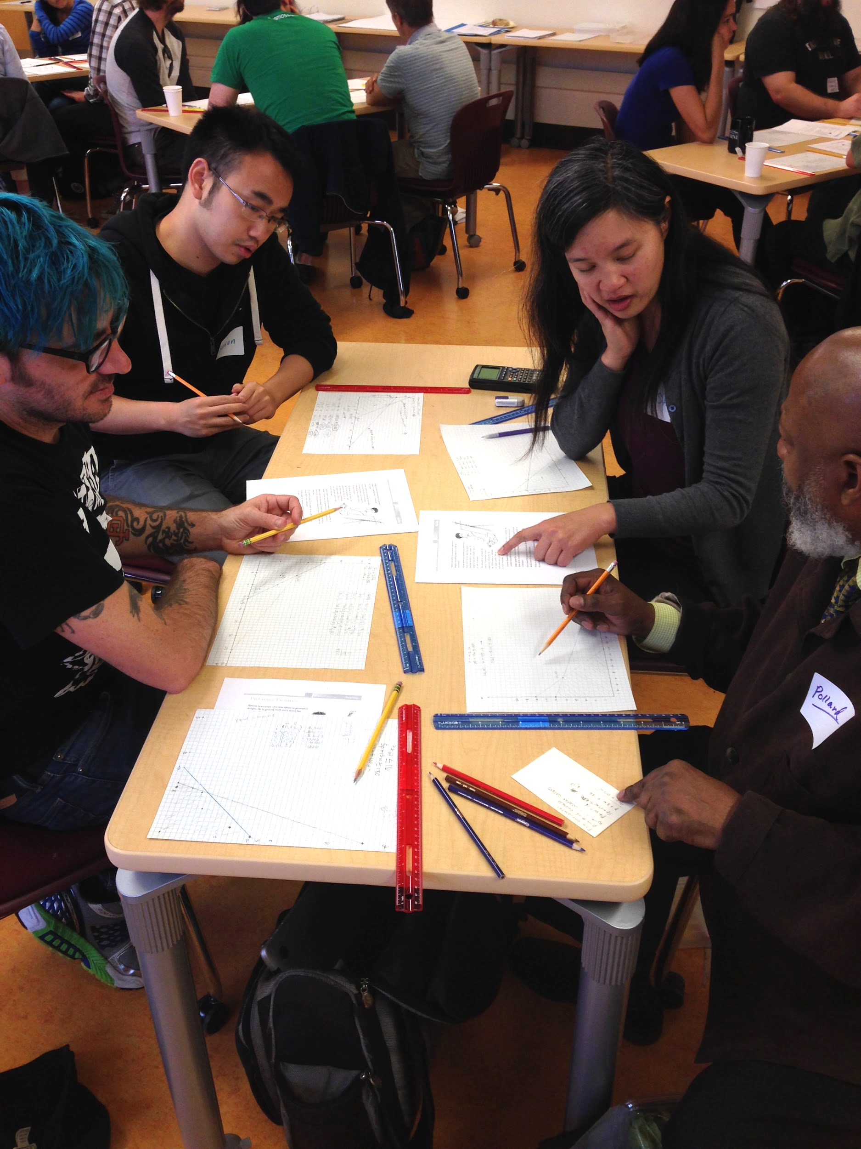
Professional Development for Teachers
Do math together.
Experience activities and strategies that give all students opportunities to engage.
Engage in deep planning that attends to the learning of all students (consider access, rigor, and structures for participation).
Use video to develop a vision of productive discourse in heterogeneous groups.

Slide 26
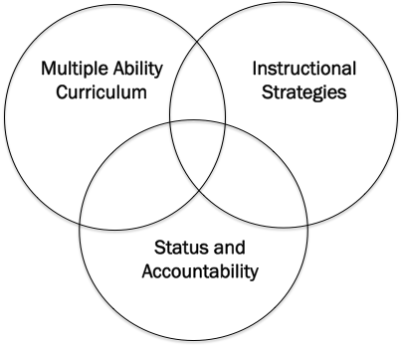
Complex Instruction
Based on research by Cohen and Lotan addressing status issues in groupwork and strategies to address them.
Active in half of high schools since 2009, expanded to half of middle schools in 2014.
Foundation of our support for teachers to make heterogeneous classes work for all students.
Notes:
CI challenges belief that students and teachers have about who is good and who is not good at math, and attempts to disrupt the predictable effect that those beliefs have on their participation and learning in groups.

Slide 27
Changing Belief Systems of Who Can Succeed in Math
Core curriculum based on rich math tasks.
Teaching strategies that encourage student discourse.
Professional development focused on supporting multiple abilities.
Policy changes and coaching support for heterogeneous classes.
Public campaign about growth mindset to address concerns of parents, administrators, and teachers.

Slide 28
Growth Mindset

Slide 29
Questions and Comments
Please share your thoughts, insights, and questions so that I can learn from you too!
How can community colleges build upon the shifts described in the CCSS-M?
How might you incorporate a growth mindset approach in your teaching?

Slide 30
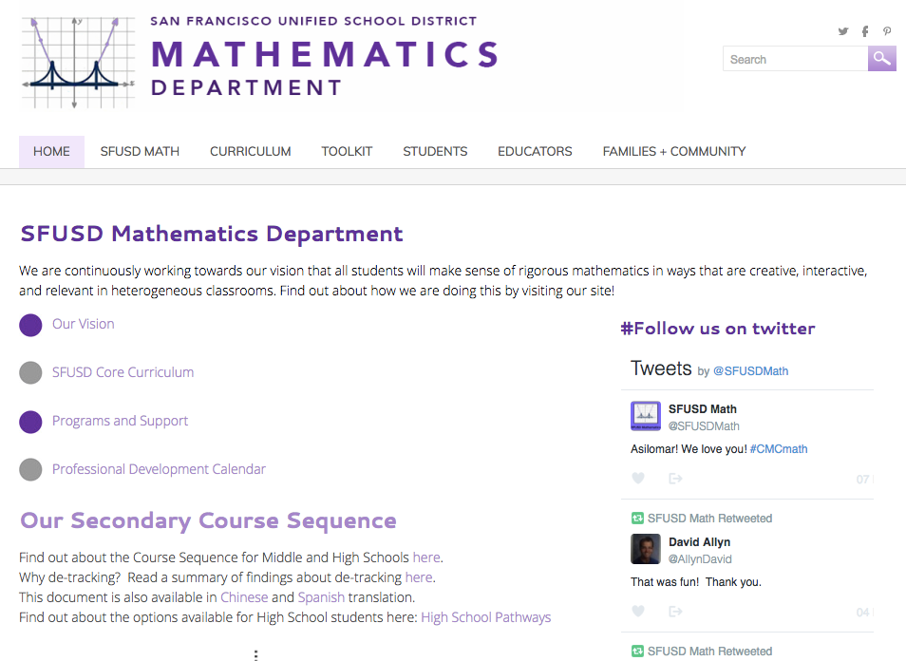
Thank You!
Andres Marti
Math Content Specialist
martia@sfusd.edu
Information and resources on our website:
sfusdmath.org
Notes:
Play heterogeneous classes in 9th grade video on our homepage.

