Slide 1
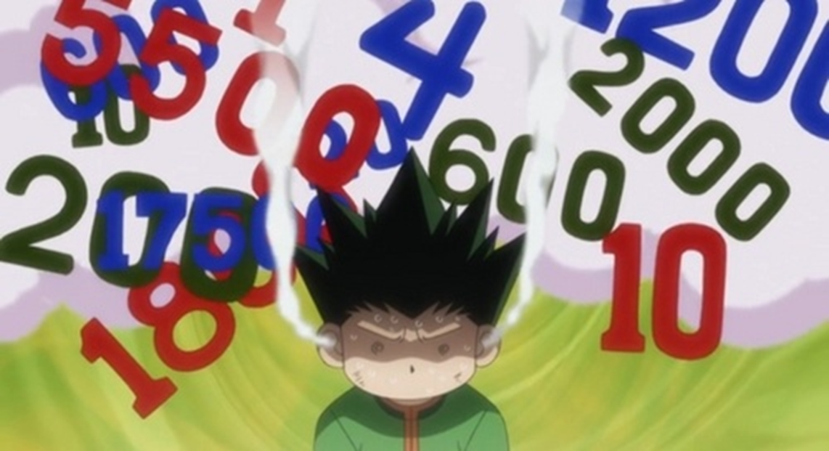
Beal’s Conjecture vs. “Positive Zero”, Fight!
Apr. 17, 2015 at the 19th Annual CMC3 Recreational Mathematics Conference in S Tahoe.
By Angela Moore: angela.moore@yale.edu

Slide 2
Introduction
This talk seeks to encourage a mathematical dialog regarding a possible solution to Beal’s Conjecture.

Slide 3
Beal’s Conjecture Background
Beal’s Conjecture was proposed by Andrew Beal in 1993.
His theory was inspired by Fermat’s Last Theorem.
Beal hoped that his conjecture would inspire young people to become more interested in the math and sciences .

Slide 4
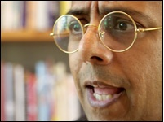
Numberphile is made possible by support from the Mathematical Sciences Research Institute(MSRI), based in Berkeley, California. The best mathematicians from around the world come to MSRI - usually for a semester - to target hot research topics.
Simon Singh is one of the UK's best-known science/math writers. He completed a PhD in particle physics at Cambridge University.

Slide 5
Fermat’s Last Theorem vs. Homer Simpson
http://www.numberphile.com/videos/homer_fermat.html (Enter url to watch clip)

Slide 6
The Undefeated Champion: Beal’s Conjecture
A^x + B^y = C^z
Where A, B, C, x, y, and z are positive integers with x, y, z > 2, then A, B, and C have a common prime factor.

Slide 7
A^x means A raised to a power
Example 1:
A=2 X=2
2^2 = 2x2 = 4
Example 2:
A=2 X=3
2^3=2X2X2=8 (2X2=4, 4X2=8)

Slide 8
Prime Number
A prime number is a number greater than 1 that is only divisible by 1 and itself.
Ex: 3 is prime because the only numbers that divide into it evenly are 3 and 1.
6 is not prime because 1, 2, 3 and 6 can go into 6 evenly. This means it is divisible by more than 1 and itself.
1 is not prime because it is not greater than 1.

Slide 9
Common Prime Factor
Prime factors of a positive integer are prime numbers that divide into that integer exactly.
Ex: 3 is a prime number that goes into 6 and 9 evenly, so 6 and 9 have a common prime factor of 3.

Slide 10
Beal Conjecture Demonstration
Example 3^3 + 6^3 = 3^5
3x3x3=27
6x6x6=216
3x3x3x3x3=243
This equates to 27+216=243
Since 3 is a prime number that goes into 27, 216 and 243, 3 is a common prime factor for all 3 numbers.

Slide 11
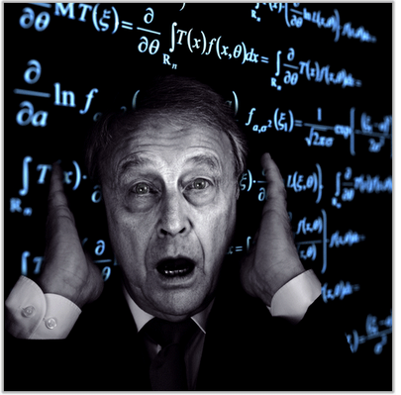
The Counterexample of Doom

Slide 12
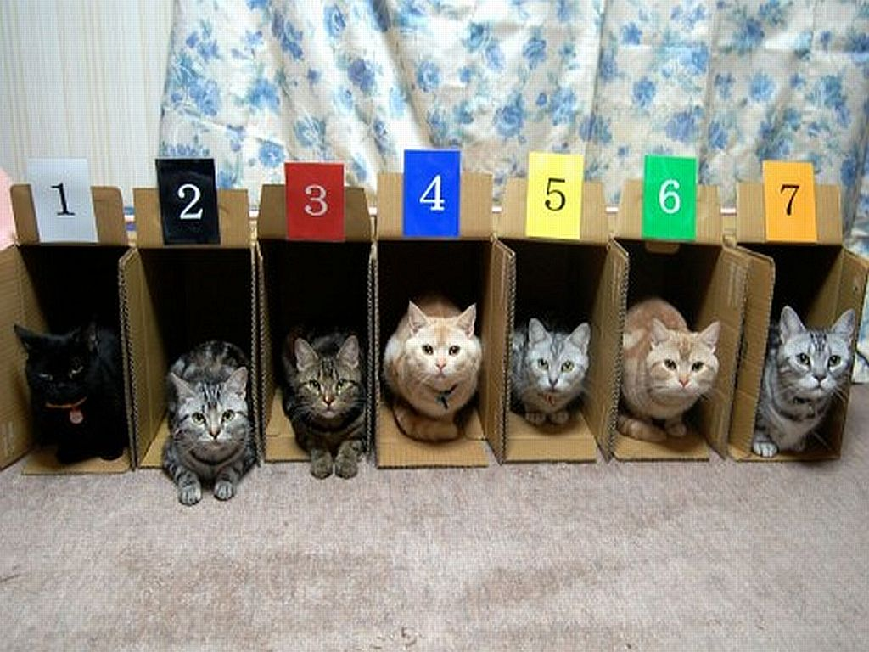
Let the Games Begin:
Beal’s Conjecture is never true when:
A B or C = 1

Slide 13
There are instances when positive 0 is not the same as zero.

Slide 14
Representations that allow negative zero can be a source of errors in programs.
It is claimed that the inclusion of signed zero in IEEE 754 makes it much easier to achieve numerical accuracy in some critical problems.

Slide 15
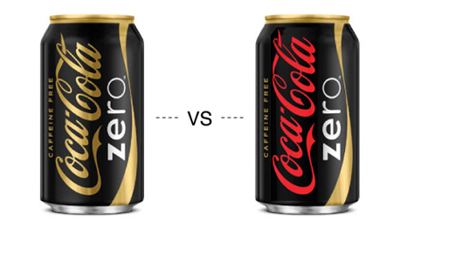
Differences Between Zero and Signed Zero in IEEE 754.

Slide 18
Beal’s Conjecture is grounded in Number Theory – a branch of mathematics that deals with the properties and relationships of integers; especially positive ones.

Slide 19
Floating point computation is used in Computational Number Theory

Slide 20
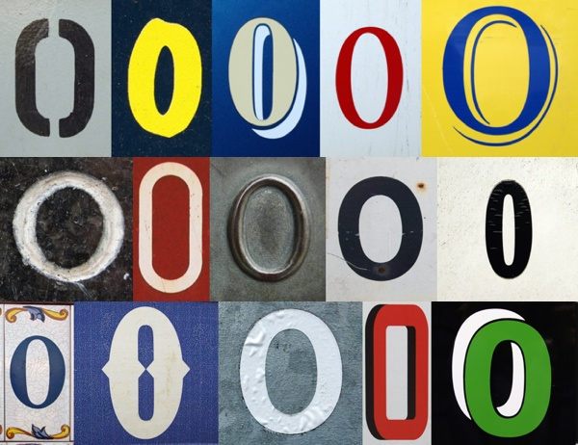
Signed Zero can be used to Represent Different Concepts

Slide 21
Signed zero echoes the mathematical analysis concept of approaching 0 from below as a one-sided limit, which may be denoted by x → 0− , x → 0−, or x → ↑0.
The notation "−0" may be used informally to denote a small negative number that has been rounded to zero.
The concept of negative zero also has some theoretical applications in statistical mechanics and other disciplines.

Slide 22
In statistical mechanics, one sometimes uses negative temperatures to describe systems with population inversion, which can be considered to have a temperature greater than positive infinity.
This is because the coefficient of energy in the population distribution function is −1/Temperature.

Slide 23
Ways to distinguish Zero from Zero
Type punning the number to an integer type, so as to look at the sign bit in the bit pattern
Using the IEEE 754 copysign() function to copy the sign of the zero to some non-zero number
Taking the reciprocal of the zero to obtain either 1/(+0) = +∞ or 1/(−0) = −∞ (if the division by zero exception is not trapped)

Slide 24
Some programming languages distinguish between the two zeros, such as the equals method in Java's Double class.

Slide 25
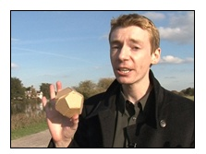
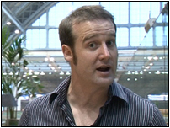
James Grime is a mathematician and public speaker on behalf of the Millennium Mathematics Project from the University of Cambridge.
Matt Parker is a mathematician based at Queen Mary College, University of London.

Slide 26
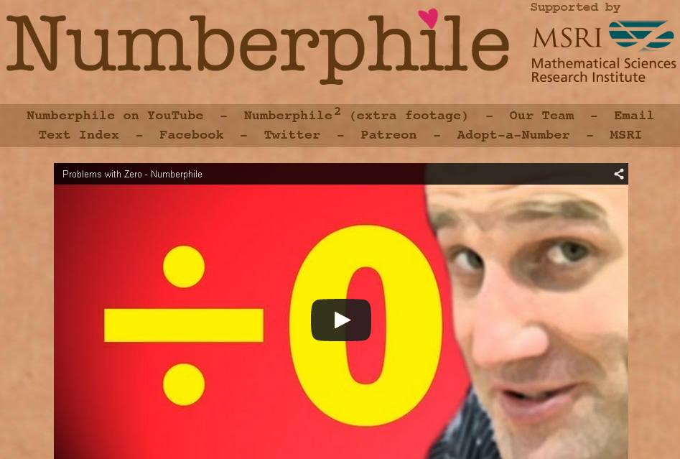
Danger’s of Using Zero
http://www.numberphile.com/videos/divide_by_zero.html (Enter URL to watch clip)

Slide 27
Recap
0 is an integer
It is possible for positive 0 to not be the same as 0
It is possible for positive zero to help achieve numerical accuracy
It is possible for positive zero to produce different results from zero

Slide 28
The Finishing Blow:
If the formula A^x + B^y = C^z is used when the existence of positive 0 that can be considered a positive integer is allowed, the following statement disproves Beal’s Conjecture:
1^3 + (+0)^4= 1^5

Slide 29
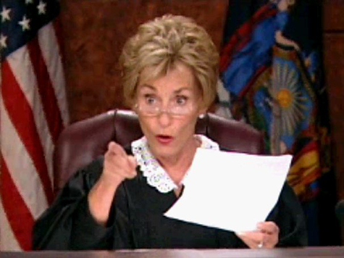
CAN YOU CHOOSE A WINNER?

Slide 30
Some people may say that Beal’s Conjecture won this fight due to the fact that zero is NEVER included in “the positive integers.” Furthermore, some people may say that it is highly implied that the numbers used in the final answer must be greater than zero.
Others may argue that Positive Zero won the match due to the fact that it is never specifically stated in the question that a positive integer has to be greater than zero or part of the “official positive integers.” The question only states that the integers must be positive and that ANY counterexample to the question posed is acceptable.

Slide 31
Others may argue that definition of a positive integer states that the integer must be greater than zero, but definitions change over time.
Just because something is assumed doesn’t mean something is true.
Some may argue that this theory break the proposed rules, but even in chess there are subjective rules such as the touch move rule which some regional organizations have different rules for.
No mathematical possibility should ever be over looked, which is why signed zero should be examined.

Slide 32
Based on what you’ve heard in this presentation and what you have learned in previous math classes, who do you think won the final match?
Regardless of the answer, the complexities of signed zero warrant thorough deliberation so that the gray area regarding what it truly means to be a “positive integer” can eventually be eliminated.

Slide 33
QUESTIONS TO CONSIDER
Are there ever exceptions to rules in mathematics?
Are there certain rules that always remain true in mathematics?
Should a question be judged on what is written or what is implied?
When is it acceptable to alter a mathematics rule?
Is math always exact?
If the definition of a positive integer changes, should Beal be allowed to alter his question or is this what he was looking for?
Is positive zero really different from zero?
Does allowing the use of positive zero alter the original question?

Slide 34
REFERENCES
https://sites.google.com/site/sixdegreesofgottfriedleibniz2/degree-4-signed-zero
http://en.wikipedia.org/wiki/Signed_zero
http://www.numberphile.com/videos/homer_fermat
http://www.numberphile.com/videos/divide_by_zero.html
http://www.numberphile.com/team/index.html
http://www.numberphile.com/MSRI/index.html
http://simonsingh.net/simon-singh/boring-biog/
http://arxiv.org/abs/1501.01673
http://www.mathgoodies.com/articles/Beals-Conjecture.html
http://mathnews.uwaterloo.ca/wp-content/uploads/2014/08/v124i1-2.pdf (Pg. 4)
IMAGES: http://images6.fanpop.com/image/answers/3463000/3463735_1391850733817.31res_500_272.jpg
https://i.embed.ly/1/display/resize?key=1e6a1a1efdb011df84894040444cdc60&url=http%3A%2F%2Fwww.seekingwholeness.com%2Fwp-content%2Fuploaded-files%2F2010%2F11%2Fmath.gif
http://www.hdwallpapersinn.com/wp-content/uploads/2014/11/cat_race-302.jpg
http://www.jokeblogger.com/sites/default/files/category_pictures/Judge-Judy1370275509.jpg
http://images.amcnetworks.com/ifc.com/wp-content/uploads/2011/11/rocky-III-11222011.jpg
http://www.bevreview.com/wp-content/design_cokeevolution3.jpg
http://www.niemanlab.org/images/a-bunch-of-zeros-cc.jpg
http://img1.ak.crunchyroll.com/i/spire4/07232008/5/7/d/a/57da4b11fa94f0_full.jpg

Slide 35
Acknowledgements
Prof. Mark Harbison -CMC³ President/AMATYC VP (West region)/Statistics Professor, Sacramento City College
Prof. Larry Green, Ph.D. - Conference Webmaster/Faculty, Mathematics Department Lake Tahoe Community College
Jenny Freidenreich – CMC³ Conference Coordinator
Gisele Glosser – Editor of Math Goodies
Murphy Berzish, Rachel Wiens and Julie Sturgeon - Editors of mathNEWS, University of Waterloo
Kenneth Mathews - K-12 Math Supervisor New Haven, CT Public Schools
Medria Blue-Ellis - Principle of the Engineering and Science University Magnet School (ESUM), New Haven CT
Bruce Dixon - CEO of the Connecticut Pre-Engineering Program
Prof. Steven Bayne – Chair of Fairfield University’s Department of Philosophy
Carolyn Arnold – Assistant Director, Academic Marketing and Communications Office, Fairfield University
Salvatore Trifilio- Reporter for the Fairfield Daily Voice
Bill Fallon - Reporter for the Fairfield County Business Journal
Mary Reynolds, Cheryl Bergman and Ingrid Derrick-Lewis – Representatives for the New Haven Works Job’s Pipeline
Greg Baldwin – Principle of New Haven Academy, CT
Meredith Gavrin - Program Director of New Haven Academy, CT
Marianne Maloney – 9-12 Math Teacher New Haven Academy
Lisa Monroe – Yale University’s African American Studies department

