Slide 1
Using Simulation/Randomization-based Methods to Introduce Statistical Inference on Day 1
Soma Roy
Department of Statistics, Cal Poly, San Luis Obispo
CMC³ Fall Conference, Monterey, California
December 6, 2014

Slide 2
Overview
Background
Sample examples
Advantages of this approach
Resources
Also,
These slides will be posted at http://www.math.hope.edu/isi/
My email: soroy@calpoly.edu

Slide 3
Background
The Stat 101 course
Algebra-based introductory statistics for non-majors
First few times I taught this course, I followed a very “traditional” route
Sequencing of topics

Slide 4
Background (contd.) Typical “traditional” sequence of topics
Part I:
Descriptive statistics (graphical and numerical)
Part II:
Data collection (types of studies)
Part III:
Probability (e.g. normal distribution, z-scores, looking up z-tables to calculate probabilities)
Sampling distribution/CLT
Part IV: Inference
Tests of hypotheses, and
Confidence intervals

Slide 5
Background: Motivation
Concerns with using the typical “traditional” sequence of topics
Puts inference at the very end of the term
Leaves very little time for students to
Develop a strong conceptual understanding of the logic of inference, and the reasoning process behind:
Statistical significance: p-values as measures of strength of evidence
Confidence intervals: Intervals of plausible values for parameter of interest
Content (parts I, II, III, and IV) appears disconnected and compartmentalized
Not successful at presenting the big picture of the entire statistical investigation process

Slide 6
Background: Philosophy and Approach
Fall 2010: Collaborating with Nathan Tintle (then Hope College, now Dordt College), Beth Chance, Allan Rossman (both Cal Poly), George Cobb (Mt. Holyoke College), Todd Swanson, Jill VanderStoep (both Hope College)
Reorder the sequence of topics to introduce the concept of statistical inference early in the term
Use simulation/randomization-based methods to introduce statistical inference early
Repeat in difference contexts – go deeper with each repetition
Introduce descriptive statistics and implications of study designs just in time

Slide 7
Background: Philosophy and Approach (contd.)
Recent attempts to change the sequence of topics
Chance and Rossman (Introduction to Statistical Concepts and Methods, 2005)
introduce statistical inference in week 1 or 2 of a 10-week quarter in a calculus-based introductory statistics course.
Malone et al. (2010)
discuss reordering of topics such that inference methods for one categorical variable are introduced in week 3 of a 15-week semester, in Stat 101 type courses.

Slide 8
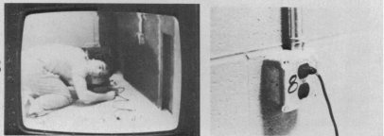
Example 1: Introduction to chance models
Research question: Can chimpanzees solve problems?
A trained adult chimpanzee named Sarah was shown videotapes of 8 different problems a human was having (Premack and Woodruff, Science,1978)
After each problem, she was shown two photographs, one of which showed a potential solution to the problem.

Slide 9
Example 1: Introduction to chance models
Research question: Can chimpanzees solve problems? (contd.)
Sarah picked the correct photograph 7 out of 8 times.
Question to students: What are two possible explanations for why Sarah got 7 correct out of 8?

Slide 10
Example 1: Intro to chance models (contd.)
Generally, students can come up with the two possible explanations
Sarah guesses in such situations, and got 7 correct just by chance
Sarah tends to do better than guess in such situations
Question: Given her performance, which explanation do you find more plausible?
Typically, students pick explanation #2 as the more plausible explanation for her performance.
Question: How do you rule out explanation #1?

Slide 11
Example 1: Intro to chance models (contd.)
Simulate what Sarah’s results could-have-been had she been just guessing
Coin tossing seems like a reasonable mechanism to model “just guessing” each time
How many tosses?
What to record after 8 tosses?
“Number of heads” ⇔ “Number of correct answers just by chance”
How many repetitions?
Thus, we establish the need to mimic the actual study, but now assuming Sarah is just guessing, to generate the long-run pattern of “just guessing” results

Slide 12
Example 1: Intro to chance models (contd.)
Here are the results of 35 repetitions ( for a class size of 35)
Aspects of the distribution to discuss: center and variability; typical and atypical values
Question: What next? How can we use the above dotplot to decide whether Sarah’s performance is surprising (i.e. unlikely) to have happened by chance alone?

Slide 13
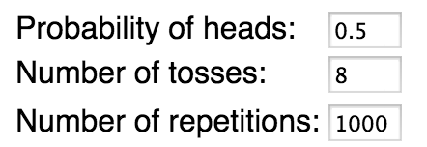
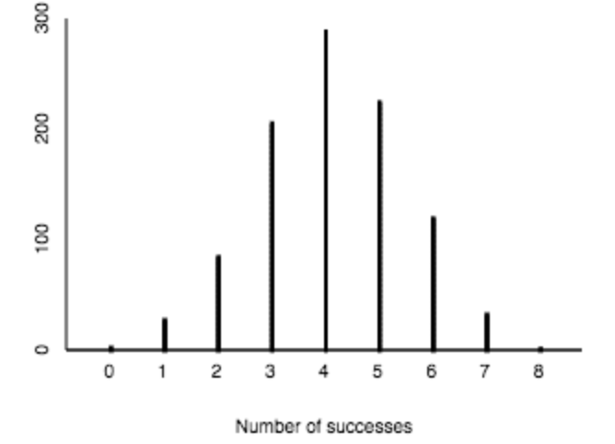
The One Proportion applet
Move to the applet to increase the number of repetitions
Question: Does the long-run guessing pattern convince you that Sarah does better than guess in such situations? Explain.

Slide 14
Example 1: Intro to chance models (contd.)
For this first example/exploration, I am deliberate about
Appealing to the student’s intuition to answer the question “is the observed result surprising to have happened by chance alone?”
Using a simple 50-50 null model
Having the observed result be quite clearly in the tail of the null distribution
Avoiding formal terminology such as parameter, hypotheses, null distribution, and p-value

Slide 15
Example 1: Intro to chance models (contd.)
Natural follow-up or “Think about it” questions:
What if Sarah had got 5 correct out of 8? Would her performance be more convincing, less convincing, or similarly convincing that she tends to do better than guess?

Slide 16
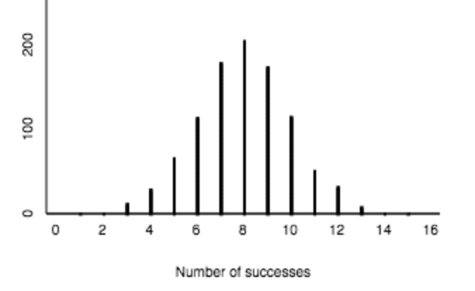
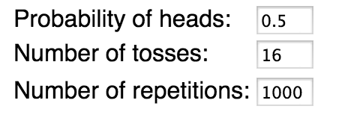
Example 1: Intro to chance models (contd.)
Natural follow-up or “Think about it” questions (contd.):
What if Sarah had got 14 correct out of 16 questions?
Still the same proportion (14/16 = 0.875) of correct responses. But is this more or less convincing evidence that she tends to do better than guess?

Slide 17
Example 1: Intro to chance models (contd.)
Natural follow-up or “Think about it” questions (contd.):
Based on Sarah’s results, can we conclude that all chimpanzees tend to do better than guess?
Main idea: Students can starting thinking about and answering these deeper questions as early as day 1!

Slide 18
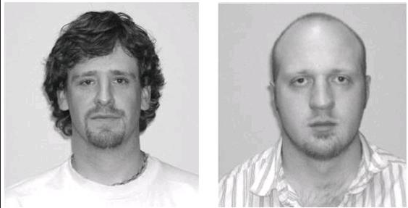
Example 2: Let’s try this out!
Face on the left: Bob or Tim?
Do people tend to pick Tim more often than expected to happen by random chance alone?
Let’s use the One Proportion applet.

Slide 19
Example 3: Measuring the strength of evidence
Research question: Does psychic functioning exist?
Utts (1995) cites research from various studies involving the Ganzfeld technique
“Receiver” sitting in a different room has to choose the picture (from 4 choices) being “sent” by the “sender”
Out of 329 sessions, 106 produced a “hit” (Bem and Honorton, Psychological Bulletin, 1994)

Slide 20
Example 3: Measuring the strength of evidence (contd.)
What are two possible explanations for the observed proportion of “hits” being 0.322 ( = 106/329)?
Key question: Is the observed number of hits surprising (i.e. unlikely) to have happened by chance alone?

Slide 21
Example 3: Measuring the strength of evidence (contd.)
Question: What is the probability of getting a hit by chance?
0.25 (because 1 out of 4)
Can’t use a coin. How about a spinner?
Same logic as before:
Use simulation to generate what the pattern/distribution for “number of hits” could-have-been if receivers are randomly choosing an image from 4 choices.
Compare the observed number of hits (106) to this pattern

Slide 22
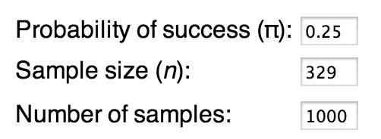
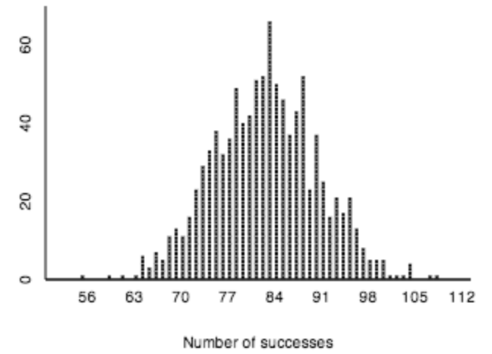
The One Proportion applet
Question: Is the observed number of hits surprising (i.e. unlikely) to have happened by chance alone?
What’s a measure of how surprising (i.e. unlikely)?
“Tail proportion”
The p-value!

Slide 23
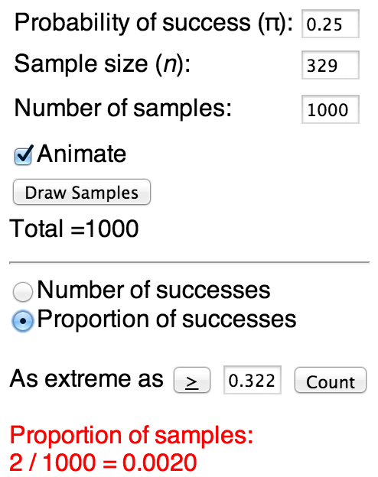
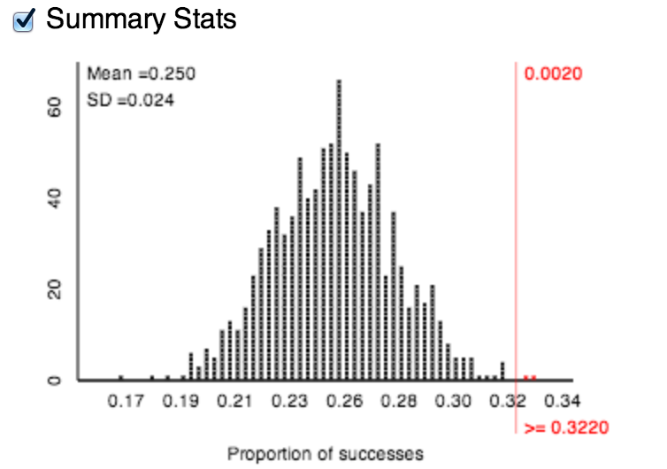
The One Proportion applet
So, the approx. p-value = 0.002
Note that the statistic can either be the number of or the proportion of hits

Slide 24
Example 3: Measuring the strength of evidence (contd.)
For this example I am deliberate about
Formalizing terminology such as hypotheses, parameter vs. statistic (with symbols), null distribution, and p-value
Moving away from 50-50 null model
Still staying with a one-sided alternative to facilitate the understanding of what the p-value measures, but in a simpler scenario

Slide 25
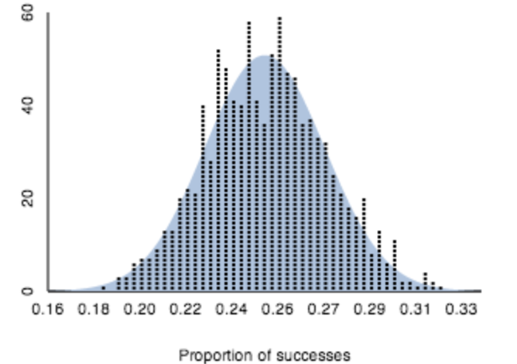
Example 3: Measuring the strength of evidence (contd.)
Natural follow-ups
The standardized statistic (or z-score) as a measure of how far the observed result is in the tail of the null distribution
Theoretical distribution: the normal model, and normal approximation-based p-value
Examples of studies where the normal approximation is not a valid approach

Slide 26
Example 4: Let’s try this out
Which tire?
It has been conjectured that in such situations people tend to pick the right-front tire more often than expected by random chance. Do the data collected on you provide evidence in favor of this research conjecture?
Left front | Right front
Left rear | Right rear

Slide 27
What comes next
Two-sided tests for one proportion
Sampling from a finite population
Tests of significance for one mean
Confidence intervals: for one proportion, and for one mean
Observational studies vs. experiments
Comparing two groups – simulating randomization tests…

Slide 28
Example 5: Comparing two groups on a categorical response
Research question: Are people suffering from minor to moderate depression more likely to show substantial improvement if they swim with dolphins rather than not swim with dolphins?
Researchers (Antonioli and Reveley, British Medical Journal,2005) recruited 30 subjects aged 18-65 with a clinical diagnosis of mild to moderate depression. These 30 subjects went to an island off the coast of Honduras, where they were randomly assigned to one of two treatment groups. Both groups engaged in the same amount of swimming and snorkeling each day, but one group (the animal care program) did so in the presence of bottlenose dolphins and the other group (outdoor nature program) did not. At the end of two weeks, each subject’s level of depression was evaluated, as it had been at the beginning of the study.

Slide 29
Example 5: Comparing two groups on a categorical response (contd.)
Explanatory variable: whether or not swam with dolphins (categorical)
Response variable: whether or not showed substantial improvement in depression symptoms (categorical)
Type of study: randomized experiment
Data organized in a two-way table:
 | Dolphin | No dolphin | Total
Showed substantial improvement | 10 | 3 | 13
Did not show substantial improvement | 5 | 12 | 17
Total | 15 | 15 | 30

Slide 30
Example 5: Comparing two groups on a categorical response (contd.)
Observed diff. in proportion of improvers (D – ND) = 10/15 – 3/15 = 0.4667
What are two possible explanations for the observed difference in proportion of improvers?
Swimming with dolphins does not help; observed difference is by random chance alone (Null)
Swimming with dolphins does help (Alternative)
How surprising (i.e. unlikely) is the observed difference in proportion of improvers to have happened by random chance alone?

Slide 31
Example 5: Comparing two groups on a categorical response (contd.)
How do we simulate random chance?
Why is coin tossing not an appropriate mechanism anymore?
What should we use instead?
Randomization test
Mimics what happened in the actual study, but assuming swimming with dolphins makes no difference
So, if swimming with dolphins makes no difference
The 13 improvers would have improved regardless of treatment, and
The 17 non-improvers wouldn’t have improved regardless of treatment

Slide 32
Example 5: Comparing two groups on a categorical response (contd.)
Thus, what we’d like to know is, “If 13 people would have improved anyway, and 17 wouldn’t have improved anyway, how surprising would it be to see what we did in the study by chance?”
To answer this question, we need to generate possible tables that could have happened just by random chance (assignment) alone, so we can compare our observed result to chance outcomes.
 | Dolphin | No dolphin | Total
Showed substantial improvement | ????? | ????? | 13
Did not show substantial improvement | ????? | ????? | 17
Total | 15 | 15 | 30

Slide 33
Example 5: Comparing two groups on a categorical response (contd.)
Randomization test
Tactile simulation, first:
Need 30 cards: 13 blue + 17 green
Shuffle and redistribute into two groups – 15 (D) and 15 (ND); complete table; record the (shuffled) difference in proportion of improvers.
Repeat (2) many times, say 1000 times.
Find the proportion of repetitions where (shuffled) difference in proportion of improvers was at least as extreme as 0.4667
 | Dolphin | No dolphin | Total
Showed substl. imp. |  |  | 13
Didn’t show substl. imp |  |  | 17
Total | 15 | 15 | 30

Slide 34
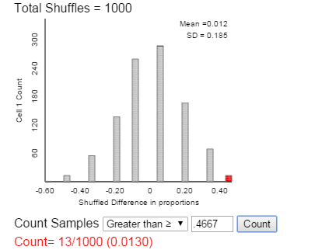
Multiple Proportions Applet
Use an applet to generate the null distribution with a large number of repetitions
Same concept as before: does the observed result (0.4667) appear unlikely to have happened by chance alone?
How do we measure how unlikely: p-value.

Slide 35
Example 6: Comparing two groups on a quantitative response
Research question: Do people tend to perform worse on a visual discrimination task if they were sleep deprived three nights ago (even though they’ve had unrestricted sleep on the following nights) compared to if they had had unrestricted sleep on all previous nights?
Explanatory variable: sleep deprived (D) or not (U) (categorical)
Response variable: score (quantitative)
Type of study: randomized experiment

Slide 36
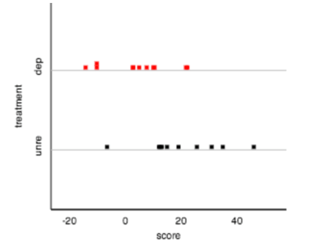
Example 6: Comparing two groups on a quantitative response (contd.)
Unrestricted-sleep group’s improvement scores (milliseconds): 25.2, 14.5, -7.0, 12.6, 34.5, 45.6, 11.6, 18.6, 12.1, 30.5
Sleep-deprived group’s improvement scores (milliseconds): -10.7, 4.5, 2.2, 21.3, -14.7, -10.7, 9.6, 2.4, 21.8, 7.2, 10.0
Observed diff. in average score (U – D) = 15.92ms
What are two possible explanations for the observed difference in averages?
How surprising (i.e. unlikely) is the observed difference in averages to have happened by chance alone?

Slide 37
Example 6: Comparing two groups on a quantitative response (contd.)
Randomization test (mimics what happened in the actual study, but assuming sleep deprivation makes no difference)
Tactile, first:
Need 21 cards - write down one score per card.
Shuffle and redistribute the scores into two groups – 10 (U) and 11 (D); record the (shuffled) difference in average scores.
Repeat (2) many times, say 1000 times.
Find the proportion of repetitions where (shuffled) difference in average scores was at least as extreme as 15.92ms

Slide 38
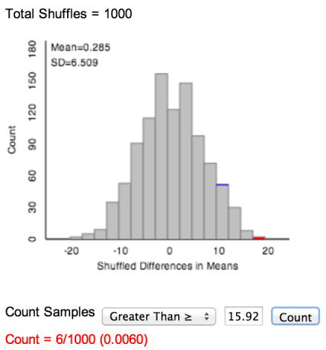
Multiple Means Applet
Use an applet to generate the null distribution with a large number of repetitions
Same concept as before: does the observed result (15.92) appear unlikely to have happened by chance alone?
How do we measure how unlikely: p-value.

Slide 39
Core idea of this approach to statistical inference
The key question is the same every time
“Is the observed result surprising (unlikely) to have happened by random chance alone?”
First through simulation/randomization, and then theory-based methods, every time
Start with a tactile simulation/randomization using coins, dice, cards, etc.
Follow up with technology – purposefully-designed (free) web applets (instead of commercial software); self-explanatory; lots of visual explanation
Wrap up with “theory-based” method, if available

Slide 40
Advantages of this approach
Does not rely on a formal discussion of probability, and hence can be used to introduce statistical inference as early as week 1
Provides a lot of opportunity for activity/exploration-based learning
Helps students see that the core logic of inference stays the same regardless of data type and data structure
Allows one to use a spiral approach
To deepen student understanding throughout the course

Slide 41
Advantages of this approach (contd.)
Students seem to find it easier to interpret the p-value
Students seem to find it easier to remember that smaller p-values provide stronger evidence against the null
Allows one to use other statistics that don’t have theoretical distributions; for example, difference in medians, or relative risk (without getting into logs)
Most importantly, this approach is more fun for instructors (not that I am biased ☺)

Slide 42
Resources
Course materials: Introduction to Statistical Investigations (Fall 2014, John Wiley and Sons) by Nathan Tintle, Beth Chance, George Cobb, Allan Rossman, Soma Roy, Todd Swanson, Jill VanderStoep
Samples of our materials as well as slides for various conference presentations are available at: http://www.math.hope.edu/isi/
Applets are available at: http://www.rossmanchance.com/ISIapplets.html
My email address: soroy@calpoly.edu

Slide 43
Acknowledgements
Thank you for listening!
National Science Foundation DUE/TUES-114069, 1323210
If you’d like to know more about our approach:
Beth Chance and Allan Rossman, “Estimating with Confidence: Developing Students' Understanding” – next session @10:30 am, same place

