Slide 1
The Common Core Standard and CCC
Larry Green
Lake Tahoe Community College

Slide 2
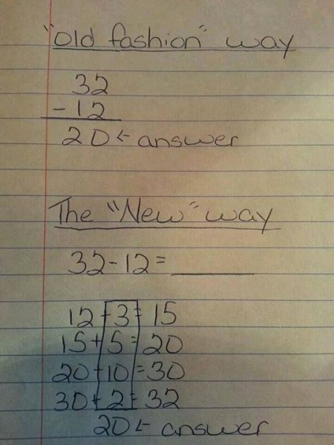
What You Learn From Facebook

Slide 3
What are the Common Core Standards?
National Math and English Standards adopted by 46 states and DC.
Replaces NCLB standards written by each state.
Nationally created but locally selected.
California started this year.

Slide 4
What’s in the CCSSM?
Standards for Mathematics Practice
Describes how math students engage with the subject matter as they grow mathematical maturity
Standards for Mathematical Content
Standards without a “+”
Standards with a “+”

Slide 5
CCSSM Practices
Make sense of problems and persevere in solving them.
Reason abstractly and quantitatively.
Construct viable arguments and critique the reasoning of others.
Model with mathematics.

Slide 6
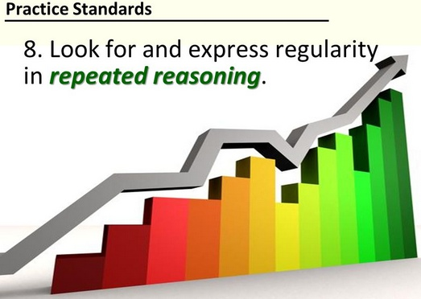
CCSSM Practices (Continued)
Use appropriate tools strategically.
Attention to precision.
Look for and make use of structure.
Look for and express regularity in repeated reasoning

Slide 7
Assessment Test
Most of California: Smarter Balance
Requires a computer for each student.
Uses AI.
Still in testing phase.
Open ended questions.
Other tests similar.

Slide 8
Smarter Balance in Action

Slide 9
Mostly Word Problems

Slide 10
Not Just Multiple Choice

Slide 11
Incorporates AI to Assess Critical Thinking

Slide 12
Free Writing

Slide 13
Still Includes Some Traditional Math

Slide 14
Includes Statistics

Slide 15
Applications and Algebra

Slide 16
Incorporates AI to Assess Critical Thinking

Slide 17
Probability and Writing

Slide 18
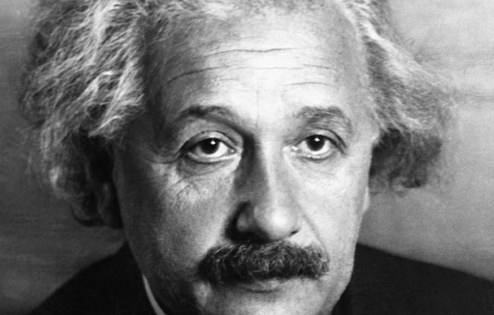
Training the Next Einstein

Slide 19
Not a Multiple Choice

Slide 20
More Analysis

Slide 21
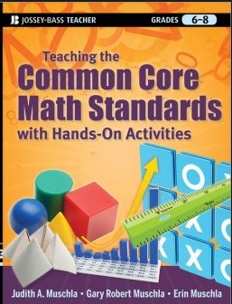
Biggest Challenge
No textbooks yet for CCC!
No textbooks yet for High Schools
High schools develop their own materials.
Two choices for Middle Schools

Slide 22
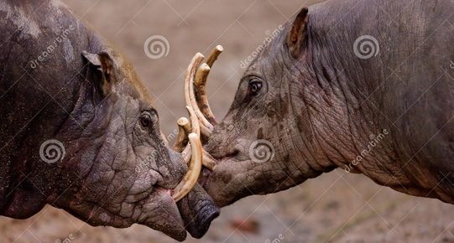
BOARS
Encourages us to move to the CCMS.
Will accept our current curriculum for the foreseeable future.
Will accept CCMS.
Does not accept Path to Stats.
Currently no CCC has adopted CCMS (as far as I know)

Slide 23
Possible Recommendations
Wait for a text book to come out.
Use what high schools have developed.
Write a book and make millions.

Slide 24
Questions?

