Slide 1
Special Needs Food Requests are Welcome. Just Ask!

Slide 2
Changing the Culture of Teaching: Reflections on Mathematics Teaching, and How to Improve It
Jim Stigler
UCLA
December 6, 2014
Notes:
We want deep learning / flexible expertise. But we don’t achieve that. What role might teaching play in this?

Slide 3
TIMSS video studies
What does teaching look like in US classrooms, and in classrooms of higher-achieving countries?

Slide 4
TIMSS Video: Background
Two large studies, started in 1993
Strategy: video survey
Goals:
Investigate “average teaching”
Compare teaching across countries
Find commonalities among high-achieving countries
Notes:
The initial problem faced by the 1995 TIMSS Video Study was how to collect a large enough sample to claim is was nationally representation and collect enough detail to study teaching (rather than an over-simplified facsimile).
Large-scale studies in the past had been conducted using teacher self-reports on questionnaires, with all the well-known (validity) difficulties; on the other hand, many case studies of teaching have been conducted with the accompanying problems of generalizability.
Question: Why do another video study?
To elaborate the concept of video survey
But there are other reasons as well . . .

Slide 5
TIMSS Video: Teaching is Cultural
Teaching is a cultural activity; varies more across than within cultures (TIMSS 1995 video study; goals/scripts)
Notes:
Learned implicitly (ritual learning)
Hard to see (e.g., confusion)
Hard to change: culture wins

Slide 6
US: “Quick and snappy”
Japan: “Slow and sticky”
SOURCE: Hess & Azuma (1991)
Notes:
Hess & Azuma:
Quick & Snappy vs. Slow and Sticky
They also argue: Every society solves the problem of motivation in a different way.
Also: US teachers think teaching math is easy; Japanese teachers think it’s hard!

Slide 7
TIMSS Video: Teaching is Cultural
Cultural activities are:
Learned implicitly (ritual learning)
Multiply determined
Hard to see (e.g., confusion)
Hard to change: culture wins
Notes:
Competent implementation of limited methods.

Slide 8
What do high-achieving countries have in common?*
*Do they all teach like Japan?
Notes:
So, US and Japan very different; but do we have to teach like Japan to get deep learning?

Slide 9
Hong Kong
Notes:
In the second TIMSS video study we studied a variety of other high-achieving countries

Slide 10
Netherlands
Notes:
Mostly look different from Japan
And though they all differ in most respects
Lecture vs. groups
Real world vs. symbolic
Digging deeper we found that the high-achievers offered something in common
… which we call learning opportunities

Slide 11
TIMSS Video: What Do High-Achieving Countries Have in Common?
Not the cultural routines, but the ability to implement routines effectively to create certain kinds of learning opportunities for students.
Not this…
Teachers’ strategies
Students’ Learning
This:
Teachers’ strategies
Learning Opportunities
Students’ Learning

Slide 12
The three Learning opportunities
What kinds of experiences result in students’ deep learning?

Slide 13
Research Indicates Three Types of Learning Opportunities Required for Deep Understanding
To achieve flexible expertise, students need recurring and sustained opportunities for:
Productive struggle – with important mathematics
Explicit connections – between concepts, procedures, problems, situations
Deliberate practice – increasing variation and complexity over time

Slide 14
1. Productive Struggle
Notes:
Learning sciences research supports these learning opportunities
E.g., Hiebert & Grouws
Deep learning requires “desirable difficulties:”
Many studies in which learners think they learn less, feel confused, but actually learn more, especially in the long run
E.g., Roediger & Karpicke
Bad outline better than good outline (Mannes & Kintsch, 1987)

Slide 15
Productive Struggle and Desirable Difficulties
Students randomly assigned to two conditions to study science text:
Four study periods
Read passage 14.2 times
Predicted good recall
One study / 3 recall periods
Read passage 3.4 times
Predicted poor recall
Source: Roediger & Karpicke (2006)
Notes:
A number of new studies show that things we do to make learning harder lead to deeper, longer-lasting learning, even though students don’t perceive it this way.
Here’s an example: Roediger & Karpicke
Another example: Mannes & Kintsch – poor outline better than good outline

Slide 16
Productive Struggle and Desirable Difficulties
Students randomly assigned to two conditions to study science text:
Four study periods
Read passage 14.2 times
Predicted good recall
One study / 3 recall periods
Read passage 3.4 times
Predicted poor recall
Source: Roediger & Karpicke (2006)
Notes:
A number of new studies show that things we do to make learning harder lead to deeper, longer-lasting learning, even though students don’t perceive it this way.
Here’s an example: Roediger & Karpicke
Another example: Mannes & Kintsch – poor outline better than good outline

Slide 17
Confucius
I never enlighten anyone who has not been driven to distraction by trying to understand a difficulty or who has not got into a frenzy trying to put his ideas into words. When I have pointed out one corner of a square to anyone and he does not come back with the other three, I will not point it out to him a second time” (不愤不启, 不悱不发. 举一隅不以三隅反, 则不复也.) (Lau, 7:8)

Slide 18
2. Explicit Connections
Notes:
Learning sciences research supports these learning opportunities
E.g., Hiebert & Grouws
Deep learning requires “desirable difficulties:”
Many studies in which learners think they learn less, feel confused, but actually learn more, especially in the long run
E.g., Roediger & Karpicke
Bad outline better than good outline (Mannes & Kintsch, 1987)

Slide 19
Thinking Hard

Slide 20
The Power of Connections
Few Connections
Many Connections
B
B
C
C
A
A
D
D
F
F
E
E
G
H
G
H

Slide 21
Example: Struggle to Make Connections
What fraction of the rectangle is shaded brown?
(a)
(b)
⅓
¼
⅓
½
SOURCE: Deborah Ball (2013)
Notes:
This illustrates all three learning opportunities: the increasing variation/complexity (deliberate practice); the struggle (hard for students); the connection to explicit concepts (equal size pieces, keeping track of what the “whole” is)

Slide 22
Igor Gregoriev: “Only 5 Chords”

Slide 23
2. Deliberate Practice
Notes:
Learning sciences research supports these learning opportunities
E.g., Hiebert & Grouws
Deep learning requires “desirable difficulties:”
Many studies in which learners think they learn less, feel confused, but actually learn more, especially in the long run
E.g., Roediger & Karpicke
Bad outline better than good outline (Mannes & Kintsch, 1987)

Slide 24
Deliberate Practice
Different from repetitive practice
Constantly increasing variation, complexity, challenge
With feedback
Staving off premature automaticity

Slide 25
Learning Opportunities
Explicit Connections
− +
Step-By-Step Procedures | Well-Formed Lecture
Discovery Learning | ✪
−
+
Productive
Struggle

Slide 26
Learning Opportunities
Deliberate Practice
✪
✪
Explicit Connections
− +
✪
Step-By-Step Procedures | Well-Formed Lecture
Discovery Learning | ✪
−
+
✪
Productive
Struggle
✪
Maintaining
struggle and connections
through time

Slide 27
Creating Learning Opportunities: Easier Said than Done!
Teacher Actions
Learning Opportunities
Flexible Expertise

Slide 28
Community college Developmental mathematics
Consequences of US teaching routines

Slide 29
60% of entering community college students place into remedial math. Why?

Slide 30
DEVELOPMENTAL MATH STUDENTS Socialized to Maladaptive View of Math
View math as rules/procedures to be memorized; can’t “figure it out”
When students were asked, “What does it mean to be good at math?” 77% gave answers like these:
“Math is just all these steps.”
“In math, sometimes you have to just accept that that’s the way it is and there’s no reason behind it.”
“I don't think [being good at math] has anything to do with reasoning. It's all memorization.”

Slide 31
Knowing Mathematics
“I used to think that maths teachers were all teaching the same subject, some doing it better than others. I now believe that there are two effectively different subjects being taught under the same name, ‘mathematics.’”
Skemp (1976)

Slide 32
DEVELOPMENTAL MATH STUDENTS Compulsion to Calculate
a
5
a
8
Which is greater: or ?
53% correct, but very few could explain why
Compulsion…
5a = a8
5 = 8
✔

Slide 33
DEVELOPMENTAL MATH STUDENTS Compulsion to Calculate: Find a Pattern and Do Something!
In the equation 2(x+3) = 14,
what is the value of (x+3)?
43% got correct answer of 7. But only 7% went straight to 7.
77% distributed the 2…
2x+6=14
2x=8
x=4
50% stop right here!

Slide 34
DEVELOPMENTAL MATH STUDENTS Conceptual Atrophy
462
+ 253
715
Interviewer: “How could you check that your answer is correct?”
Interviewer: “Why did you subtract 253? Could you have subtracted 462 to check the answer?”

Slide 35
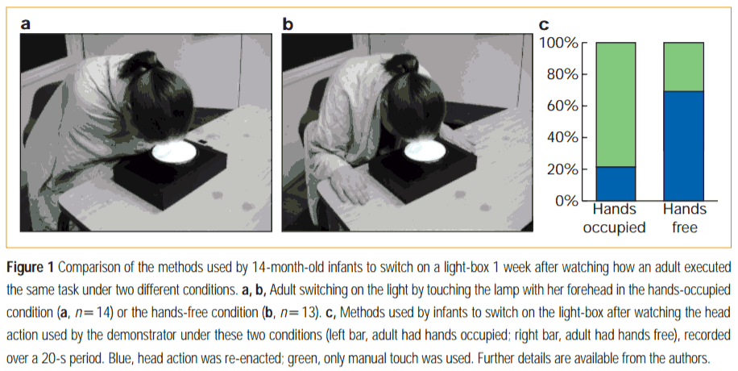
Ritual Learning in Infants
Gergely, Bekkering, & Kiraly (2002). Nature, 415, 755.

Slide 36
Socialization of US Students into Mathematics
Young children: concepts and counting, linked together
Some insist that math make sense, with or without teacher’s help
May become mathematicians/scientists
SCHOOL: Practicing procedures/memorizing rules
Good memorizers, memorize their way through algebra
Success, but never really “get” mathematics
Poor memorizers have difficulty
All comes crumbling down
Community College Developmental Math

Slide 37
Improving teaching and learning

Slide 38
“Every system is perfectly designed to achieve the results it gets.”
-Paul Bataldan

Slide 39
Improving Teaching
Shift focus from teachers to teaching
Use systems improvement methods
Engage both teachers and students in improving routines of teaching and learning
Keep the focus on learning opportunities and student learning
Awareness
Incremental changes

Slide 40
Conclusions
Teaching is a cultural activity: routines evolved over time, multiply determined, hard to change
High-achieving countries have different teaching scripts, but use them to create common learning opportunities
US script is limited, leading students to limited view of what it means to learn mathematics, resulting in conceptual atrophy
Improving teaching will require teachers and students to become aware of their cultural routines; and make gradual improvements over time.

Slide 41
stigler@ucla.edu

Slide 42
Teacher’s Goal for the Lesson
"What was the main thing you wanted students to learn from today's lesson?"
[back]

