Slide 1
OEI, BSI, SSI, CAI, EPI – My, oh My!
The California Community Colleges Initiatives
Barbara Illowsky, PhD
De Anza College
illowskybarbara@fhda.edu
@DrBSI

Slide 2
OEI: Online Ed http://www.ccconlineed.org/
Proposal for increasing access and success through online instruction funded through the Governor’s request
$56.9 million over 55 months, starting December 2013
Sponsored by Foothill-De Anza CCD in partnership with Butte College

Slide 3
Why OEI?
Funding for the California Community Colleges was cut $1.5 billion between the 2007-08 and 2011-12 academic years
Course offerings statewide were cut by roughly 25 percent due to the five consecutive years of deep budget cuts.
The cuts forced community colleges to ration course offerings and as a direct result, nearly 500,000 students were shut out of the system.

Slide 4
Steering Committee Work Groups
Professional Development
Consortium
Student Services
Common Course Management System
Academic Affairs
Basic Skills

Slide 5
24 pilot college consortium
1. Student Readiness Review: 8 colleges piloting the Student Readiness Solutions, providing feedback, collecting information in Spring of 2014.
2. Tutoring Support Review: 8 colleges piloting the Tutoring solutions, providing feedback, collecting information in Spring of 2014.
3. Full Launch: 8 colleges in consortium piloting the full launch and related processes in the CCMS in Summer and Fall of 2015.

Slide 6
OEI Pilot Colleges
Student Readiness Spring 2015 | Online Tutoring Spring 2015 | Full-Launch (CCMS) Summer/Fall 2015
Antelope Valley | Barstow | Butte
Cabrillo | College of the Canyons | Coastline
Hartnell | Columbia | Foothill
MiraCosta | Imperial Valley | Shasta
Monterey Peninsula | Mt. San Antonio | Fresno City
Ohlone | Pierce | Lake Tahoe
Rio Hondo | Saddleback | Mt. San Jacinto
West Los Angeles | Victor Valley | Ventura

Slide 7
What does the OEI hope to accomplish?
Increase the ability of our
students to
complete their goals.

Slide 8
Basic Skills Support
In OEI transfer courses
Pre-assessment support in CAI

Slide 9
Finding basic skills support
Open Educational Resources – aim is to find and use these as much as possible
Homegrown modules
Low cost licensing, if budget allows for it

Slide 10
BSI: Basic Skills http://extranet.cccco.edu/Divisions/AcademicAffairs/BasicSkillsEnglishasaSecondLanguage.aspx
≈ $19 million to individual colleges
≈ $1 million to LACCD/3CSN to provide statewide professional development http://3csn.org/

Slide 11
For mathematics:
Funds may be used to assist students in courses from noncredit through Intermediate Algebra

Slide 12
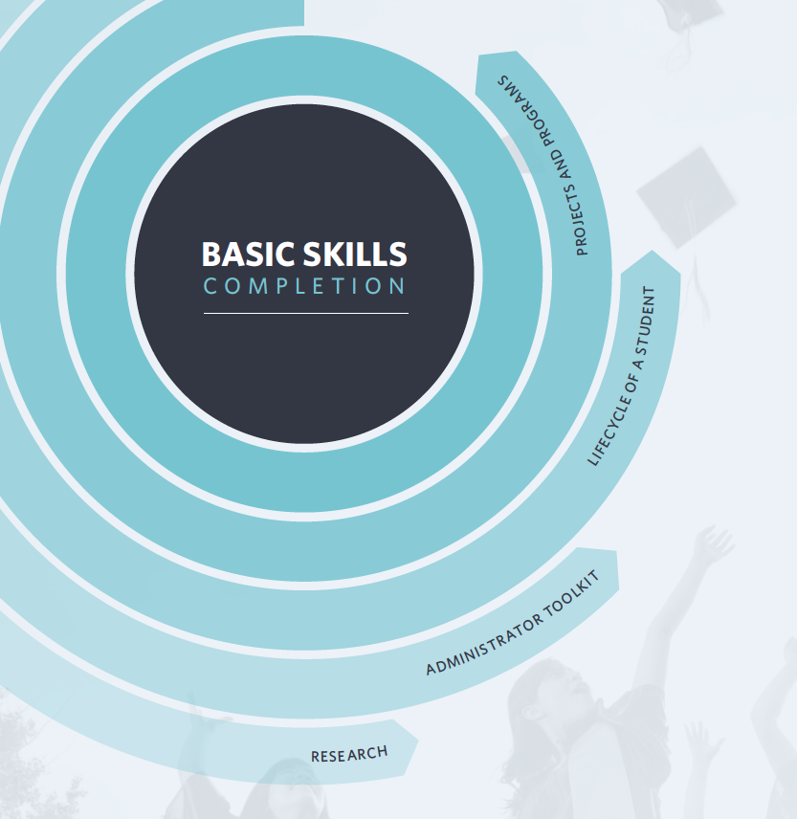

Slide 13
SSI: Student Success http://www.californiacommunitycolleges.cccco.edu/StudentSuccessInitiative.aspx
January 2011: CCC BOG formed a task force to chart a roadmap for system-wide focus on student success. The task force identified best practices and designed evidence-based recommendations to ensure student success is a driving theme in our colleges.

Slide 14
SSI: comprehensive plan
Focuses on our core missions of workforce preparation, remediation, transfer to four-year colleges and universities, and degree and certificate completion.

Slide 16
CAI: Common Assessment http://cccassess.org/
Common Assessment System for the benefit of all CCC and their students
Contain test preparation, test delivery, test administration, data collection, and course placement guidance
Centralized and integrated technology solutions to support assessment and placement.
RFP will go out “soon”

Slide 17
EPI: Educ. Planning http://cccedplan.org/
Develop a student services portal that will customize and sequence matriculation information and activities
Develop an Educ. Planning and Degree Audit System to provide transcript, articulation, and curriculum inventory elements to colleges and help college counselors reach more students.

Slide 18
Ultimate goal

Slide 19
How do YOU join the parties?

Slide 20
Sign up on listservs
TechEDge
http://ccctechedge.org/

Slide 21
Thank you!

