Slide 1
Community College Math Faculty Engagement in Assessment
Marie Bruley
Merced College
December 14, 2013

Slide 2
SLO Assessment: The Issues
Varied processes within community colleges
Little is known about math faculty engagement and the improvement interventions that are resulting from assessment processes.
Much of the current research focuses on institutional level outcomes or case studies
Improving student success in mathematics is an important system goal…Is SLO assessment a vehicle that could potentially address this goal?
Resources are being devoted to SLO assessment cycles within institutions and represent a significant investment and should be as robust and effective as possible
Significance of the study:
Important for understanding how assessment data are being used to improve mathematics instruction
Low student success in mathematics (CCCCO Data Mart, 2011)
Community college leaders need information on how campus environments serve to support or discourage faculty participation in SLO assessment

Slide 3
The Literature on Assessment
Historical and current context
Four key national reports and a paradigm shift away from a teacher centered approach to teaching and learning (Ewell, 2009; Marwick, 2007; Banta, 2002; Barr & Tagg, 1995; Banta et. al, 2004; Nelson, Wallner, Powers, & Hartley, 2000).
Community colleges have an 18 year history of implementation of assessment and are wondering whether access is enough (Chaplot, 2010; Somerville, 2008; Bailey, Alfonso, Calcagno, Jenkins, Kienzl, & Leinback, 2004; Gardiner, 1998; Moore & Shulock, 2010).
Assessment for the improvement of teaching and learning
Assessment of an institution is designed to determine how effective it is at meeting its mission and a means for attaining feedback to improve the student experience (Beno, 2004; Frye, 1999; Kuh & Ewell, 2010; Banta et. al, 2004; Seybert, 2002).

Slide 4
The Literature on Assessment
The faculty role in assessment
Faculty engaging in assessment utilize student learning data to restructure learning experiences for students (Kuh & Ewell, 2010; Lightner & Benander, 2010)
“An essential act of our profession is the design of learning experiences to meet specified purposes” (Lightner & Benander, 2010, p. 7).
Institutional context and the impact on teaching and learning
The institution impacts both teaching and learning by influencing teacher work, organizational strategy, campus climate, and culture (Gamoran, Secada, & Marrett, 2000; Goren et al., 2000).
Community college mathematics curriculum
Success rates in mathematics hover around 50% (California Community College Chancellor’s Office Data Mart, 2011)
Basic skills courses act as a gatekeeper to degree completion and transfer readiness
All community college students face a mathematics requirement
Traditional emphasis on algebra in preparing students for transfer level mathematics and Calculus

Slide 5
Research Methodology and Research Questions
Research methodology
Exploratory, mixed methods, sequential design
Interviews with nine faculty from small, medium, and large community colleges
Surveys sent out throughout the system, responses from 62 faculty that identified themselves as full-time faculty in the system
Research Questions
RQ1: What practices are community college mathematics faculty engaging in that utilize SLO assessments for the improvement of mathematics instruction?
RQ2: How are community college mathematics faculty using SLO assessment results to improve instruction?
RQ3: How does the organizational context and working environment in which SLO assessments are conducted impact the practices that math faculty are engaged in?
RQ3a: How does institutional support affect the SLO assessment practices that community college math faculty engage in?
RQ4: How are community college mathematics faculty implementing instructional improvements in courses at different levels?

Slide 6
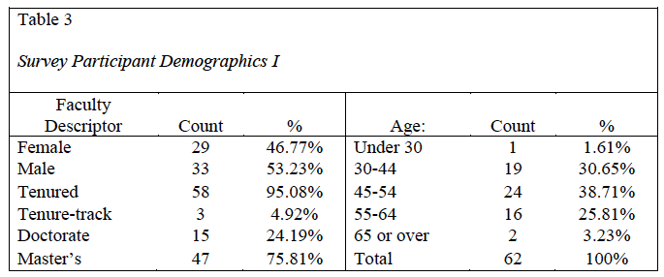
Participant Demographics

Slide 7
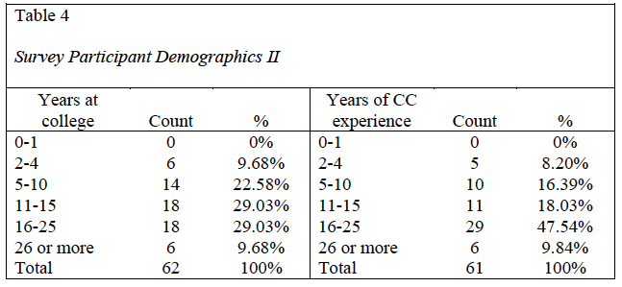
Participant Demographics

Slide 8
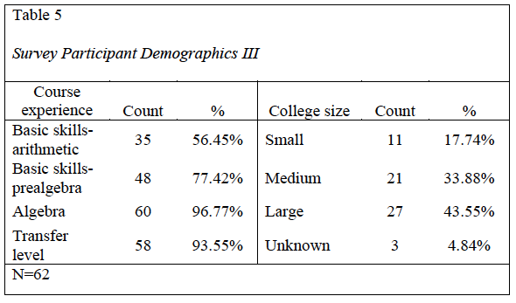
Participant Demographics

Slide 9
Research question 1: What assessment practices are community college mathematics faculty engaging in?
Math faculty are actively engaging in a variety of assessment activities (table 6, SQ: 2, 10, 12, 13, 15)
Three approaches to the assessment process
Individual, departmental, and institutional responsibility for assessment (Table 8 and 9). Math departments use a mixed approach to assessment (table 7 & 8).
Differences in the approach used depends on the type and level of the course
Plans for course improvements are being developed by either individual faculty or by departments (SQ5)
More varied assessment methods are occurring in small scale assessments coordinated by individual faculty (QD)

Slide 10
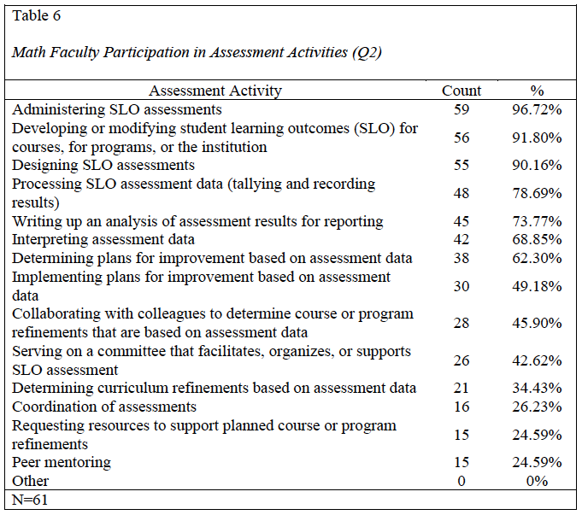

Slide 11
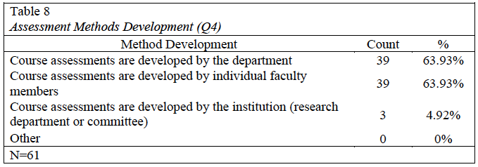
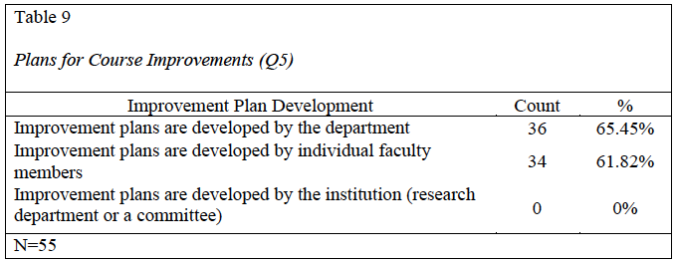

Slide 12
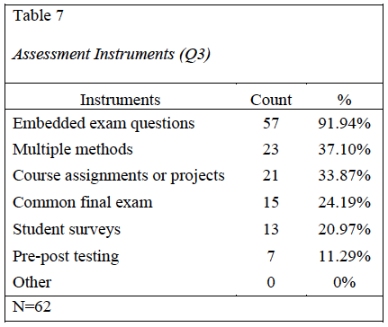

Slide 13
Research question 1: What assessment practices are community college mathematics faculty engaging in?
The majority of the participating departments are not assessing student attitudes towards the mathematics they are learning (80.32%).
The qualitative data suggest that some math faculty would like to include qualitative data in the assessment process.
A faculty member from a large college says, “I would be more excited about it [assessment] because we could focus more on qualitative discussion, which actually has changed my teaching style, instead of quantitative data.”

Slide 14
Faculty Assessment Practices: Qualitative Data
Process challenges
Distraction from teaching, competing priorities, difficulties collaborating
A faculty member from a large community college states, “I think it’s a priority for everybody but it’s just among all the others sometimes it gets shoved down a little bit.”
Process Effectiveness/Improvement
Meaningfulness emerged 11 times in statements in varied ways
“…are we answering other peoples questions or are we empowered to ask and answer what’s meaningful to us.”
“Our curriculum committee has limited us to three SLOs per course. We have so many skills embedded in each SLO, that they are impossible to measure and they tell us nothing about what aspects of our instruction need improvement.”
“I might like to change the assessment to more specific questions that will focus on ways we can improve the class,”
Concern about the over emphasis on assessment outcomes
Faculty within community colleges are wrestling with the assessment for accountability and assessment for improvement paradigms (Ewell, 2009).

Slide 15
Faculty Assessment Practices: Qualitative Data
Process strengths
Peer mentors for support
Systematic process with defined timelines
Technology that supports collaboration and dialogue
An adaptable process
Feedback from students
“What works well I think is gathering data and getting the feedback from the students especially on what they feel they are taking from the classes, that’s definitely one thing that I think works well.”
Facilitates review of the course outcomes

Slide 16
Faculty Assessment Practices: Qualitative Data
Process weaknesses
The process keeps changing
A moving target
Need for better technology
No time set aside for closing the loop
Process is time consuming
Data is not actionable
“It’s [the assessment process] great at documentation but I’m not sure that it actually has any pedagogical, educational improvement value.”
Uniformity of the process discourages creativity
A faculty member from a small college says, “the paper trail process hinders my participation.”

Slide 17
Research Question 2: How are community college mathematics faculty using SLO assessment results to improve instruction?
Increased emphasis on topics (SQ 16)
“I see the value of clearly communicating expectations for students and the improvement that makes both on your teaching and their learning.”
“…we took the data and we noticed some deviations from some of the SLOs and so we’re in the process still of making adjustments to the curriculum and what it’s actually done is opened up a discussion of our basic skills classes and how we’re offering them and if there’s any way we can maybe restructure the classes to improve student success…”

Slide 18
Research Question 2: How are community college mathematics faculty using SLO assessment results to improve instruction?
Revision or changing SLOs (SQ 16)
Broad SLOs or poorly selected SLOs hinder efforts to collect meaningful data
Half of respondents are implementing improvement plans; a majority of them are aligning their courses with the course SLOs (SQ 17, 21).
The study data suggest changes are relatively superficial
Participants do not believe that teaching practices are really changing (SQ 25, 26)
Interview data suggest smaller scale changes are occurring because of individual faculty efforts
Assignments, projects, course materials, and course assessments
“In some ways, changing courses for the better is now more difficult. Now the workload to do the SLOs and assess, takes away from our ability to assess courses for specific key areas of need. We now spend all of our time assessing a broad overarching topic and discussing ways to improve the SLO. It does not translate into actual class improvement.”

Slide 19
Research Question 2: How are community college mathematics faculty using SLO assessment results to improve instruction?
Changes to the math curriculum are largely due to pressures and data other than SLO assessment data (SQ 27, 28).
System-wide projects are forcing changes to the curriculum
C-ID, TMC, and transfer articulation requirements.
SLO assessment should facilitate professional development (SQ 45).

Slide 20
Research Question 3: How does the organizational context and working environment in which SLO assessments are conducted impact the practices that math faculty are engaging in?
Departmental dynamics (SQ 39)
Difficulty collaborating or lack of collaboration (SQ 23, 36, and 38).
“My department can’t seem to work together on anything…”
“…the process itself is more cumbersome with a group than with an individual and so agreeing on what improvements are needed, what improvements ought to be made is a much more cumbersome process when that level of collaboration is required.”
Part-time faculty
“…we have 70 adjuncts as compared to 18 full-time, we have to really work with, it’s the communication issue with the adjunct that’s the biggest challenge.”

Slide 21
Research Question 3: How does the organizational context and working environment in which SLO assessments are conducted impact the practices that math faculty are engaging in?
Faculty workload (SQ 33, 50)
Architect and/or carpenter…should we expect faculty to successfully be both?
A faculty member from a medium size college states, “…what I would change is find a way that it’s not so much work, it’s just every time we do it you’re asking more of the instructors, it’s coming through the instructor’s, it’s an extra step on the instructors, now they’re having to mark this extra thing, get this data back, and then somebody’s got to process this data and turn it in to the next person.
Peer support encourages math faculty engagement
Faculty obligations impact engagement in SLO assessment.
System-wide curriculum projects add to faculty workload (C-ID and TMCs)
A faculty member from a small college states, “Course load and other obligations hinder my participation”

Slide 22
Research Question 3: How does the organizational context and working environment in which SLO assessments are conducted impact the practices that math faculty are engaging in?
Emphasis on accountability (SQ 29, 31, 41, 43, 46, 45)
Perception that the process is for the benefit of external stakeholders (SQ 29, p.221)
Perception that the process is a passing fad
Making the process easier and more supported will not necessarily increase participation (SQ 41, 42, 54, 55)
Participation in assessment activities would continue despite the external mandate in one form or another (13)
Rigidity within assessment processes is attributed to accreditation requirements (page 222)
Allow for alternative ways of evaluating student progress
A better understanding of accreditation requirements is needed
Refocusing the process as a faculty development process (SQ 43, 45, and 46)

Slide 23
Research Question 3: How does the organizational context and working environment in which SLO assessments are conducted impact the practices that math faculty are engaging in?
Faculty attitudes: Individual, departmental, and college-wide
Primary motivation for participating in assessment (SQ 29, Table 15)
“My college is required to in order to maintain its accreditation”
Meaningfulness of assessment
“Meaningful assessments that actually help teaching and learning are too specific for SLOs. Now the state wants one broad SLO that covers the whole class, and tells us very little.”
Positive influences
Access to student feedback
Having a moldable (flexible) process that can be fit to the needs of the discipline
Processes that support participation

Slide 24
Research Sub-Question 3:How does institutional support affect the SLO assessment practices that community college math faculty engage in?
Few of the institutions represented by the study are offering support through institutional structures (SQ 51, 62, 64, and 65).
Types of support do not address the major issues of faculty workload and the meaningfulness of the data
It is important for institutions to provide support that is well aligned with faculty work life (Angelo, 2002).
Faculty foresee difficulties in scaling up the assessment process
More could be done if there was more time and support (SQ 61)
A faculty member from a small college reflects on the kind of support that she would like to see,
“…that kind of support of being somehow given permission to ask fewer questions, more meaningful research opportunities, facilitated by the institution with the aid of a researcher, fewer more robust projects would probably help to focus things more on the improvement aspect of it and lessen the reporting annoyance attitude of it.”

Slide 25
Research Sub-Question 3:How does institutional support affect the SLO assessment practices that community college math faculty engage in?
Meaningfulness of the process
Lack of meaningful data; redirecting the focus of the research questions
The fact that there are assessment methods that cannot be implemented because it requires a big effort diminishes the potential for obtaining meaningful assessment data (survey question 33).
Assessment process design can hinder the collection of actionable data
Blaich and Wise (2011) determined that insufficient access to high quality data was the primary hurdle institutions experienced in trying to use assessment data to advance the improvement of student learning.

Slide 26
Research Sub-Question 3:How does institutional support affect the SLO assessment practices that community college math faculty engage in?
Resources that influence math faculty engagement in SLO assessment.
Peer mentoring, a systematic process with clear timelines, easy reporting mechanisms, and a process that supports collaboration (SQ 38, quote page 228).
Support to help faculty fit assessment into their workload and juggle competing priorities
Support that helps to facilitate collaboration; coordinating opportunities for dialogue

Slide 27
Research Sub-Question 3:How does institutional support affect the SLO assessment practices that community college math faculty engage in?
Resources that influence math faculty engagement in SLO assessment.
Evaluating assessment designs to make changes that better support engagement (SQ 54, 59, 60, and 63).
Writing better SLOs impacts the meaningfulness of the data collected (SQ 52, 53).
Having targeted help for the labor of assessment supports faculty engagement (SQ 56).
“I am lucky to have a department chair who has done a lot of coordination and made the faculty’s jobs easier. This definitely helps involvement in SLO assessment”
“Help: I have a great department head”

Slide 28
Research Sub-Question 3:How does institutional support affect the SLO assessment practices that community college math faculty engage in?
Support for part-time faculty participation is desired (SQ37)
Contingent faculty are participating but not at the level desired (SQ15).
A significant percentage of courses are taught by part-time faculty.
Applying improvement plans consistently and fairness to students are concerns.

Slide 29
Research Question 4: How are community college mathematics faculty implementing instructional improvements in courses at different levels?
Differences in the changes being implemented (SQ 71, 72, and 74).
Basic skills: emphasis on skills; easier to identify gaps in learning; large number of part-time faculty
Algebra course are often subsumed under this category (mixed responses torn between an emphasis on skills and critical thinking).
Transfer level: emphasis is on critical thinking; less structured approach to the assessment process

Slide 30
Research Question 4: How are community college mathematics faculty implementing instructional improvements in courses at different levels?
Reasons for differences in changes
Assessment design
Early assessment programs focused on a particular course level (basic skills or algebra)
Basic skills: more coordination and collaboration is used
Transfer level: more of an individual faculty led effort
Fluidity of the cycle for an individual faculty member versus a group
Broad overarching SLOs versus objectives based SLOs
Departmental environment

Slide 31
Research Question 4: How are community college mathematics faculty implementing instructional improvements in courses at different levels?
Impact of articulation
“…our developmental area has always tended to be more experimental…because there’s no transfer, no articulation component, it lends itself more easily to that type of response to improvement…”
Nature of the content
“I would say the improvements I make in the basic skills are, you can see where they’re falling down, it’s skills so you just have to emphasize that.”
“…for basic skills courses the SLOs are more concrete things and then in the higher level they’re maybe more conceptual.”
Success rates
“I think in our basic skills courses we are finding they have a real lower success rate, so we’re looking at sort of a bigger modification…”
Affect of collaboration
“…those SLOs are drafted by the group and measured using common questions on the final and whatever changes would also be subject to the groups analysis that is a much more cumbersome process than an individual instructor looking at what they found in an individual course over time and making a change in their class, it’s a much swifter change when all you have is your own mind to change”
“It [work environment] hinders my involvement due to lack of communication”

Slide 32
Recommendations for Action
Resources devoted to facilitate reflection and dialogue on student learning
Address the issue of faculty workload, plan for how departments will use data, and provide resources for part-time faculty participation
Separate the collection of data for accountability from the data for the assessment and improvement of teaching and learning (Ewell, 2009; Wright, 2002).
Provide help for faculty to diversify the types of data that are collected
Focus assessment efforts on smaller research questions that are of interest to faculty

Slide 33
Recommendations for Action
Separate the collection of data for accountability from the data for the assessment and improvement of teaching and learning (Ewell, 2009; Wright, 2002).
Differentiate between data collection for information from research level data collection (Upcraft & Schuh, 2002)
“Should we call our efforts to learn about programs and outcomes “research” or “assessment”? The name can make all the difference. And trying to adhere to the standards of research may get in the way of doing effective assessment” (Upcraft & Schuh, 2002, p.16).
Develop a better understanding of accreditation requirements for SLO assessment
According to Ewell (2009), institutions need to wage a campaign to make faculty understand that assessment is a permanent part of the educational landscape and that it will not be a passing fad.

Slide 34
Conclusions
SLO assessment is a potentially powerful process for change if it is integrated with the classroom.
This connection largely depends on the engagement of faculty who structure the learning experiences for students.
Assessment work is being left to the faculty.
Given that faculty workload is a significant issue that impacts engagement, it is not enough to assume that faculty will make room in their workloads for assessment when the processes are deemed to have dubious value.

Slide 35
Conclusions
The greatest challenge institutions face is in obtaining and sustaining wide-ranging and deep faculty involvement.
“I probably think the most overriding factor is here comes another paper exercise, we’re going to do all these things, we’re going to turn in all this work, it’s going to be put on some shelf, it’s going to gather dust, we’re doing this to meet some administrators wish or goal and it doesn’t really have that much relevance to things.”

Slide 36
Conclusions
Kuh and Ikenberry (2009) state,
Student performance evaluation is so embedded in the everyday work of teaching, testing, and grading that many faculty members interpret calls for documenting outcomes at the program or institutional level-if not as an outright threat-as a redundant exercise or worse: a waste of time and resources that could be more profitably invested elsewhere (p. 9).

Slide 37
Contact Information
E-mail: bruley.m@mccd.edu
Link to the full dissertation document:
http://scholarworks.csustan.edu/handle/011235813/676

