Slide 1
CMC^3 Fall Conference
Encouraging Critical Thinking and Communication in Developmental Math
Mark Clark

Slide 2
How do we encourage critical thinking and communication?

Slide 3
Good applications that ask for more thinking than the basic math answer.

Slide 4
Growth of Medicare
The number of Florida residents who are enrolled in Medicare in thousands t years since 2000 can be represented by the equation
Source: Model derived from data found in the Statistical Abstract 2007.
Find the M-intercept. Explain its meaning in the terms of the problem.
Find the t-intercept. Explain its meaning in the terms of the problem.
What is the slope of this equation? Explain its meaning in the terms of the problem.
Notes:
Note that the t – intercept is not going to make sense.

Slide 5
Using Quick Polls
Multiple Choice Flash Cards
Linear, Quadratic, Exponential
Integer, Whole Num. , Natural Num.
Clicker Systems
PollEverywhere.com
Multiple Choice
Free Text Response

Slide 6
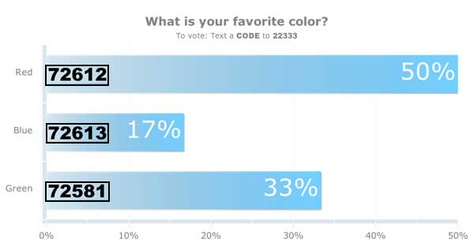
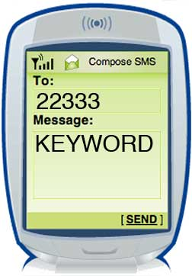
How To Vote via Texting
EXAMPLE
Notes:
This slide is for display to the audience to show them how they will vote on your polls in your presentation. You can remove this slide if you like or if the audience is already comfortable with texting and/or voting with Poll Everywhere.
Sample Oral Instructions:
Ladies and gentlemen, throughout today’s meeting we’re going to engage in some audience polling to find out what you’re thinking, what you’re up to and what you know. Now I’m going to ask for your opinion. We’re going to use your phones to do some audience voting just like on American Idol.
So please take out your cell phones, but remember to leave them on silent. You can participate by sending a text message.
This is a just standard rate text message, so it may be free for you, or up to twenty cents on some carriers if you do not have a text messaging plan. The service we are using is serious about privacy. I cannot see your phone numbers, and you’ll never receive follow-up text messages outside this presentation. There’s only one thing worse than email spam – and that’s text message spam because you have to pay to receive it!

Slide 7
Don’t forget: You can copy-paste this slide into other presentations, and move or resize the poll.
Notes:
Press F5 or enter presentation mode to view the poll In an emergency during your presentation, if the poll isn't showing, navigate to this link in your web browser: http://www.polleverywhere.com/multiple_choice_polls/LTE5ODQxNTkzNjI
If you like, you can use this slide as a template for your own voting slides. You might use a slide like this if you feel your audience would benefit from the picture showing a text message on a phone.

Slide 8
Don’t forget: You can copy-paste this slide into other presentations, and move or resize the poll.
Notes:
Press F5 or enter presentation mode to view the poll In an emergency during your presentation, if the poll isn't showing, navigate to this link in your web browser: http://www.polleverywhere.com/multiple_choice_polls/LTEwNzM4NzcwOTU
If you like, you can use this slide as a template for your own voting slides. You might use a slide like this if you feel your audience would benefit from the picture showing a text message on a phone.

Slide 9
Diagnosed Diabetes
The percentage of Americans who have been diagnosed with diabetes has been growing steadily over the years. In 2002, 4.8% of Americans had been diagnosed with diabetes. In 2004, 5.1% of Americans had been diagnosed with diabetes.
Source: CDC Diabetes Program
Assuming that the percentage of Americans diagnosed with diabetes continues to grow at a constant rate, write an equation to represent this situation.

Slide 10
Diagnosed Diabetes Cont.
Use the equation to estimate the percentage of Americans who will have been diagnosed with diabetes in 2010.
What is the slope of the equation you found. Explain what it means using the terms of the problem?

Slide 11
Costco Revenue
The total revenue for Costco Wholesale Corporation is given here
Source: http://finance.google.com.
Find an equation for a model of these data.
Year | Total Revenue (billion $)
2002 | 37.8
2003 | 42.5
2004 | 48.1
2005 | 53.0
2006 | 60.2
2007 | 64.4
2008 | 72.5

Slide 12
Costco Revenue Cont.
What is the slope of this model? Explain its meaning in this situation.
Estimate the total revenue for Costco Wholesale Corporation in 2010.
What is a reasonable domain and range for your model?

Slide 13
Healthcare Debate
Source: www.opensecrets.org

Slide 14
How’s Your Cholesterol?
Source: New York Times 3/31/2010

Slide 15
What Colleges Are Growing Fastest?
Source: Bloomberg Bussinessweek 3/15/2010

Slide 16
What’s Google Up To?
Source: www.opensecrets.org

Slide 17
Nice System of Equations
Source: Bloomberg Bussinessweek 3/8/2010

Slide 18
Student work

Slide 19
Test 1
1. The number of volunteers in the United States can be modeled by where is the number of volunteers in the United States in millions t years since 2000.
a. What is the t-intercept for this model and what does it represent in this context?

Slide 20
b. Find V(10) and explain its meaning in this context.
c. What is the slope of this model and what does it represent in this context?

Slide 21
Test 2
The height of a cannonball after being shot can be modeled by the function where H(t) is the height of the cannonball in feet, t seconds after being shot from the cannon.
Find H(3) and explain its meaning in this context.

Slide 22
b. At what time was the cannonball at its maximum height?

Slide 23
Test 1
6. The total revenue from cable TV programming in the U.S. is given in the table.
a. Find an equation for a model of these data.
Year | Revenue (million $)
2004 | 31,373
2005 | 35,386
2006 | 37,981
2007 | 40,870

Slide 24
b. Give a reasonable domain and range for your model.
c. Give the slope for this model and explain its meaning in this context.
d. What is the vertical intercept for this model and what does it mean in this context?

Slide 25
Test 2
3. The revenue from selling custom tools depends on the number of tools sold.
a. Find a model for this data.
Number of tools produced | Revenue ($)
8 | 1070.20
14 | 1139.80
27 | 1241.20
34 | 1267.80
40 | 1275.00
56 | 1223.80
66 | 1139.80

Slide 26
b. Give a reasonable domain and range for your model.
c. How many custom tools need to be sold to have a revenue of $1195?

Slide 27
d. What is the vertex of your model and what does it mean in this context?

Slide 28
Activities that students can do together.

Slide 29
Exponent Sort

Slide 30
Other Sorts
Types of numbers
Types of equations
Equations and Expressions
Types of Graphs
Units to the function or derivative
Simplifying Expressions

Slide 31
Make Living Graphs
Lines
m positive
m negative
m really small
m large
b negative
b positive
Parabolas
a positive
a negative
a small
a big
h positive
h negative
k positive
k negative

Slide 32
Create Two-Second Graphs

Slide 33
Create Two Second Graphs

Slide 34
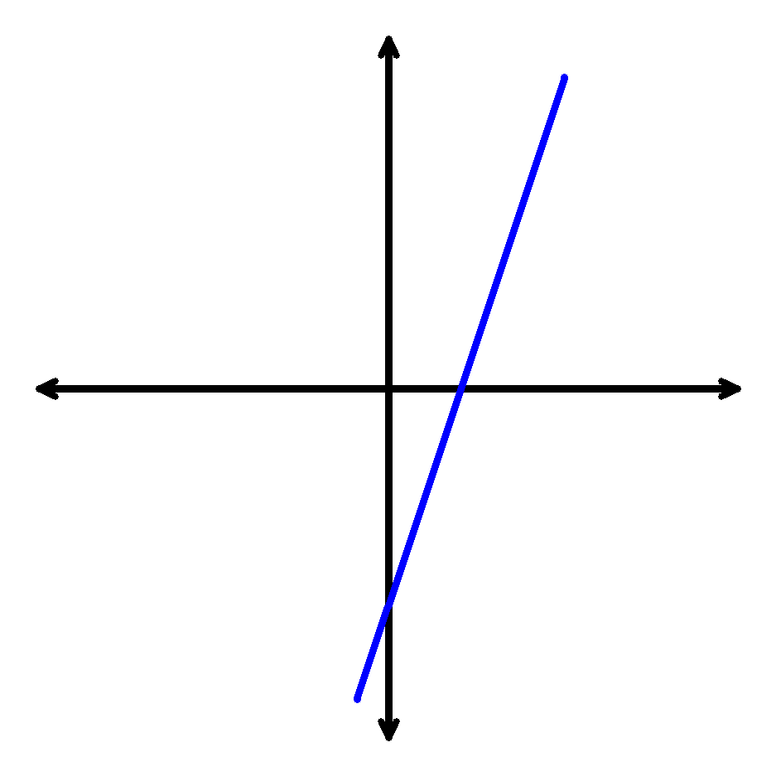
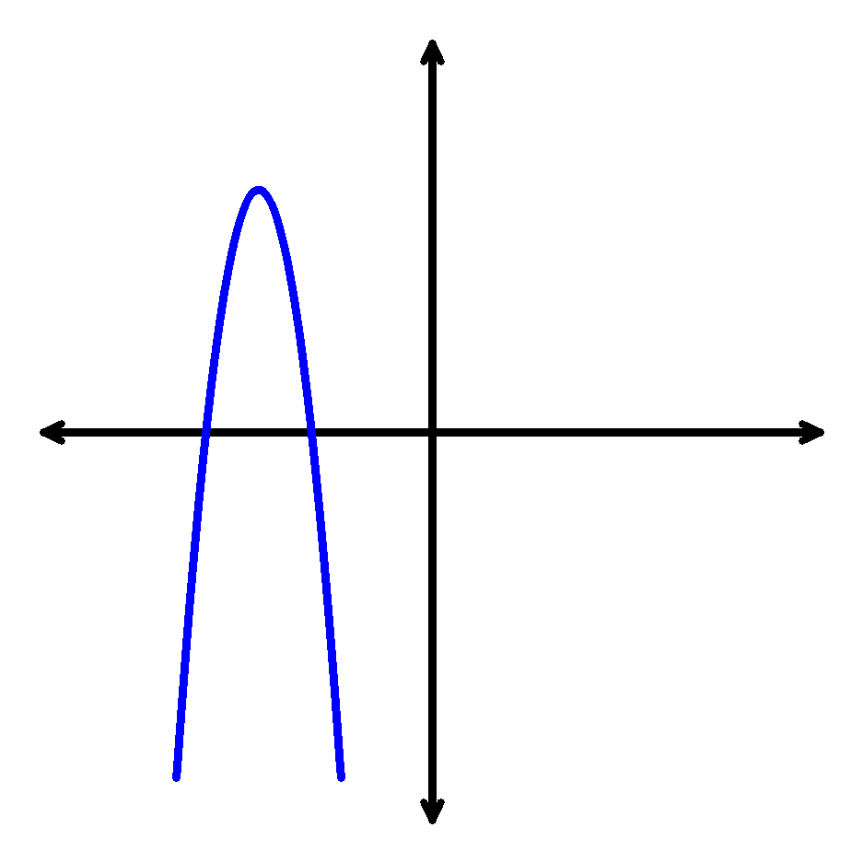
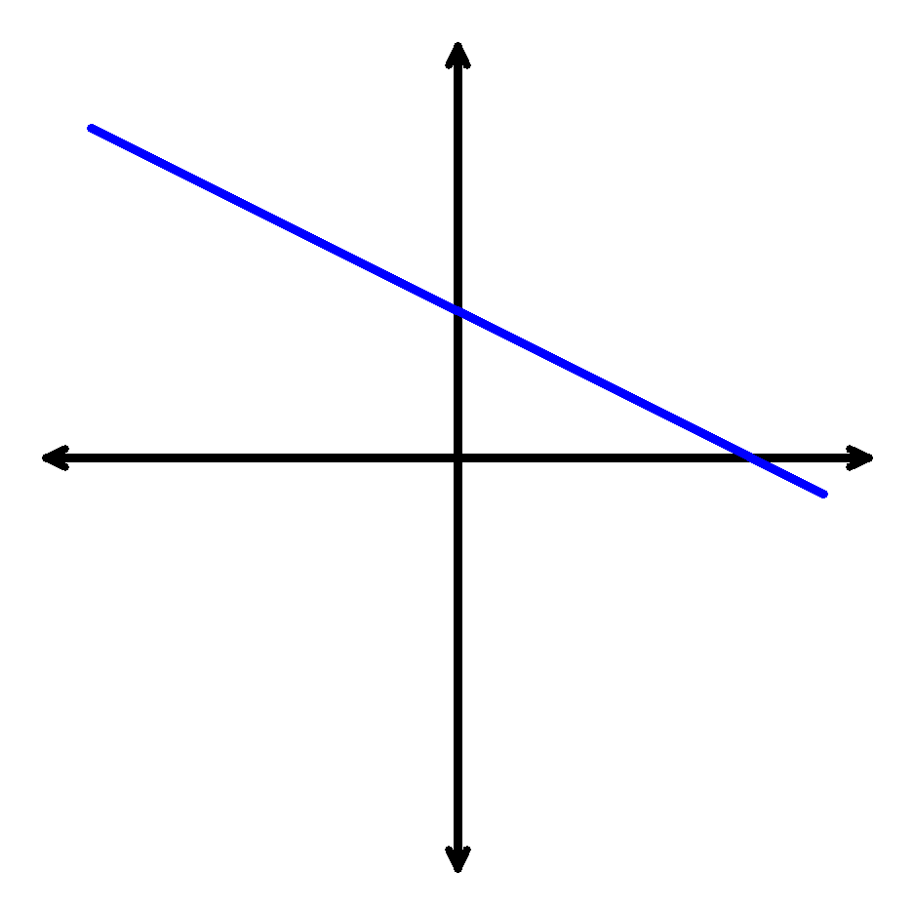
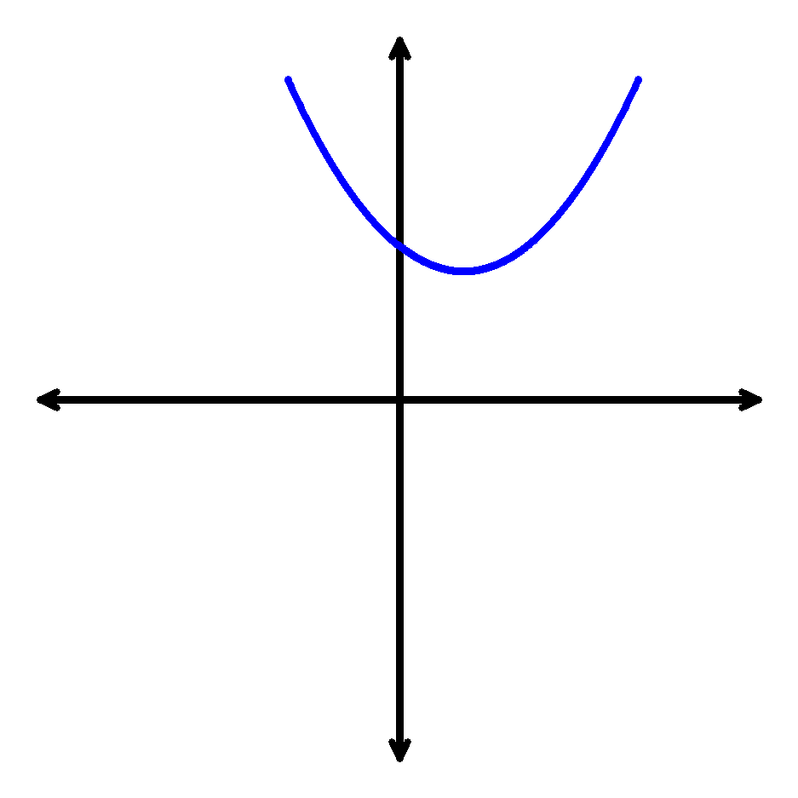
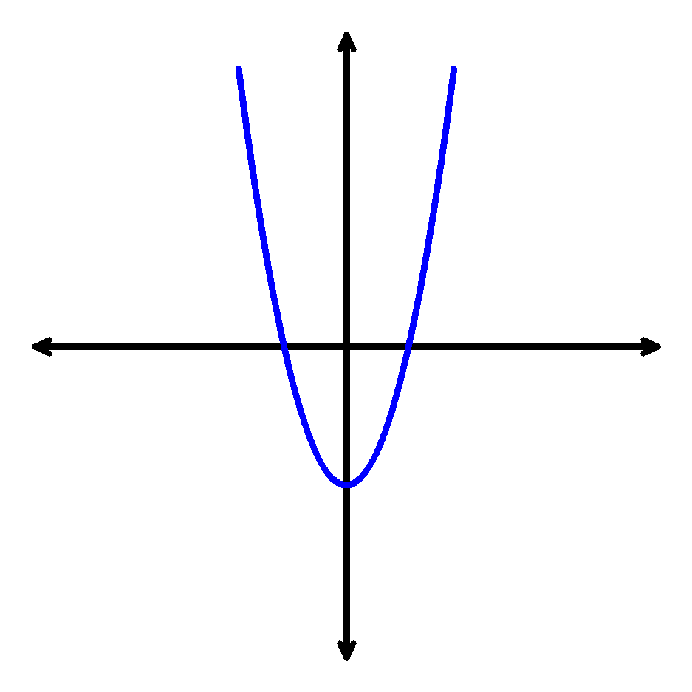
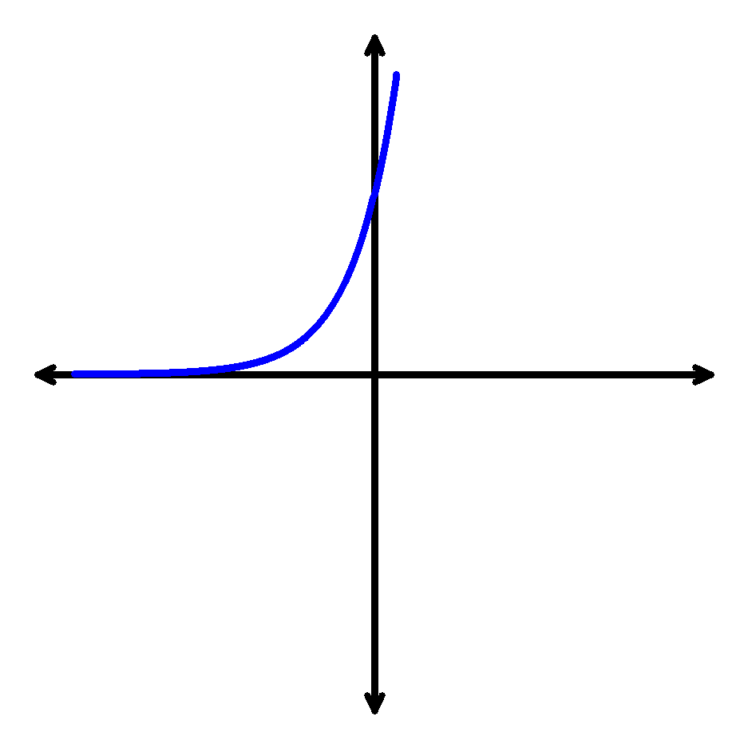
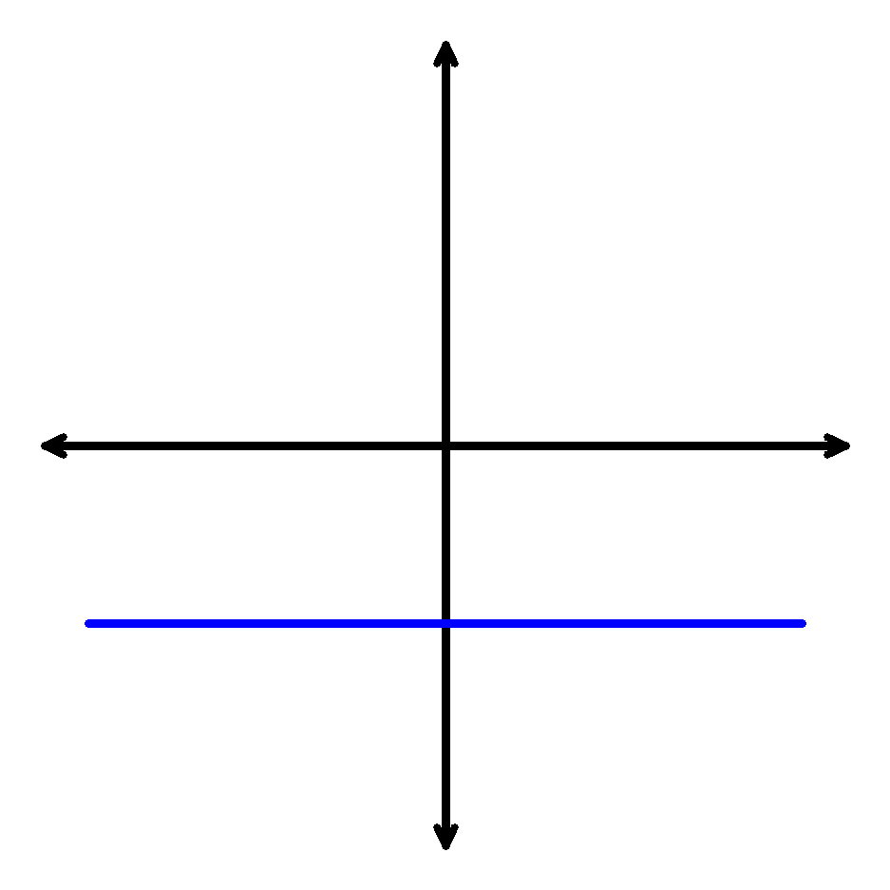
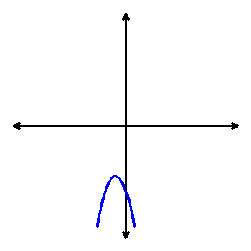
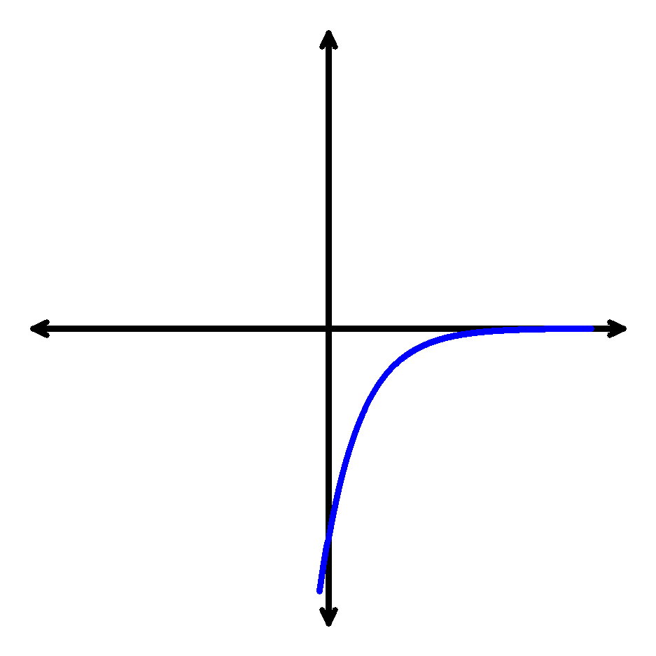
Create Two-Second Graphs

Slide 35
Look at common topics from a different perspective.

Slide 36
Vertex form of a quadratic
Nice way to investigate the characteristics of a parabola.
Introduce graphing parabolas and reinforce it later by graphing from standard form.
Use vertex form to model data by hand.

Slide 37
Concept Investigations

Slide 38
Use applications to introduce topics.

Slide 39
Inverses.

Slide 40
Quadratics

Slide 41
Questions?
?

Slide 42
Summary
Good applications
Activities to get students involved
Look at common topics from a different perspective
Use applications to introduce topics

Slide 43
Thank you!

